Slide 1
MISS POLLY A History of Mary Lumpkin Barnes

Slide 2
Mary Lumpkin Barnes 1811-1891

Slide 3
Alexander Graham
Mary Lumpkin Barnes

Slide 5
2.434.83 Acres of Land

Slide 6
J. Waller Henry
“Sketches from Pioneer Times”

Slide 7
Strata Academy

Slide 8
William McGAUHY
Born on the 10th of October, 1804
Converted in 16th Year—1820
Began Preaching 17th Year--1821
23 First Preached at Fair Prospect
Baptized Mary Lumpkin 1828
Est. Fair Prospect 1828
Preached Alabama and Georgia 1827-1830
Died July 19, 1930 Before He Was 26

Slide 10
UNION MEETING 1841
In 1841 a great union meeting was brought about by the efforts of Wm. C. Kirkpatrick…and was held under an arbor on the hill near Pigeon Creek in Butler County, by the side of the old Meriwether trail.” (Alabama Christian, March 1906.)

Slide 11
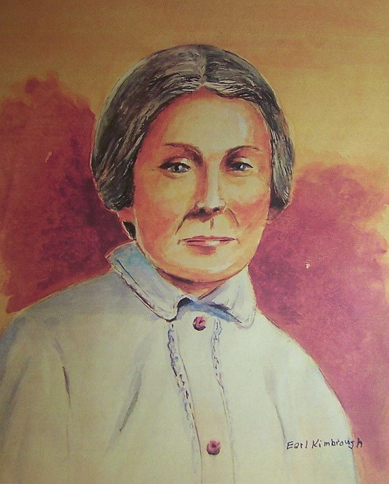
Mary Lumpkin Baptized by Wm. McGauhy at Fair Prospect in 1828
When 17 Years Old

Slide 12
Fair Prospect Site of Church and Cemetery

Slide 13
Elkanah Barnes

Slide 14
“He never made a sacrifice or endured a hardship for the love of truth as a preacher while his mother lived that she did not stand bravely by him with gentle, loving words of praise, comfort, and encouragement.” F.D. Srygley

Slide 15
“She realized from [Dr. William D. Hooker’s] first sermon, he was preaching the truth, the very things she knew the Bible taught, the same message she had heard years before from the lips of William McGauhy.” Durden Stough

Slide 16
1. Anne Barnes’ Home 2. Thomas Lumpkin’s Home 3. Elly and Polly’s Plantation 4. Fair Prospect Church

Slide 17
Gen. Lafayette

Slide 18
STRABO - STRATA

Slide 19
ALABAMA STATESMEN
William Lowndes Yancey
Gov. Thomas H. Watts

Slide 20
Judge Benajah Bibb

Slide 21
Mary Lumpkin Barnes

Slide 22
A Mother’s Message
“Be your own self; never effect to be what you are not. Be kind and courteous to every one. Be polite and respectful to those older than yourself. Treat others as you would have them treat you. Trust God and serve him, and he will take care of you.”

Slide 23
H. Leo Boles
“Perhaps no man in the church of our Lord has touched the hearts of so many in Alabama as did Brother Barnes ….He established hundreds of congre-gations and strengthened many others.”

Slide 24
Highland Home

Slide 25
Justus McDuffie Barnes 1836-1913

Slide 26
MISS POLLY A History of Mary Lumpkin Barnes

Slide 27
“A worthy woman who can find? For her price is far above rubies.”
Proverbs 31:10 ASV

