Slide 1
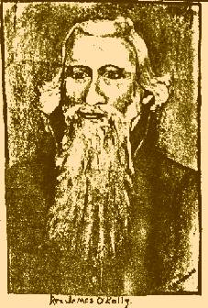
James O’Kelley
James O'Kelley
Born In Ireland
Moved To America At A Young Age
Fell Under Influence Of Methodist Episcopal Church
Ordained A Methodist Preacher
1738-1826

Slide 2
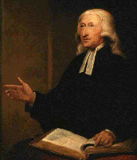
Methodism & Its Influence
John Wesley
John Wesley, Anglican Bishop Who Landed In Georgia In 1735
May 1, 1739 In England Began First Methodist Society
Giving Christianity A More Personal Appeal, Became Very Attractive To People
He Never Left Anglican Church
In 1784 Sent Letter To American Churches Giving Them Independence From British Churches
1703-1791
Francis Asbury
Francis Asbury Was Appointed Head Of American Methodist Church, Dec. 25, 1784
Asbury’s Methods Were Harsh, Most Difficult To Follow
Took Control Of The Circuit Riding Preachers
1745-1816

Slide 3
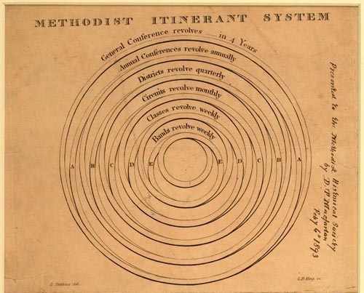
James O’Kelley & The Methodist System
Asbury Sent Circuit Riding Preachers To Outlying Churches
An Elaborate Program
O’Kelley Felt He Should Be Able To Go Where He Wanted

Slide 4
O’Kelley Leaves Methodism
O’Kelley’s Concerns
Didn’t Like One Man Being Placed Over The Church
Thought Circuit Riders Should Go Where They Felt The Need
By 1792 – Other Than Asbury, O’Kelley Was Probably The Most Influential Preacher Among Methodists
In 1789 – He Had Written Essays On Negro Slavery
He Was A Personal Friend To Thomas Jefferson
Had Addressed & Preached Before The U.S. Congress
December 24, 1792 – Awkward Conference Of Methodist – Made Two Suggestions
If Circuit Riders Did Not Like Their Assigned Circuit, They Could Appeal To The Conference For Change
Proposed That The Bible Be Taken As Final Authority In All Doctrinal Matters
Neither Were Accepted

Slide 5
O’Kelley Leaves Methodism
Broke With Methodists With Many Followers
They Called Themselves Republican (Free) Methodists
August 4, 1794 – At A Meeting At “Old Lebanon” Surry County, Virginia A Momentous Event Took Place
At The Suggestion Of Rice Haggard They Took The Name “Christian” Only And Determined To Go Back To The Bible

Slide 6
Christian Movement In Virginia & North Carolina
The First “Christian” Church Was Established Near Flavana, Virginia
Marked A Coming Together Of The Smith, O’Kelley & Jones Movements
O’Kelley Lived Near Durham, North Carolina And Planted Christian Churches
His Beliefs
Lord’s Supper On 1st Day Of Week
Collection – Free-Will Offering
Singing, Preaching, Praying
Failed At Baptism

Slide 7
An Indiana Movement
John Wright Was A Member Of A German Free-Will Baptist Group
Known As “Dunkers” – German For “Immersers”
Began Comparing Baptist Doctrine To Baptist Doctrine And Found Discrepancies
When Comparing Baptist Doctrine To Scripture, Found Discrepancies
Taught That The Bible Was All-Sufficient For Faith & Practice
The Lord’s Supper Should Be Taken On The 1st Day Of Every Week
Thought Baptism Was Essential To Eternal Salvation, But Not For Forgiveness Of Sins – Later Changed This Belief
His Actions: Took 16 Baptist Churches Away From Baptists Near Salem, Indiana
In All This He Had Never Heard Of Alexander Campbell
John Wright
1785-1851

