Slide 1
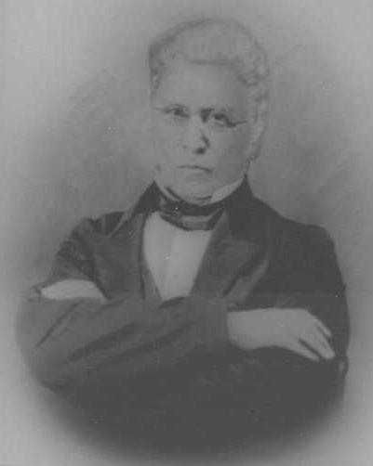
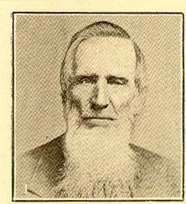
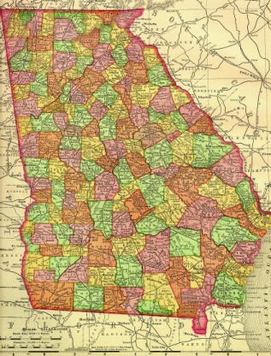
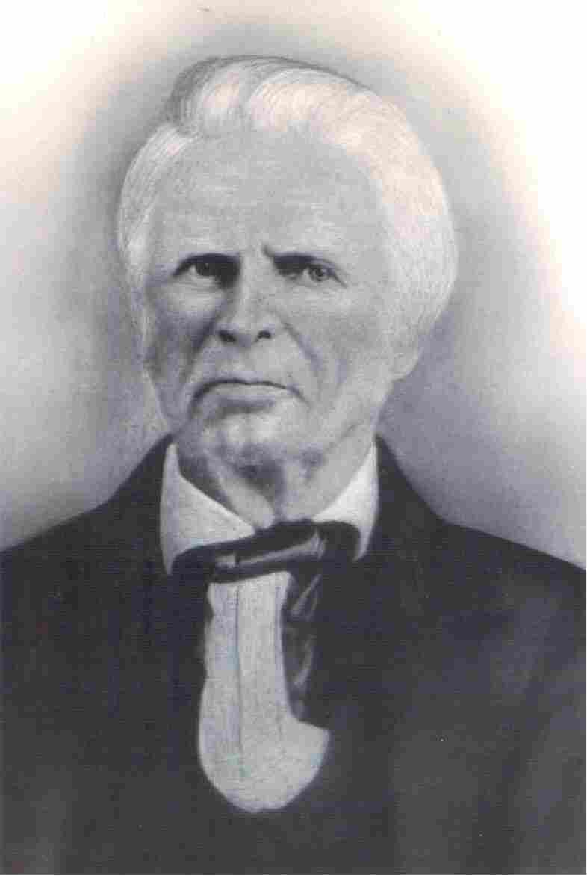
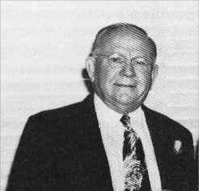
Restoration In Georgia
Atlanta
Dr. Daniel Hook
Nathan W. Smith
Skull Shoals
Augusta
Effingham County
Savannah
Lowndes Cty. Dasher
Christian Herman Dasher
S.H. Hall

Slide 2
Earliest Years
William Guirey, born in Georgia backwoods in 1773
Initially connected with Episcopalians, Methodists, O’Kellyites, and Christian Baptists between 1792 or 1793 and 1810.
An immersionist, he joined with Christian Church (O’Kellyites) in 1810.
He was reported to have “traveled from Philadelphia to the southern frontier of Georgia, preaching the word.”
Not known if he, or his influence ever connected with the Churches of Christ in Georgia.
Atlanta

Slide 3
Earliest Years
James Buys
Dekalb County, Georgia – 1828 wrote to Christian Messenger (CM) concerning efforts in that county.
Communion Meeting at Bethel Meeting House eleven elders.
Stated that 26 “joined the Church of Christ” at this meeting. CM, Dec. 1828, p.43
In 1830 Reported another camp meeting 7th of Oct. where “twenty professed faith in Christ, and fourteen joined the church.” CM, Jan. 1830, p.46f.
Also said in same report that he had traveled to Jackson County, Ga on 21st of Oct to a camp-meeting, “the result was, about fifteen professed faith in him; ten joined the Church, and about the same number were baptized.” CM, Jan. 1830, p.46f.
Also reported a meeting in Pike County, “about ten made an open profession of faith in Christ, while Christians were much encouraged” CM, Jan. 1830, p.46f.
Atlanta

Slide 4
Earliest Years
Christian Preachers Who Evangelized Early
1833 - Thacker V. Griffin, Winchester, Tn came to Ga. in winter.
William T. Lowe baptized in Old Rose Creek, near the church, by William R. Pendleton, believed to be the first man in North Georgia to be baptized for the remission of sins. (Excluding Dunning and Dasher in South Georgia)
Atlanta

Slide 5
Earliest Years
1835 – William R. Shehane, of Tenn. Made preaching trips among Ga. Churches in April, 1835
1836 – William R. Hooton, Tenn. Evangelist came in the winter of 1836
The Obituary Of Dr. D.W. Elder (1809-1901) stated that he was one of the first men in Georgia. (Read the Bible thru hundreds of times). He was an elder of the Republican Church.
Early 1830s. James J. Trott, a Methodist Missionary to the Cherokee Indians, read Campbell’s writings while imprisoned in Georgia for refusal to take an oath of allegiance to the State.
Atlanta

Slide 6
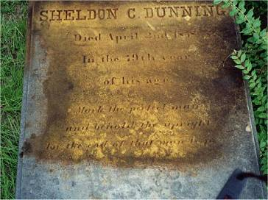
Effingham Cty. / Savannah, 1819
1819 – Christian Herman Dasher: Salzburger Lutheran Who Studied His Bible
Searched For A Person To Immerse Him
S.C. Dunning, A Baptist Preacher From Savannah contacted
Immersed Dasher
Church Began In Effingham County & At Savannah
1825 Dashers Move To Lowndes County, Starting a work at Dasher
Atlanta
Augusta
Effingham County
Savannah
Lowndes Cty. Dasher
C.H. Dasher

Slide 7
Skull Shoals, Oconee County, 1807
1807- Republican Methodists (O’Kelleyites) from North Carolina moved onto Skull Shoals, Southern Clark, now Oconee County
1822 – Reorganization took place, calling themselves, “Bible Christians.”
Gave up sprinkling infants
Gave up all human creeds
1842 – Division took place over the teachings of Alexander Campbell
1843 – Full Restoration Under Direction Of Nathan W. Smith, Dr. Daniel Hook, & James Shannon
1844 – Reorganization, first Georgia church — called Antioch Church of Christ
Became Mother Church To Many Churches
Atlanta
Skull Shoals
Augusta

Slide 8
Plantings From Skull Shoals
1842 – Mt. Vernon Church of Christ, Walton County
1843 – County Line Church of Christ, Fayette County
1845 – Union Church, Oconee County
1863 – Bogart Church, Oconee County, formerly Bethany, Jackson County
Mt.Vernon Walton Cty.
Bogart, Oconee Cty.
Atlanta
Skull Shoals
Augusta
Union, Oconee Cty.
County Line Fayette Cty.

Slide 9
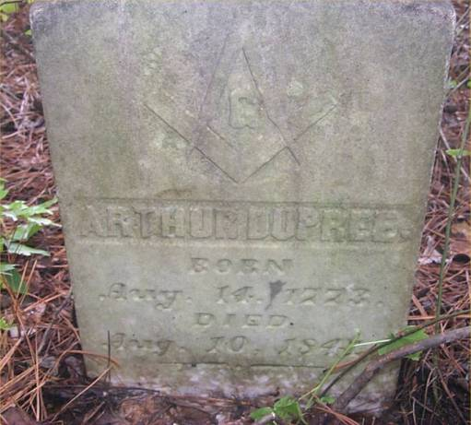
Earliest Years
Arthur Dupree
Wrote Christian Messenger in Jan. 1830 issue, p. 44ff. concerning the churches in Georgia at that time. The Report:
23 churches or congregations, each with about 25 members.
About 575 member in all, 20 Elders & 6 licensed preachers.
An annual conference of Elders and Preachers, Deacons, delegates and private or lay members attended. Usually beginning the Friday before the 3rd Sat. in Dec.
They held that baptism must be by immersion, after conversion (but later this changed).
Mentions an enjoyed Camp Meeting at Skull-Shoals, in Clark County.

Slide 10
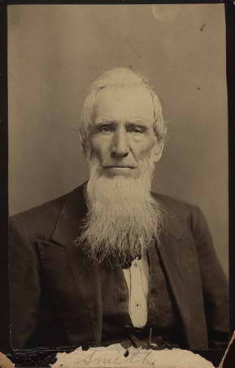
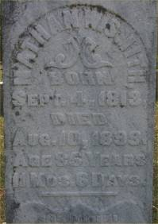
Earliest Years
1832 – Nathan Williamson Smith
Moved to Clarke (now Oconee) County from his native North Carolina in 1831.
Baptized by Arthur Dupree in 1832, and united with the little congregation.
At first opposed the teachings of the Disciples, but later accepted them.
Set to the ministry in 1836.
In Millennial Harbinger, June, 1838, p.183 he reported, “I am traveling and trying to preach the word of God, the only traveling preacher in the reformation in the whole state of Georgia that I know of, and I have left my family to spend the year in the good cause, and have not the promise of one cent as a reward for my time, from any man or set of men.”

Slide 11
Augusta 1832
Dr. Daniel Hook (1795-1870)
Born in Maryland, settled in Louisville, Jefferson County, Ga., in 1817.
1828 Hook was introduced to writings Of Alexander Campbell: Baptized in Brushy Creek
Attached to Ozzias Baptist Church, licensed to preach.
The “pastor” of the church J.H.T Kilpatrick denounced Hook as a “wolf in sheep’s clothing.”
1832 Hook moved to Augusta.
Atlanta
Skull Shoals
Augusta
Louisville

Slide 12
Augusta 1832
Built a home in Richmond Hill, six miles south of town.
In 1834 or 1835 every member of his family was stricken with scarlet fever – the two youngest children, Emily and America, died.
1835 His wife Catherine’s brother, William Schley was elected the 18th governor of Georgia.
Hook met a Capt. Edward Campfield & wife Margaret, Baptists, who were attracted to the plea of the Disciples.
When they communed with other Disciples from Savannah they were all three expelled from the Baptists.
Atlanta
Skull Shoals
Augusta
Louisville

Slide 13
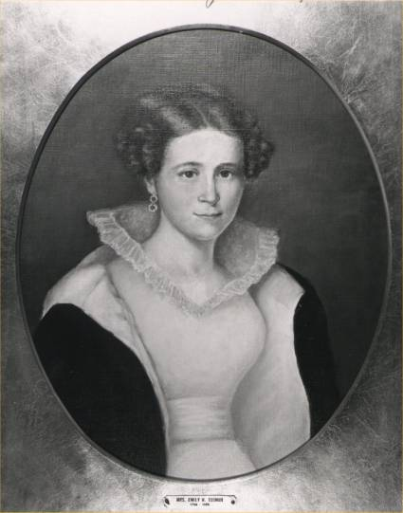
Augusta 1832
In 1835, Hook & The Campfields met in their homes.
Three people together for worship.
They had praying, reading of Scripture, singing, and observance of the Lord’s supper.
In 1836, Mrs. Emily Harvey Tubman (1794-1885) joined the fellowship.
The same year she was widowed by the wealthy Richard Tubman.
She had resided in Augusta since 1819, following her marriage.
She was from Frankfurt, Ky, and had been immersed by Silas M. Noel (Baptist) in 1828.
Never worshipped with Baptists
Soon after her baptism she had met and accepted the teaching of A. Campbell.
Dr. Daniel Hook
Emily H. Tubman

Slide 14
More On Dr. Daniel Hook
1839 Augusta was hit with a severe epidemic of Yellow Fever
Dr. Hook stayed in the city helping to cure the disease
Hook treated 200 cases and only lost two.
Seeing the danger he sat down and wrote his own treatment and gave it to another doctor, as he knew he would soon catch the disease, saving his own life when he contracted the disease.
In 1840 the citizens of Augusta made him mayor of the city. Served two terms
Other Claims Of Note
Trustee Of The University of Georgia, elected by the State Legislature
Member of Board of Trustees for Atlanta Medical College in 1853
1845 he left Augusta after a visit from A. Campbell due to public opinion.
Dr. Daniel Hook

Slide 15
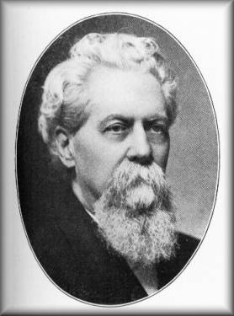
Atlanta Work
1850 – Atlanta had 10,000 pop.
1851 – Dr. Hook established the first congregation of the Church of Christ in Atlanta
1853 – First Building At Corner Of Pryor And Mitchell Streets
1854 – Church Moved To An Existing Building On Decatur St. Near Ivy.
1855 – Dr. Alvinzi Gano Thomas (1833-1903) became the first paid minister
Born In Taversville, Twiggs County
Georgia’s First Student To Be Educated At Bethany College
Read 10 Languages And Spoke 4
1856 Started “Christian Union” Pub. With J.S. Lamar – Ga. Paper
1859 M.D. From Atlanta Med. Col.
Confederate Chaplin During War
Atlanta
Dr. Daniel Hook
Dr. A.G. Thomas

Slide 16
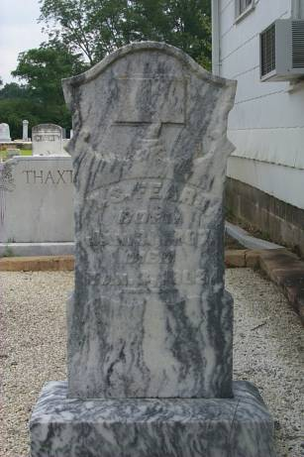
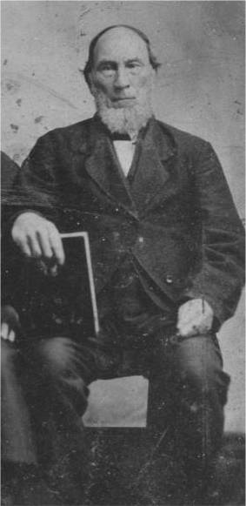
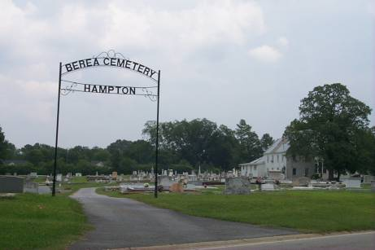
Hampton, Georgia Work
1845 – Nathan W. Smith and Dr. Hook planted a church in Hampton, Georgia
William Sadler Fears and his family were among the first to be baptized for the remission of sins.
Church established there – Berea Christian Church
“Over my dead body!” — W.S. Fears
Nathan Smith
Dr. Daniel Hook
Wm. S. Fears

Slide 17
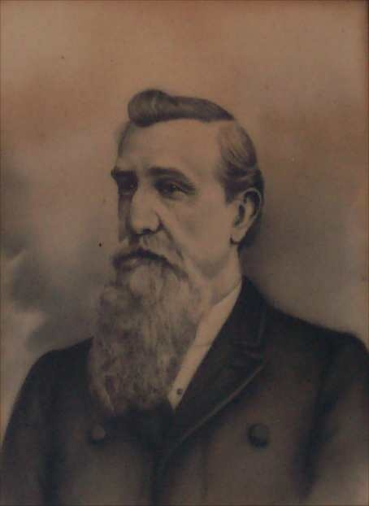
Other Works
Thomas Marcus Harris (1829-1893)
Dr. Daniel Hook was his sister’s father-in-law. She had married Hook’s son – Judge James Schley Hook.
Harris had been preaching for ten years among the Methodists
Came in contact with writings of Alexander Campbell – Obeyed the gospel
At age 28 he obeyed the gospel
Took over 40 Methodists members with him to establish N.T. Christianity in Davisboro
Among The Blacks
Helped Organize Churches
Ordained Ministers
Donated Land For Black Congregations To Build Buildings
Atlanta
Augusta
Davisboro
T.M. Harris 1829-1893

Slide 18
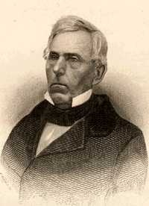
Civil War
1861-1865 Had its affect on the south.
Many preachers both in north and south became chaplains in the military
A.G. Thomas was chaplain
Fanning’s visit- Dec. 21, 1860 in the home of A.G. Thomas
Later wrote: “Dr. A.G. Thomas is a brother of fine address, superior talents and learning, but we saw him with a feather in his hat and a glittering sword in his right hand, and doubted if he would be able to hold the sword of Georgia in one hand and the sword of the Spirit in the other.”
T.M. Harris reached Major, but was soon honorably dismissed because of an attack of Typhoid Fever. Recalled to lead a group of Wash. Cty. Regiment at the Battle of Atlanta.
Atlanta
T.M. Harris
Tolbert Fanning
Dr. A.G. Thomas

Slide 19
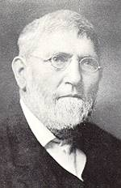
Civil War: Aftermath
The Church was devastated by the effects of the war.
Many church doors were closed, works given up.
Homes of Christians were looted and destroyed.
Nathan W. Smith’s work in Acworth was affected.
Sherman’s forces had destroyed the Acworth building using its timber to build shanties at Allatoona
Smith wrote letters to the Gospel Advocate requesting relief
Building was overtaken and destroyed
Lipscomb wrote, “Send bread now, brethren, and afterwards the Bibles and preachers.” GA Jun 13, 1867, p. 476.
D. Lipscomb helped to promote relief for the poor Georgia Christians
Sent Smith one of his own horses so he could plow.
Atlanta
David Lipscomb
Nathan Smith
Notes:
Smith took the Acworth church bell and escaped to Jonesboro. When Sherman came to Jonesboro the bell was taken and beaten upon by the northern forces. It was beat on so much that the people begged for it to stop. Finally a request was made for the bell to be returned.
Smith and family fled to Mitchell County, (down below Albany) 200 miles away to find safety. After war, returned to war-torn Acworth.

Slide 20
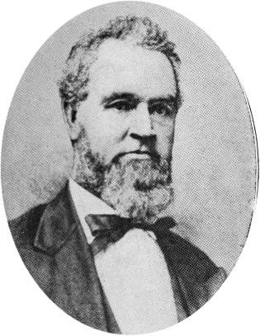
Departures
1849 ACMS Organized In Cincinnati, Ohio
Dr. Daniel Hook from Georgia with 10th of 20 vice-presidents elected.
S.J. Pinkerton Of Augusta was with Walter Scott on committee on order of business and nominating committee.
Most Georgia Preachers And Churches Supported Organization
By 1871 Isaac Errett reported in the Christian Standard that there were 3000 members of the church in Georgia.
1875 – Augusta church was prob. first to add the instrument to the worship. Many followed.
Not without a fight. One Rome church member said, “I’d rather eat bacon and eggs off the communion table than have an organ in the church.”
W.S. Fears, Berea “Over my dead body.”
1902 Yearbook, 142 churches, 12,000 members
Atlanta
Dr. Daniel Hook
Isaac Errett

Slide 21
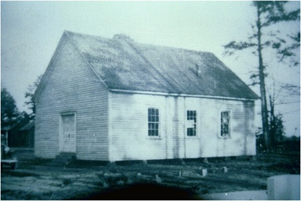
Some Churches Not Moved By Change
Atlanta
1881 - Liberty Hill Congregation, Mableton Area (Now S. Cobb church)
1885 - Pleasant Grove, Marietta
1895, Halls Valley near Trion, Georgia work
Perhaps Others
Pleasant Grove, Marietta

Slide 22
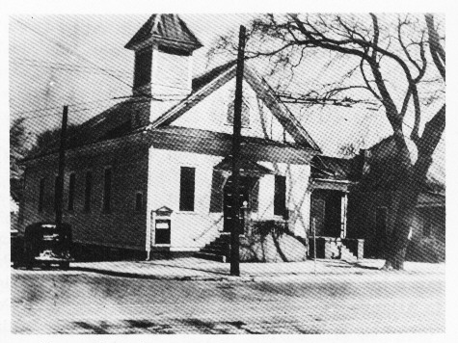
Restoration
1901 – O.D. Bearden family moved to Atlanta, finding no sound church to worship with.
S.H. Hall had graduated from Nashville Bible School in 1905. Moved his family to Atlanta, Jan. 1907 to work with church.
1910 South Pryor Street was Planted (became Moreland Ave. Church)
1911 East Point Church w/150 Additions (100 baptisms)
After 14 years work Hall reported good efforts taking place in “Macon, Rome, Menlo, Rockmart, Pleasant Grove and Liberty Hill
Atlanta
1st West End Ave. Bldg.
S.H. Hall

Slide 23
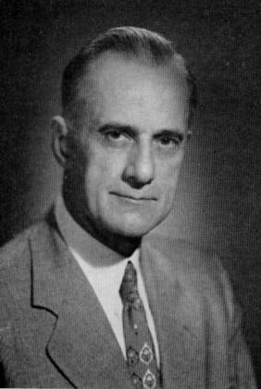
Continual Growth
1917 – Dalton work planted by W.C. Philips
1920 – B.C. Goodpasture followed Hall in the work at West End - Hall to California after 14 years in Atlanta
When Goodpasture departed in 1927 he left with over 600 in attendance
After a year in Florence, Alabama, he returned to work 7 more years with the newly formed Seminole Ave. Congregation (Druid Hills) Feb. 1928
1928 Bainbridge work by S.H. Hall; Summit, GA w/ A.R. Hill
Atlanta
1st West End Ave. Bldg.
B.C. Goodpasture

Slide 24
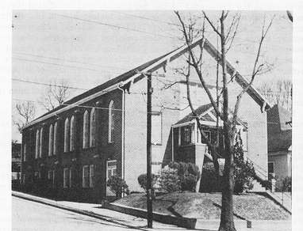
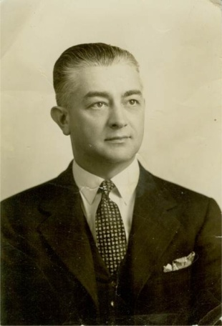
Continual Growth
1927 – H. Clyde Hale followed B.C. Goodpasture at West End Avenue
Baptized by S.H. Hall in 1922
26 yrs. old when coming to Atlanta
1929 – New building built on cnr. Gordon and Hopkins St. (name changed to West End)
1929, Feb. 19, Hale conducted the first radio broadcast of the church on radio, WAGA, 12:15pm daily for 10 years
1933 Athens work planted by H. Clyde Hale
Atlanta
West End Church
H. Clyde Hale

Slide 25
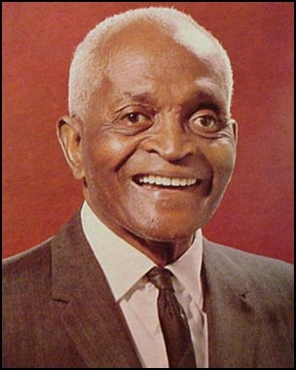
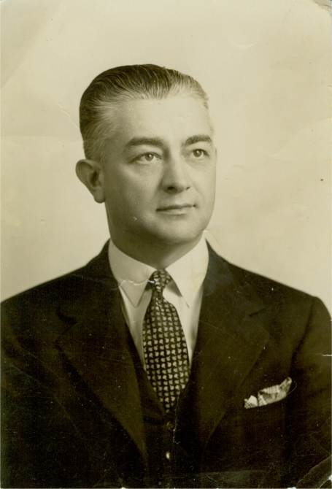
Continual Growth
1931, Aug. 10th, Hale brought Marshall Keeble in to plant the work among the Black population
Tent pitched on Simpson St.
As many as 2,500 came, never less than 1000
Preached four hours each evening
Baptized 166, Beginning the Simpson St. Church.
Mid 30’s tent meetings held all over Atlanta, incl. Gainesville, Fitzgerald, Cartersville, etc.
1942 - Northwest Congregation
1944 Hale returned to Nashville area after 16 years in Georgia
Having Started Five Churches
West End - 800 Attendees
1949 - Hapeville Planted
Atlanta
Marshall Keeble
H. Clyde Hale

Slide 26
50’s - 80’s
1950’s saw the planting of a number of churches
1954 Smyrna planted by the Olive Street church
1950s North Ave., Hapeville
1955 Fayetteville Work Established
1959 Forest Park, Cascade Heights
1960s Hillcrest, Riverdale (‘62), Chestnut Drive
1970s Jackson, (’72) Lithia Springs, (’74) Peachtree City, (‘76) Tara, Jonesboro
1976 Statistics, Ralph Henley stated in May GA, p.343
119 of 159 counties in Georgia had congregations
30 Counties churches had all Black members
As Of April, 89 churches in Georgia
66 Counties w/30 or less members
Atlanta

Slide 27
1987 Stats
Mac Lynn Reported Concerning Restoration Related Churches In Georgia
1984 – 10,558 Disciples of Christ in 77 Congregations
1987 – 34,024 Christian Church (Instrumental) in 158 Congregations
1987 – 28,700 members of Churches of Christ in 385 Congregations
Today the numbers would be less
Atlanta

