Slide 1
New Testament Christianity In A Postmodern World
Making Jesus Viable

Slide 2
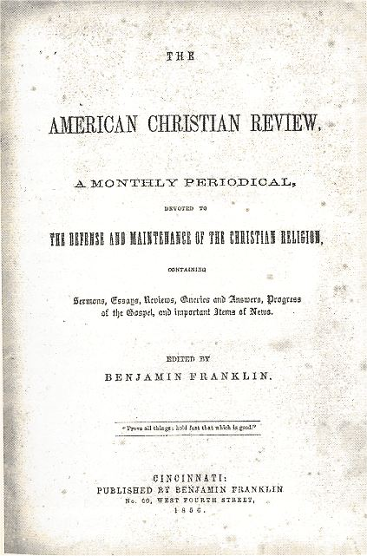
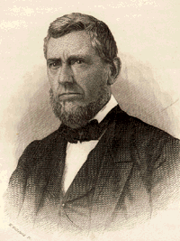
First A Little Look At The Past
American Christian Review – 1856 – Editors: Benjamin Franklin, John F. Rowe, & Daniel Sommer: Voices Of Truth Among 19th Century Christians

Slide 3
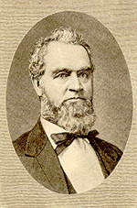
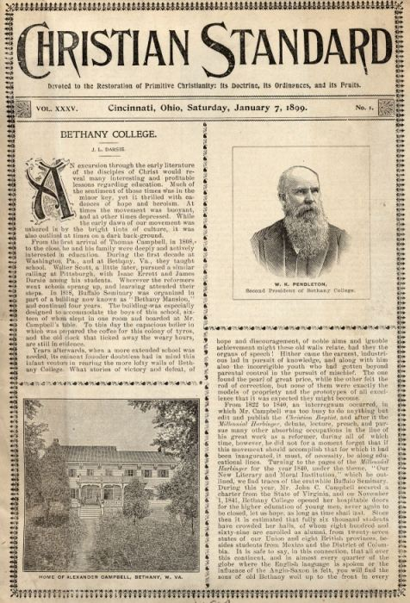
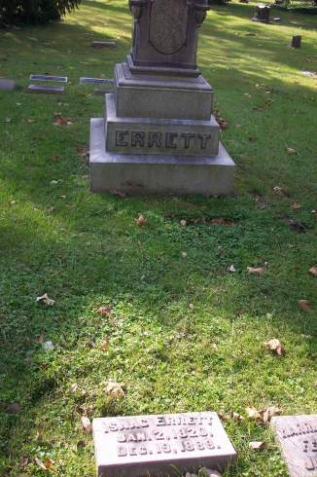
Ten Years Later
Isaac Errett Begins A Paper In Reaction To The Conservative Sound Of The ACR And Calls It The Christian Standard - 1866

Slide 4
On The Home Front
Georgia Had Been Hit By General Sherman By 1865
The Civil War Took It’s Toll On Brethren
Through The War The Church Was Held Together In Georgia By Some Faithful Gospel Preachers

Slide 5
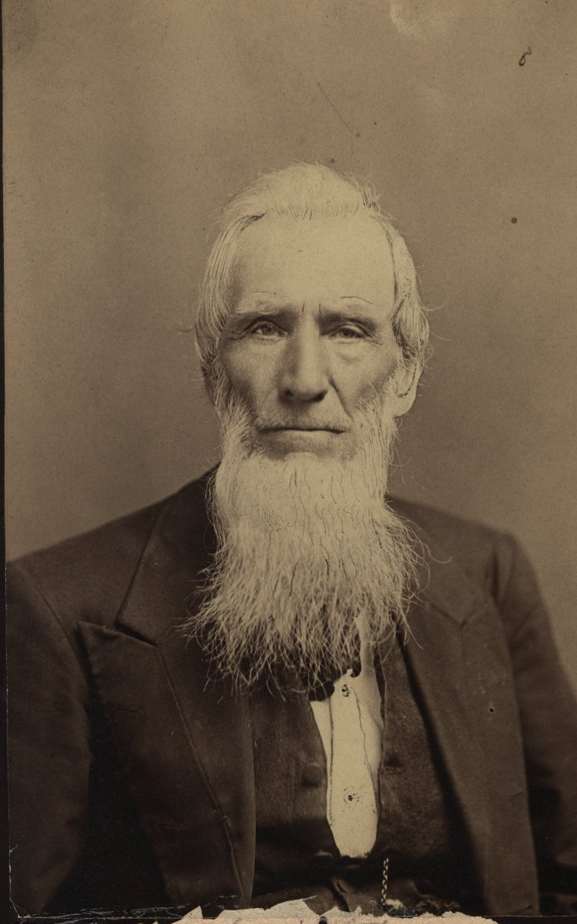
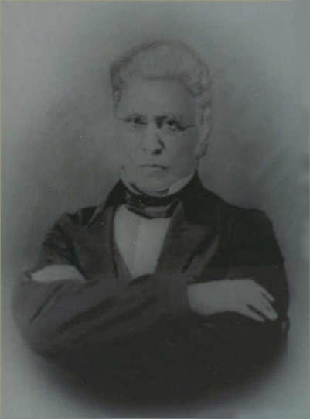
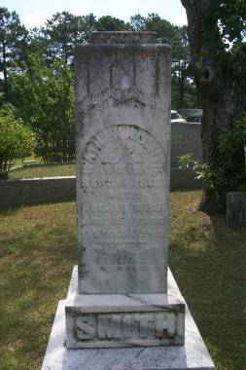
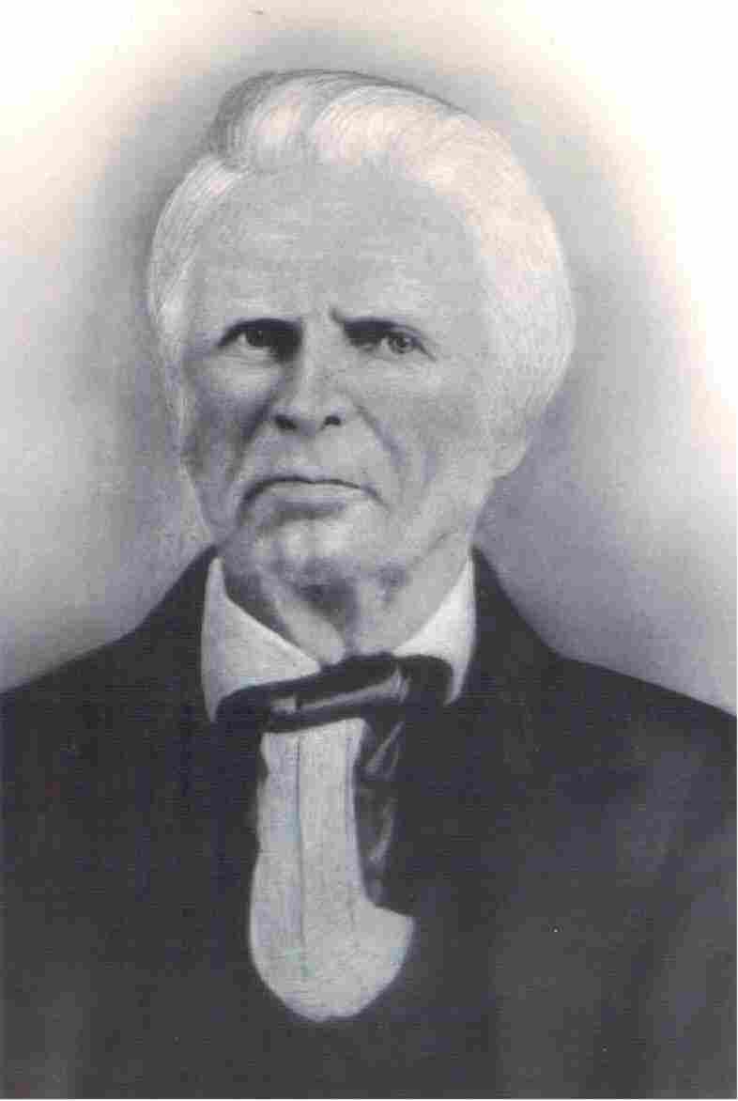
Preachers In Georgia
Nathan W. Smith
Dr. Daniel Hook
1813-1899
1795-1870
Christian H. Dasher
1789-1866

Slide 6
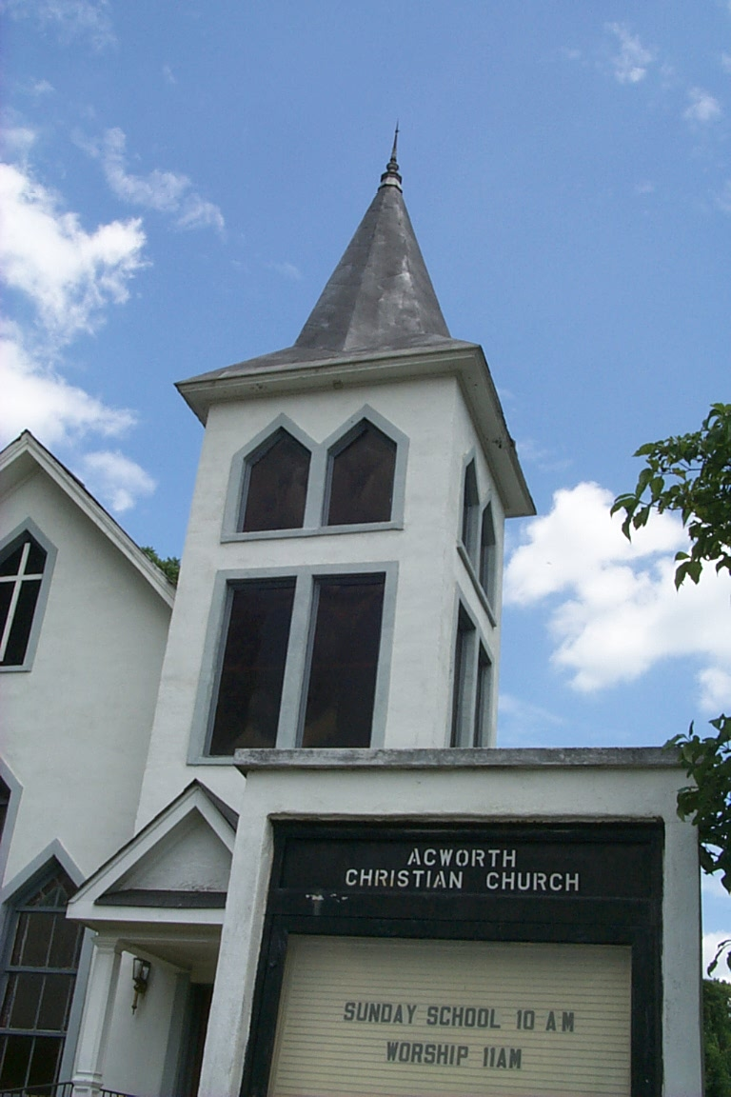
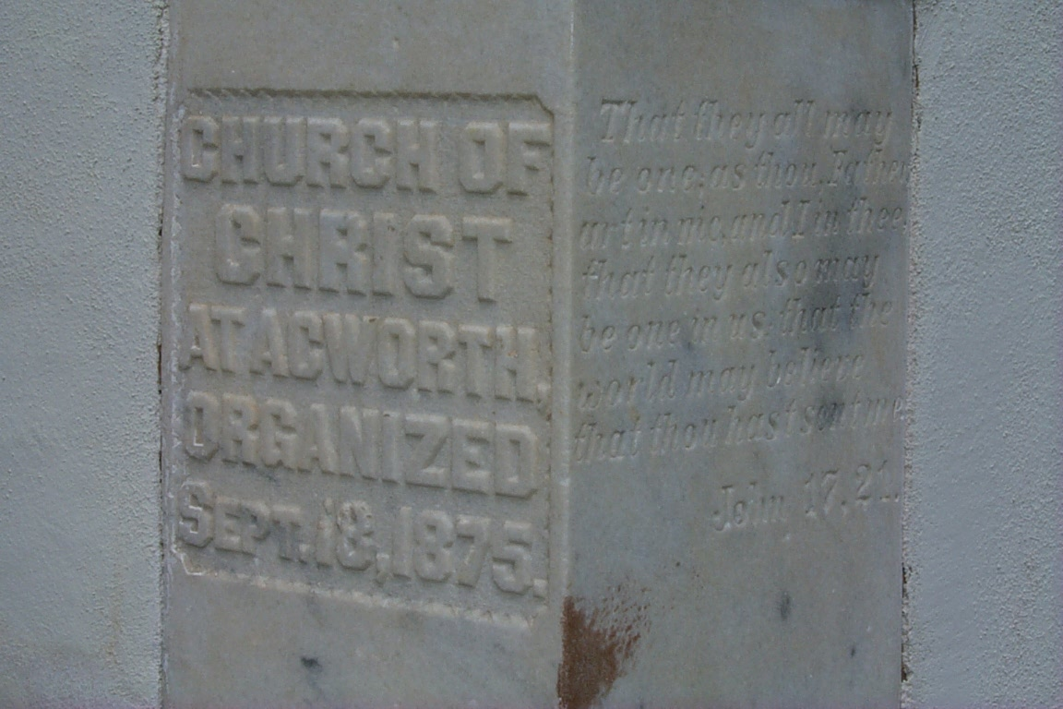
Acworth/Marietta, Georgia
Nathan W. Smith Strengthened Churches All Through North Georgia
However, The Winds Of Change With The Financial Stress Of The Civil War Took Its Toll
Influence Of The ACMS & The Instrument Brought Apostasy

Slide 7
Why The Changes?
Cultural Influences
Pragmatism
Growth Among Evangelicals
Desire Not To Be Seen As Different

Slide 8
Some Of The Changes
American Christian Missionary Society – 1849
The Addition Of The Instrument – 1860
The Christian Standard – 1866
Titles Appeared – “Pastor, Reverend” etc.
By 1906 Census A National Recognition Of Difference Between Churches Of Christ And Christian Churches

Slide 9
Some In Georgia Stayed The Course
Pleasant Grove Church – 1850 – Lower Roswell Rd @ Little Road.
Liberty Hill Church of Christ, Mableton.
Dasher & Central, Valdosta, Georgia
By 1906 The New Testament Church Was Re-Established In Atlanta’s West End Where Many Of The Churches Of Today Find Their Roots

Slide 10
What Is Postmodern?
“Its central "doctrines" all seem to spring from a denial that there are any rules for anything. So the postmodernists say that "There is no such thing as truth," "Reality is merely a political construction" and "morality is meaningless.” – John Ray

Slide 11
Who Is The Postmodernist?
"Postmodernists claim that there is no objective truth, that there is only interpretation, and that it all depends on who is in power. According to the postmodernists, we are so biased by our race, class, and gender that knowledge is impossible. The postmodernists allow freedom of speech only for those who share their Leftist political views on issues like feminism, affirmative action, and free enterprise versus socialism. They hire and fire on the basis of ideology rather than scholarship, and they try to prevent speakers of whose views they don't approve from appearing on campus.” – Joe Willingham

Slide 12
1st Century Christianity We Understand . . .
Jesus said he would build His church. Matt. 16:18
That Church was established on 1st Pentecost after the D.B. & R. of Christ. Acts 2.
To be a part of that church we must emulate it in every way through devotion to Biblical Authority.
Follow its teaching on salvation.
Follow its teaching on church organization.
Follow its teaching on God-centered worship.
Follow its teaching on daily Christian living.

Slide 13
1st Century Christianity In A Postmodern World Avoids:
Relativism – John 8:32; Rom. 1:16; 2 Tim. 4:1-5
Jesus is the same, yesterday today and forever
We will speak where the Bible speaks and remain silent where the Bible is silent.
See the subtle movement in the church to move away from this mentality
With relativism there is no sin — But Jesus — Luke 19:10
Materialism – Matt. 6: 25-31
Individualism – Matt. 16:26; - God’s way is right, not man’s.
Denominationalism – 1 Cor. 1 – Be one, Speak the same things, etc.

Slide 14
How A Teacher Brings This About
Understand Your Value In This Process.
You’ve got something to say.
You are not just a warm body filling a position.
You are not just preparing lessons.
You are a viable part in God’s plan to mold minds into being what they should become.
Expose The Reality Of The Postmodern Culture For What It Is To Your Students
Give Students A Viable Alternative – Christ!
Find Tools That Help Keep Them On Track
Personalize Your Work Through Availability

