Slide 1
Discovering Godly People Of The Past

Slide 2
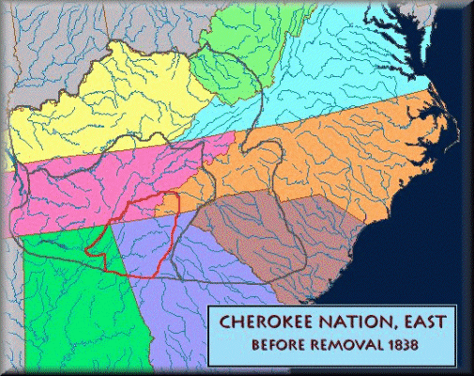
James Jenkins Trott
Born on November 4, 1800 In Western North Carolina
Sprinkled as a baby, his parents raised him in the Methodist faith.
Moved to middle Tennessee in 1815 with his family at which time he got religion.
In 1823 he entered Methodist ministry
In 1825 the Tennessee Methodist Conference authorized Trott to preach among the Cherokee Nation of North Georgia.
Notes:
Chief Junaluska – Helped General Andrew Jackson defeat the Creek Indians at Horseshoe Bend in 1814. When the Cherokees were moved west, he said that if he had known what President Jackson would do to the Cherokee Nation, he would have killed him at Horseshoe.

Slide 3
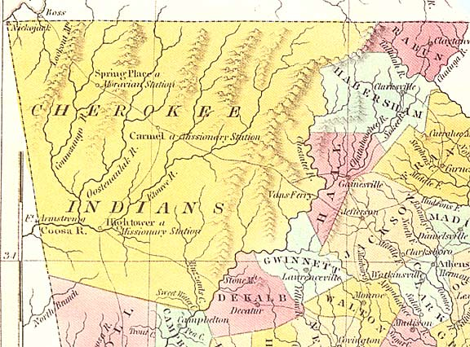
James Jenkins Trott
A Methodist mission was started in 1827.
By 1831 there were six schools, 120 pupils and
930 who pronounced faith among the Cherokee.
February 1828, Trott married Sally Adair, a Cherokee woman.
  They were married three years and had two children, Benjamin and Mary
Cherokee Nation in Georgia, 1830

Slide 4
James Jenkins Trott
1828 – Gold Discovered In Dahlonega, Georgia
1830 – Congress Passed The Indian Removal Act
Georgia Sought Written Oaths Of Allegiance To The State By All Missionaries
Trott Refused To Sign – Arrested 12 March, 1831.
Made To Walk In Chains 22 Miles to Fort Gilmer To Be Imprisoned
Then 110 miles for trial at Lawrenceville, GA
Cherokee Nation in Georgia, 1830

Slide 5
James Jenkins Trott
Under a four year sentence, he was put in prison in Milledgeville, GA
While in prison he came under the influence of the writings of Alexander Campbell
Very soon was acquitted upon the condition he would leave the state.
April 10, 1832 he officially left the Methodist Church
He settled in Rutherford County, Tennessee
He contacted the Baptist minister, Peyton Smith requesting baptism. Smith said, "Go before the Church, and relate your Christian experience." The clear headed Trott said, "Nay, I have not been in the Kingdom of the Savior, and have no experience therein; but I believe now, and have long believed, with all my heart in the Lord, and I desire to put him on in baptism." Baptized in Overall Creek, near Murfreesboro

Slide 6
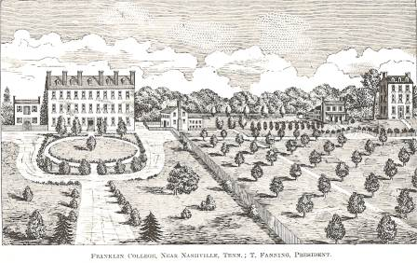
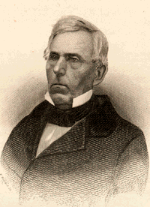
James Jenkins Trott
Came under the influence of Tolbert Fanning and attended Franklin College for a period, attending the church there.
Began making trips back into the Cherokee nations in Georgia, Louisiana, and finally to Oklahoma
1837-1859 Co-labored with T. Fanning. Fanning said after his death, “We attended many missionary meetings, co-operating and consultation meetings together, and it affords me the highest satisfaction to state, that in my whole forty years work I have not found a more self-sacrificing, independent, earnest, humble and faithful teacher of the Christian religion than was our departed Brother J. J. Trott.”

Slide 7
James Jenkins Trott
Before 1859, he was as well known in central Tennessee as Tolbert Fanning, because of his meeting work, camp meetings, etc.
Trott embarked on a preaching tour of some three thousand miles from November 1855 through February 1856. He traveled to Missouri, Arkansas and the Western Indian Territory by steamboat, railroad, stage, horseback and foot.
In 1859 Trott and family moved to Oklahoma to live and work among the Indian Nations.

Slide 8
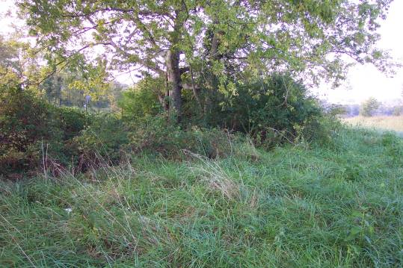
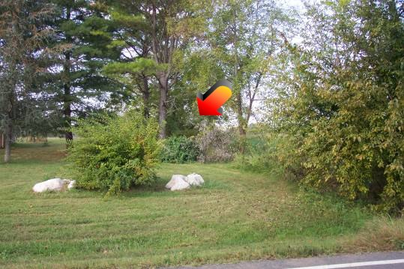
James Jenkins Trott
In a report to the Millennial Harbinger in 1860 that there was a congregation of 75 members in the Cherokee Nation in West Arkansas
Eight more years he works among the Cherokee people evangelizing.
On a visiting trip back to Tennessee he fell sick and died of pneumonia, among brethren, December 10, 1868. He was buried in the cemetery where his friend and preacher F.M. Carmack had been buried seven years earlier, located about six miles from Gallatin, Tennessee

Slide 9
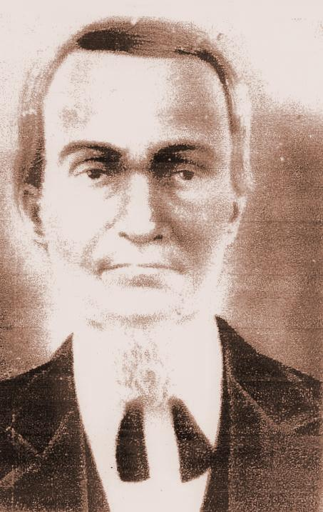
Murrell Askew
Born in Williamson County, Tennessee March 4, 1811
1816 removed to Lauderdale County, Alabama
His father, Aaron, got religion in 1819 – was said to be a “wicked and profane man.”
Yet he became a Baptist minister.
Growing up in the Baptist faith, he came across the writings of Tolbert Fanning in the Christian Review
Between 1850 and 1854 Murrell began preaching among the Baptists around Lexington, Alabama

Slide 10
Murrell Askew
1862 was a bad year.
  The Civil War was underway
  His father died
  His preaching came under fire because he was charged with preaching “Campbellism.”
He taught that “a sinner must obey all the requirements of the gospel.”
After the war he subscribed to the Gospel Advocate, further being influenced against Baptist teaching.

Slide 11
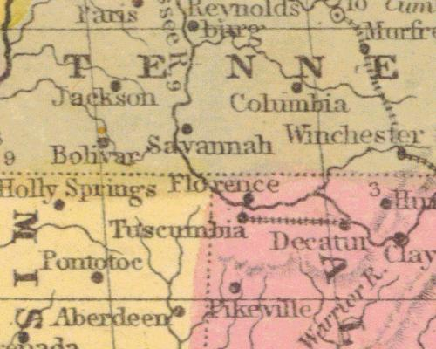
Murrell Askew
1875 – Four churches under the direction of Askew withdrew from the Baptists and took the identity of churches of Christ.
One, the Union Grove church became known as The North Carolina Church of Christ, which meets presently.
By 1876 a number of churches became restoration churches, according to some, mimicking the Kentucky Revival of 50 years before.
By 1880 he had started numerous congregations of the Lord’s church in Lauderdale county as well as Savannah, Tennessee

Slide 12
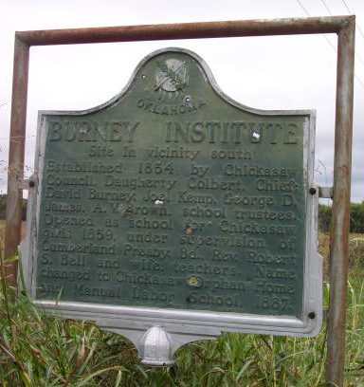
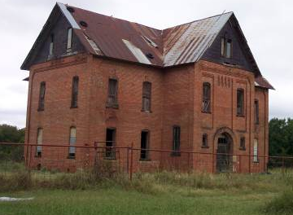
Murrell Askew
Around this time that he began a friendship with R.W. Officer, another Baptist minister who had converted to N.T. Christianity.
Askew, who was ¼ Choctaw Indian was interested in work among the Indian Nations.
1881 – R.W. Officer sent for Askew to come to the Indian Territory to evangelize.
Askew set up residence in the Chickasaw nation.
A teacher, he supported himself by teaching at Burney Institute, an Indian school near Lebanon, Oklahoma

Slide 13
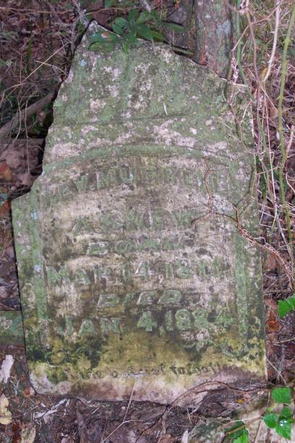
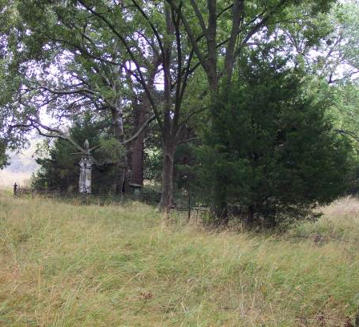
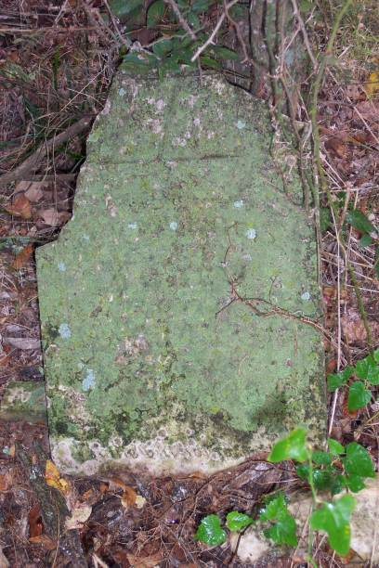
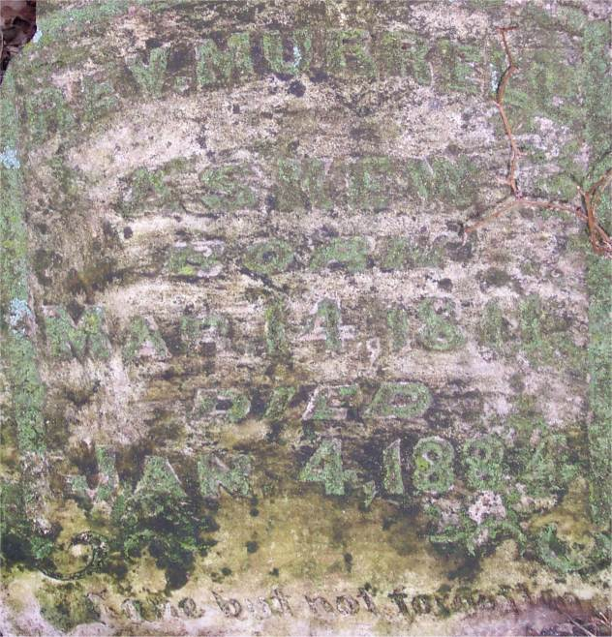
Murrell Askew
He taught in the school for two years.
In the fall of 1883, he became ill & died January 4, 1884
He was buried in the cemetery there on the campus of Burney Institute
His work in Lauderdale County was a precursor to that of T.B. Larimore, and still survives to this day.
At least one of his sons also preached among the Indian nations
Rev. Murrell
Askew
Born
Mar. 14, 1811
Died
Jan. 4, 1884
Gone but not forgotten

Slide 14
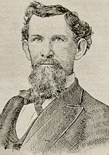
Robert Wallace Officer
Born August 18,1845 in Murray County, Georgia
According to F.D. Srygley, He preached his first sermon the night he declared his faith in Jesus. – At a Methodist meeting. The minister asked if he would submit to the Methodist discipline. His response was, “that is the wrong book.”
He asked for someone to baptize assist him as Philip assisted the Ethiopian Eunuch in Acts 8. No one responded.
1870—Six months later he found a Dr. Barris who baptized him into Christ

Slide 15
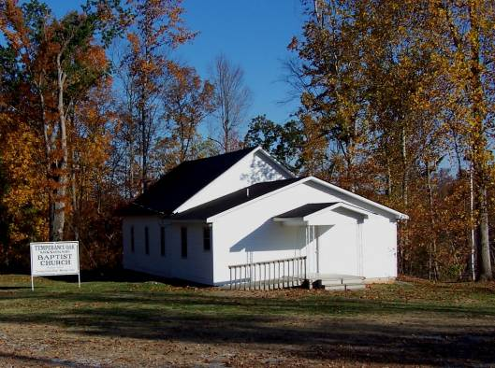
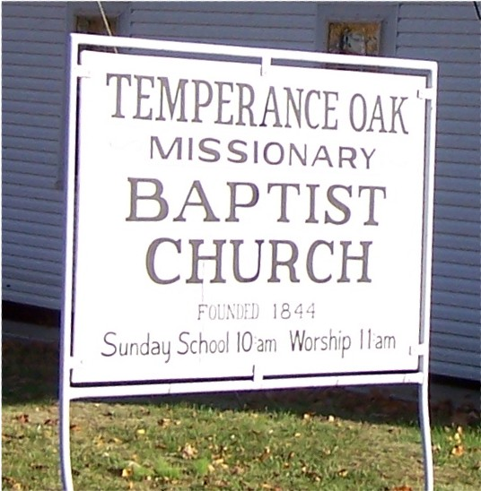
Robert Wallace Officer
Though claimed by the Baptists and supported by them to evangelize, he gave no allegiance to denominationalism.
Before long the Baptists of North Alabama tried him at Poplar Creek Church, Limestone County, Alabama
After being excommunicated from the Baptists, he worked throughout the area with restoration preachers such as Murrell Askew evangelizing.
1880 — He finally moved to Gainesville, Texas to work with the church.

Slide 16
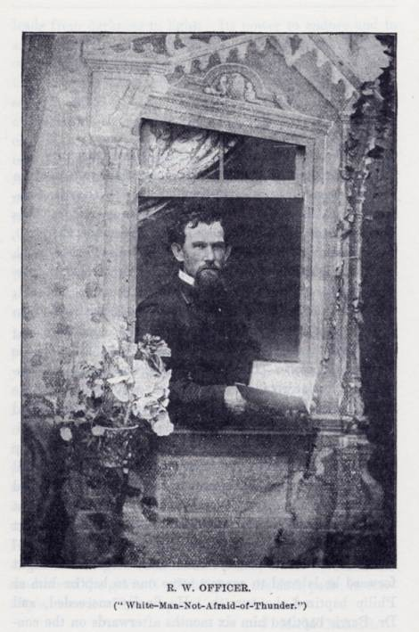
Robert Wallace Officer
1884 — After the death of Askew he moved to Paris, Texas where F.D. Srygley preached, and prepared to move into the Indian Territory
Officer greatly rejected Missionary Societies, believing them to be unscriptural
Editors such as David Lipscomb of the Gospel Advocate and Daniel Sommer of the Octographic Review pickup to the charge of helping to raise individual support for Officer
By August, 1884 he was making numerous excursions into the Indian Territory to preach and teach.
1886 moved to Atoka, Choctaw Nation

Slide 17
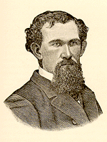
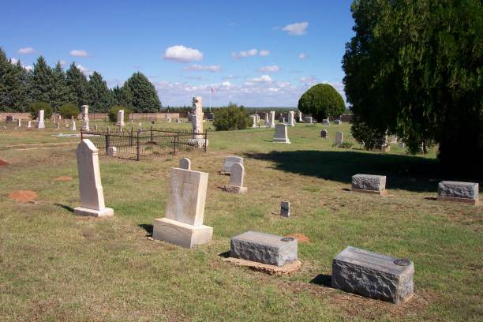
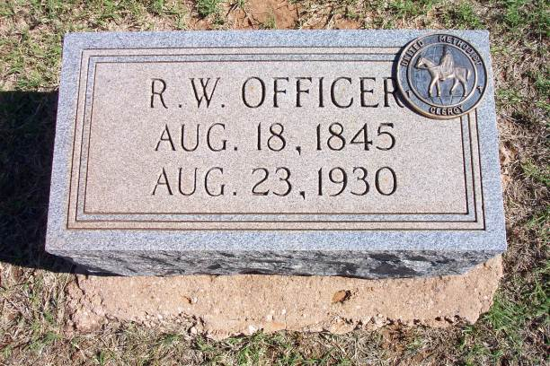
Robert Wallace Officer
Preached in a Methodist Episcopal Building
Sent regular reports to the Christian Leader, Octographic Review & Gospel Advocate
By 1889 at least six evangelists worked among the Choctaw Nation
Skirmishes
  Stolen Ponies
  “Look Out For Robbers”
Incidents
  Rube’s Conversion
  Towacany Jim – “White-man-not-afraid-of-thunder”
  Indian Camp Meetings
Died in August 23, 1930

