Slide 1
BARTON W. STONE
HIS INFLUENCE IN ALABAMA

Slide 2
I. His Direct Influence In Alabama
A. He is Known To Have Come To
This State Only One Time.
1. This was in 1839, upon the death John Biard.
2. Biard’s wife was Stone’s niece.
3. It is believed that John Nelson Biard was a Gospel Preacher.

Slide 3
  A few of the pioneer preachers who planted and watered this work were: Alexander Campbell, Philip S. Fall. John Taylor. Prior Reeves. Jacob Creath. Alexander Graham. Pinckney B. Lawson, AV. H. Goodloe. Col. T. W. Caskey. Wm. Kirkpatrick. Jesse Wood, William Stringer, L. D. Randolph. Jerry Randolph, James A. Butler, later, J. M. Pickens, C. S. Reeves, A. C. Borden, J.N. Biard, Dr. A. C. Henry, and others of blessed memory. Of those yet living who may be classed with the pioneers, I mention: Dr. David Adams, who united with the church of Christ under the preaching of P. B. Lawson, at Basketbottom Baptist church, four miles east of Pine Apple, in 1859, when the whole church, including the house, was converted to the plea for a complete restoration of the New Testament doctrine and life, and who has been preaching for that church ever since, being now our oldest minister in the state; J. M. Barnes, T. B. Larimore, Samuel Jordan, J. M. Curtis, and others.

Slide 4
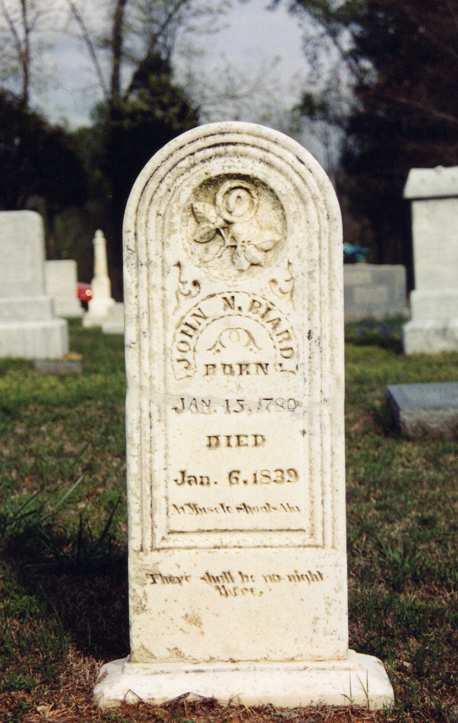
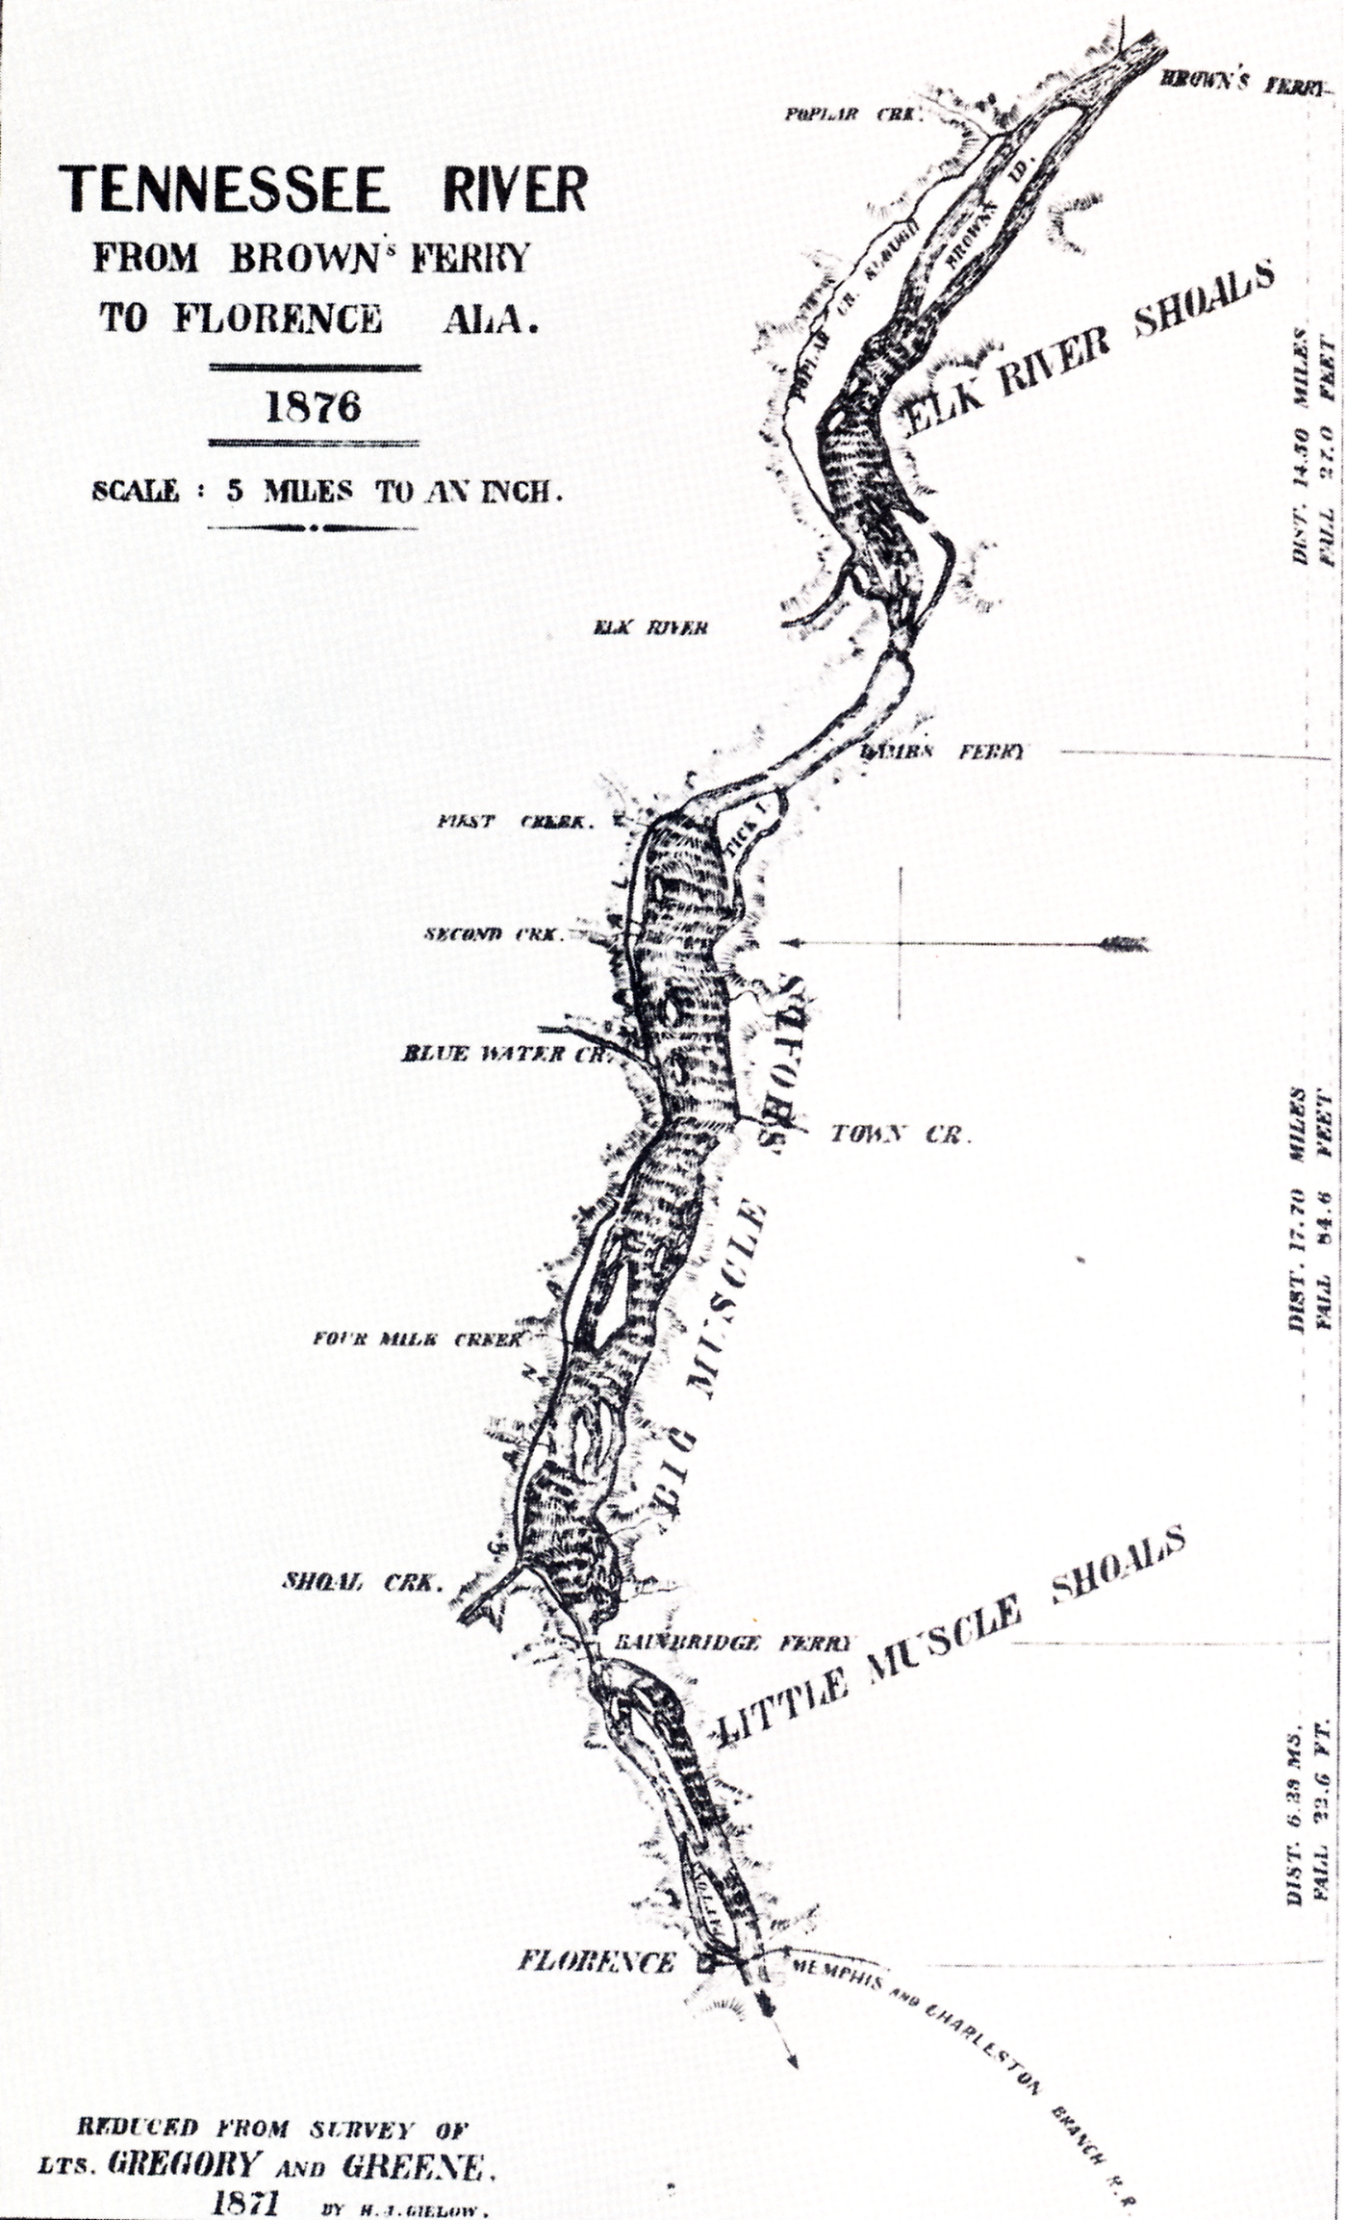

Slide 5
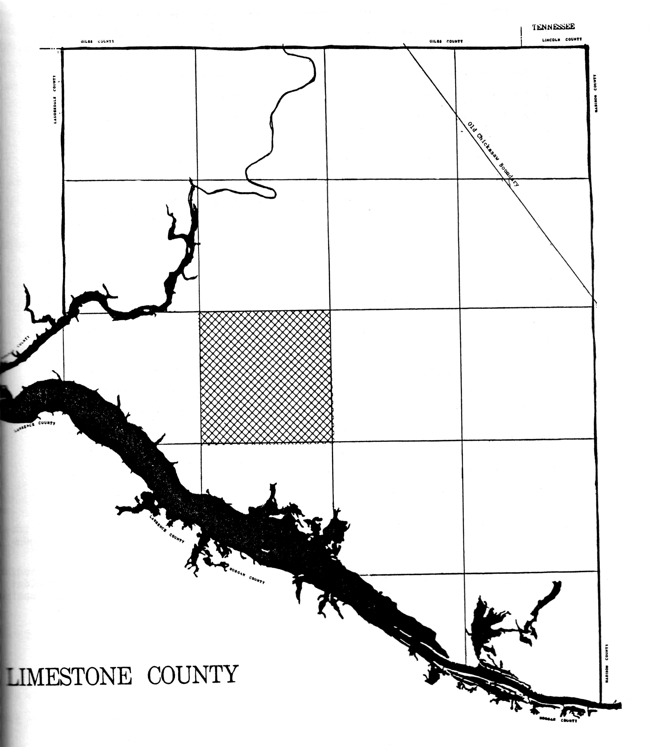
3.They lived in the south-western corner of Limestone County, Alabama.
4.He was an early minister in our movement, accord-ing to O.P.Spiegel, in John T. Brown’s The Church Of Christ .

Slide 6
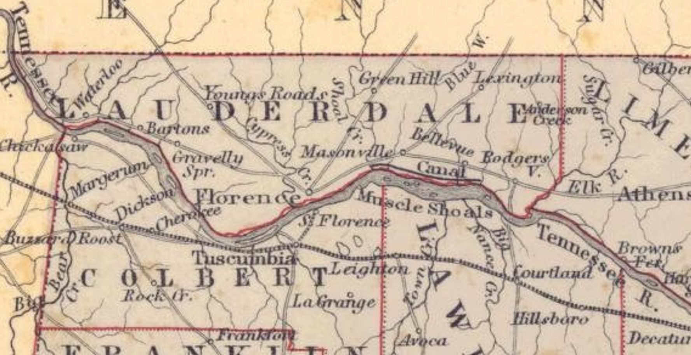

Slide 7
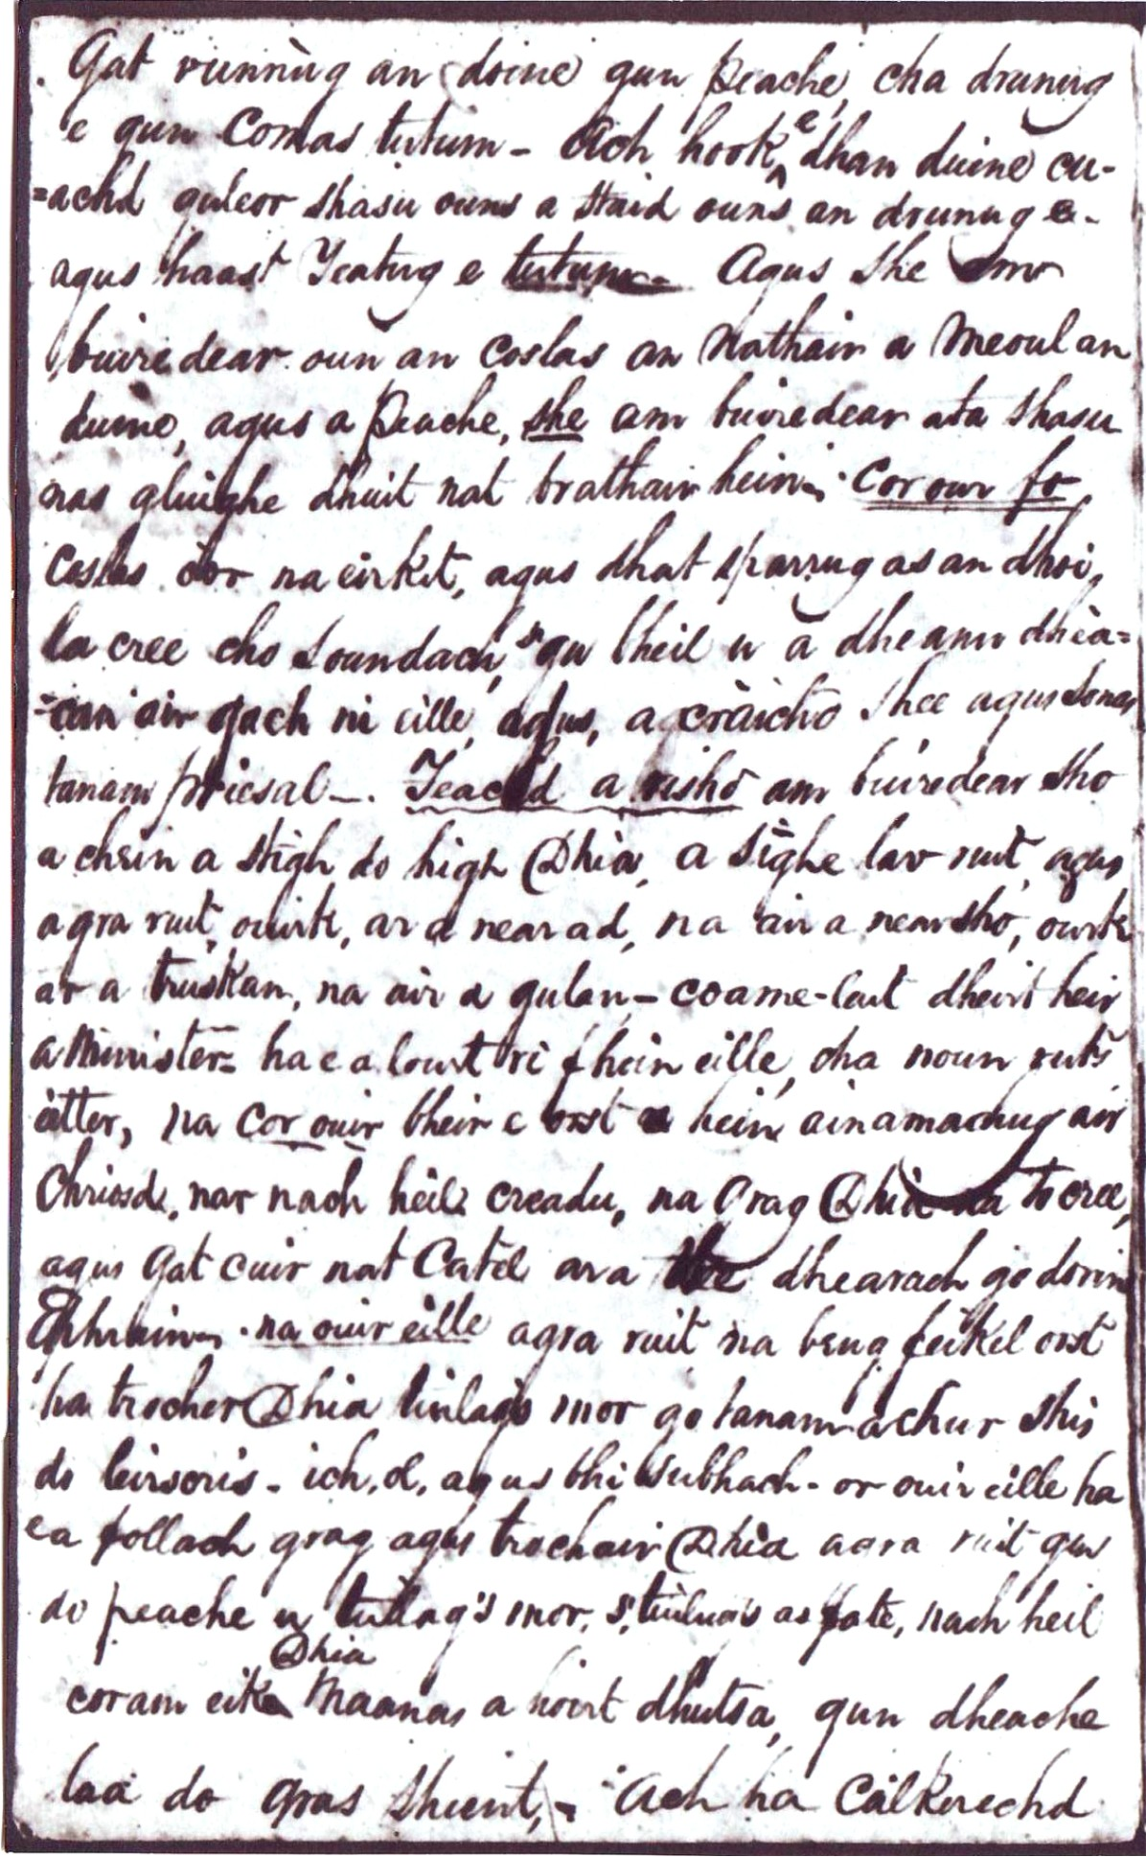
B. Stone Preached
To The Cherokee
Indians On the
Tennessee River.
C. He Also Preached In
The Octagon.
D. Meetinghouse Near
Athens, Alabama.

Slide 8
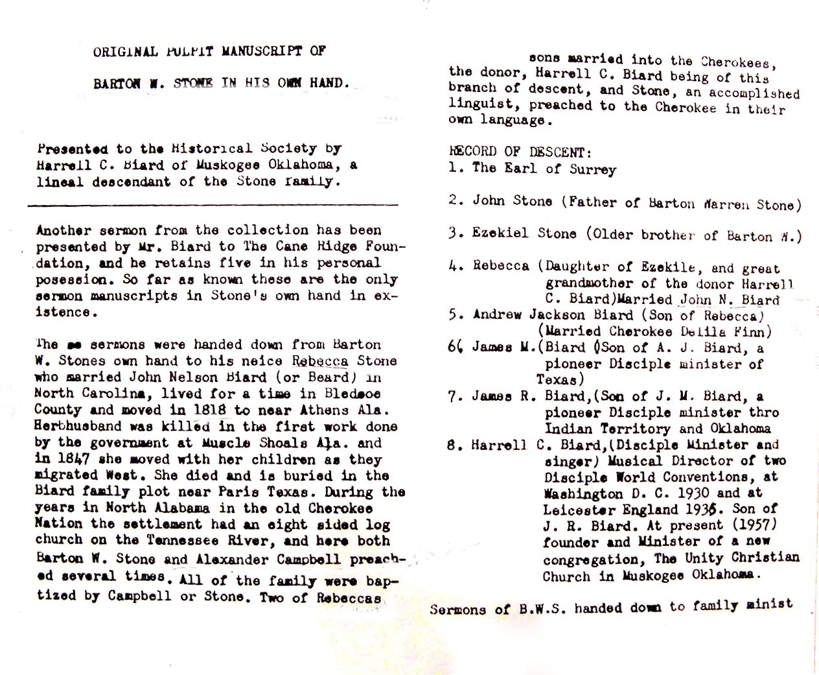

Slide 9
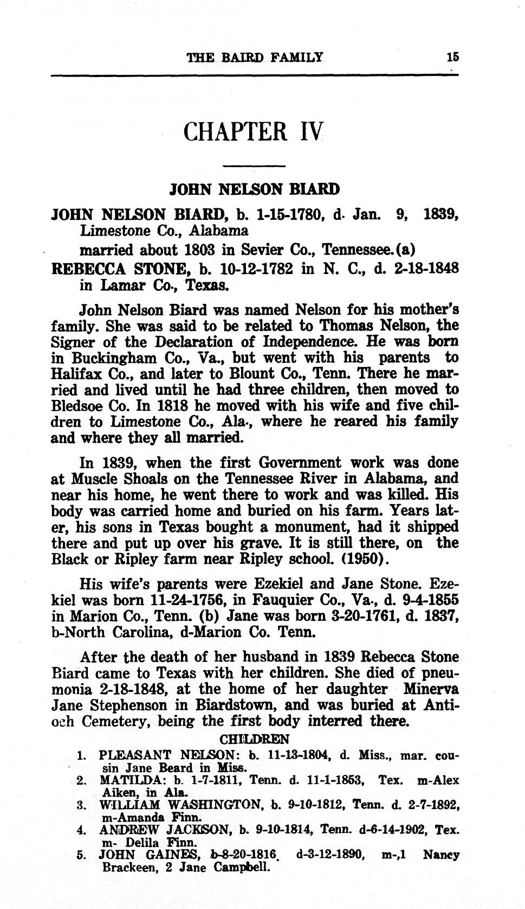
Biard Was Influenced By Stone’s Teachings
His Family Was Very
Much Into The Restoration Move-
ment.
Several Ministers
Came From This
Family.

Slide 10
II. Stone’s Indirect Influence
In Alabama
A. Through the preaching of some preachers, who had known him,
prior to coming to Alabama.
1. Ephraim D. Moore
2. James Evans Matthews
3. Crockett McDonald
4. Elisha Randolph
5. James Young
6. Benjamin Franklin Hall

Slide 11
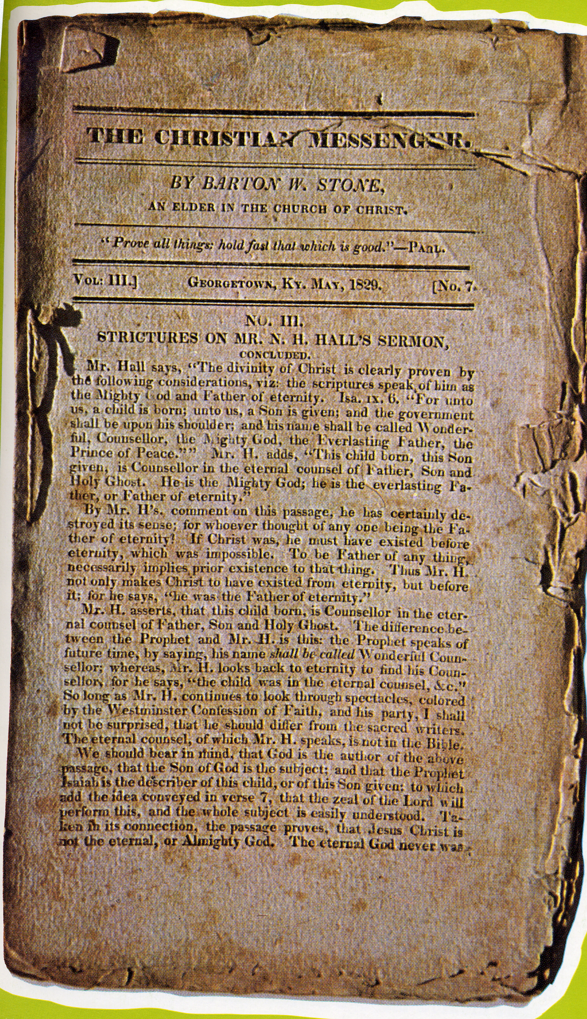
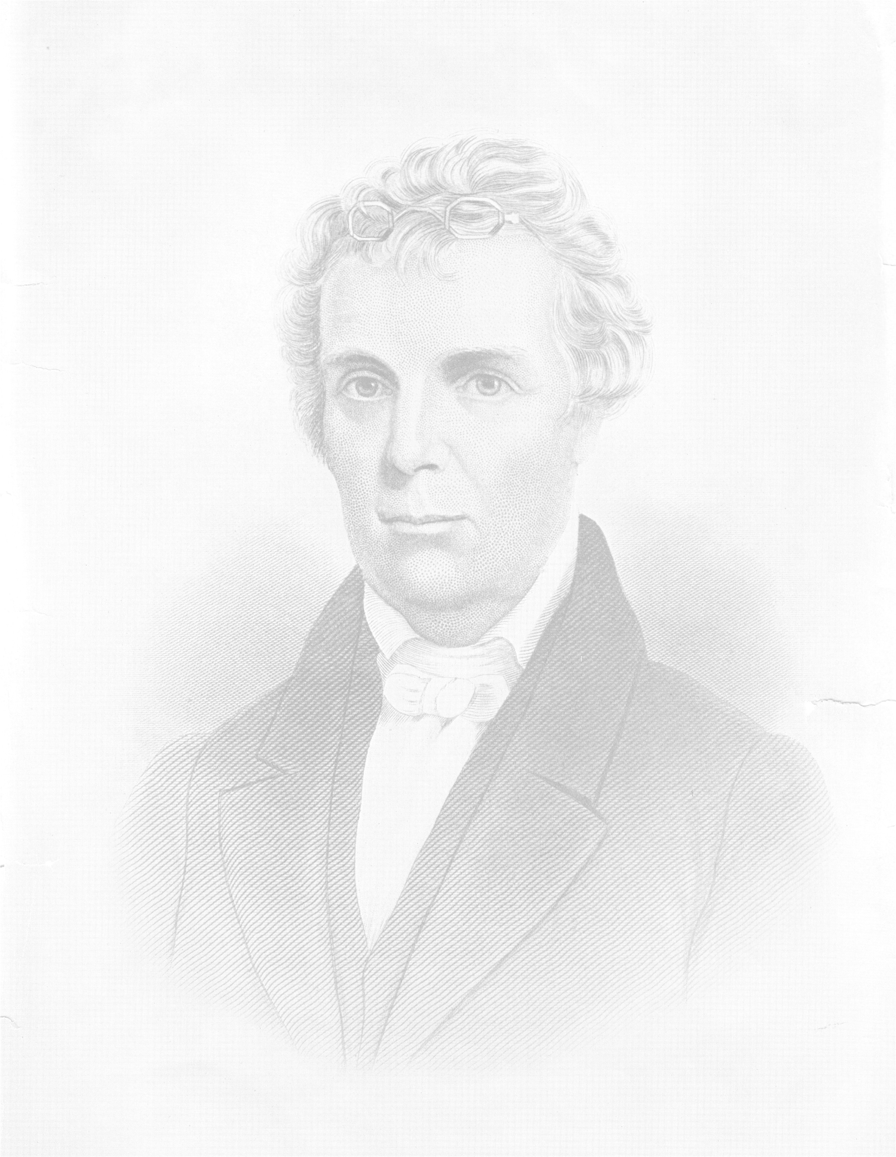
B. Stone’s Christian Messenger

Slide 12
C. Review
1. Ephraim D. Moore First Stone Disciple
2. James Evans Matthews Came In 1825.
3. Elisha Randolph Came To Morgan Co.
4. Crocket McDonald Came To Lawrence Co.
5. James Young Comes To Florence, Lauderdale County, Alabama In 1830.

Slide 13
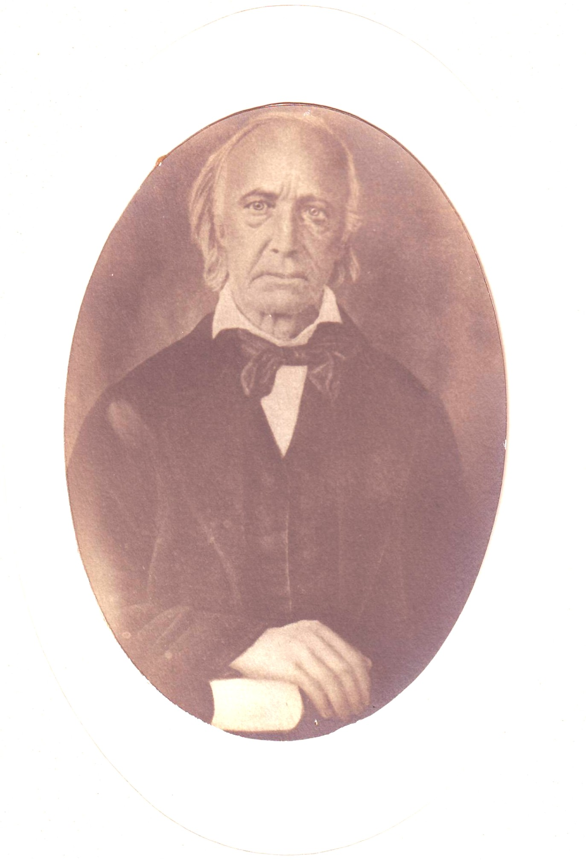
Ephraim D. Moore
Extract of a letter from Elder E. D. MOORE, dated
"FLORENCE, Ala. Nov. 4, 1828.
"BR. STONE— On the second Lord's day of October, we had our camp-meeting. I am happy to inform you that the meeting was attended with deep solemnity, and very good effect. I do not know how many professed; but believe there were 36 baptized: Some have professed since. We are still increasing in number, and the brethren steadfast in the faith."
Volume2,#2, Dec.,1828,p42

Slide 14
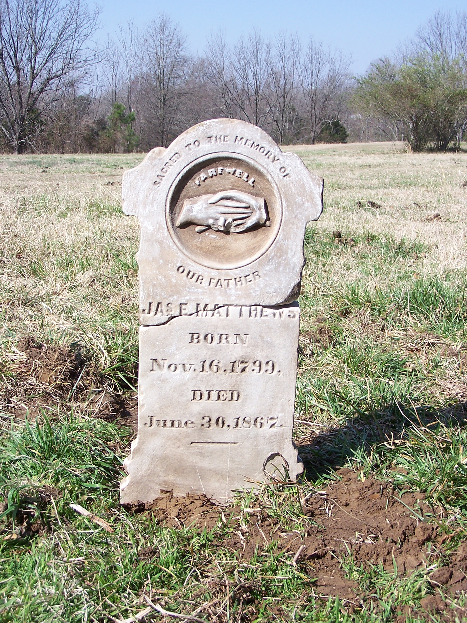
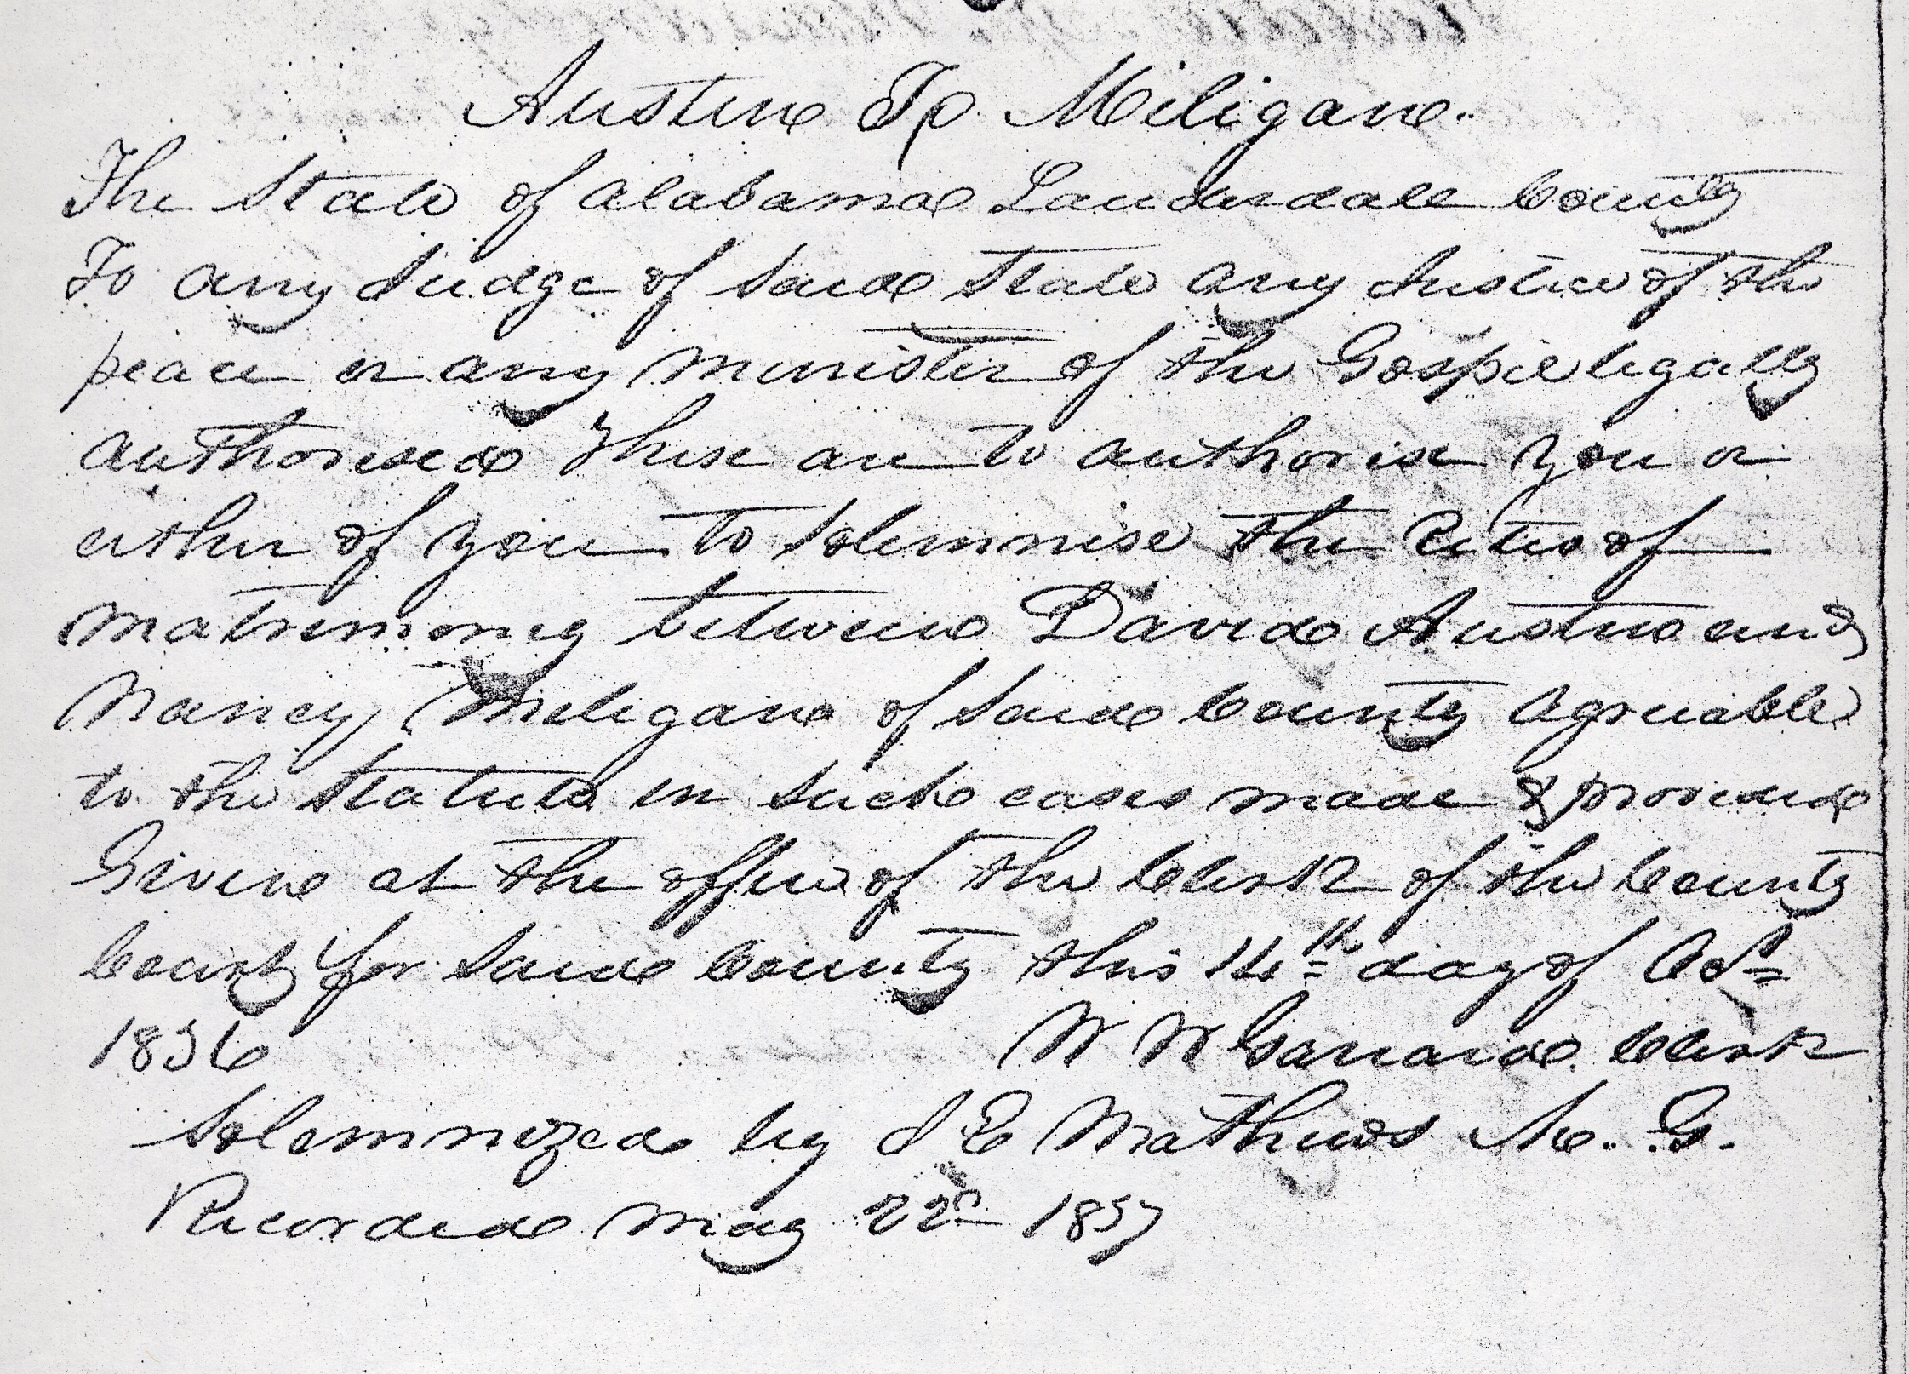

Slide 15
Extract of a letter to the Editor, dated,
"LAUDERDALE COUNTY, Ala. Nov. 30, 1828.
"The cause of religion prospers with us; our church numbers near 130, and the prospect of its increase is flattering. Brother Moore and myself attended a meeting to day, at which 5 were baptized, and one more professed faith in Christ. I do not know how many have joined the Church since I wrote to you last, but I think they may be set down at 10 or 12. This makes an increase to the Church of near 70 members in about seven weeks, A number more may be numbered as the seals of our ministry.
Some of them have joined the Methodist brethren, and some have not joined any church.
I have been informed that at a Camp Meeting, near Athens, in Limestone County, about 20 professed faith in Christ, 15 of whom were baptized. In September last, I attended a four days meeting in Salem, Franklin county, Tennessee, where we constituted a church of 7 members. In this place and its vicinity, I was informed that we suffered great opposition, yet the meeting was well attended, and many appeared
surprised, that we had been so greatly misrepresented. The prospect of doing good in this place is flattering. Brother J. McDonald is riding in that quarter, and I am informed that he has planted several churches in the neighborhood of Winchester, and the adjoining settlements.
        JAMES E. MATTHEWS
Volume3, #6, Apr., 1829 p142

Slide 16
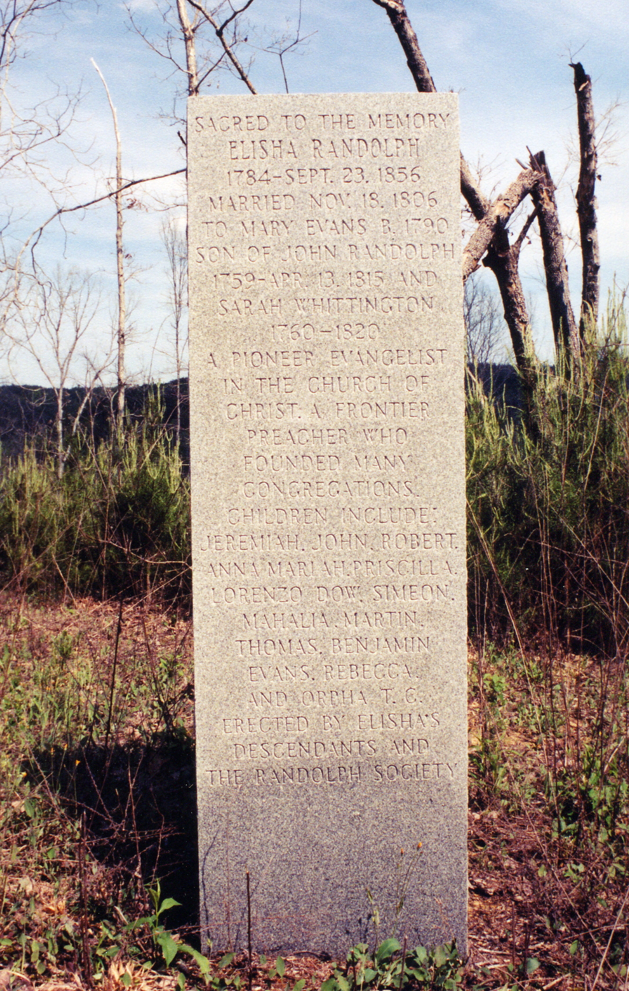
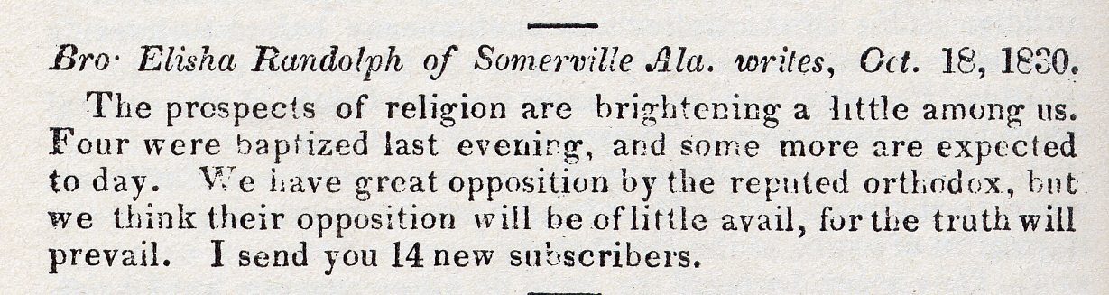

Slide 17
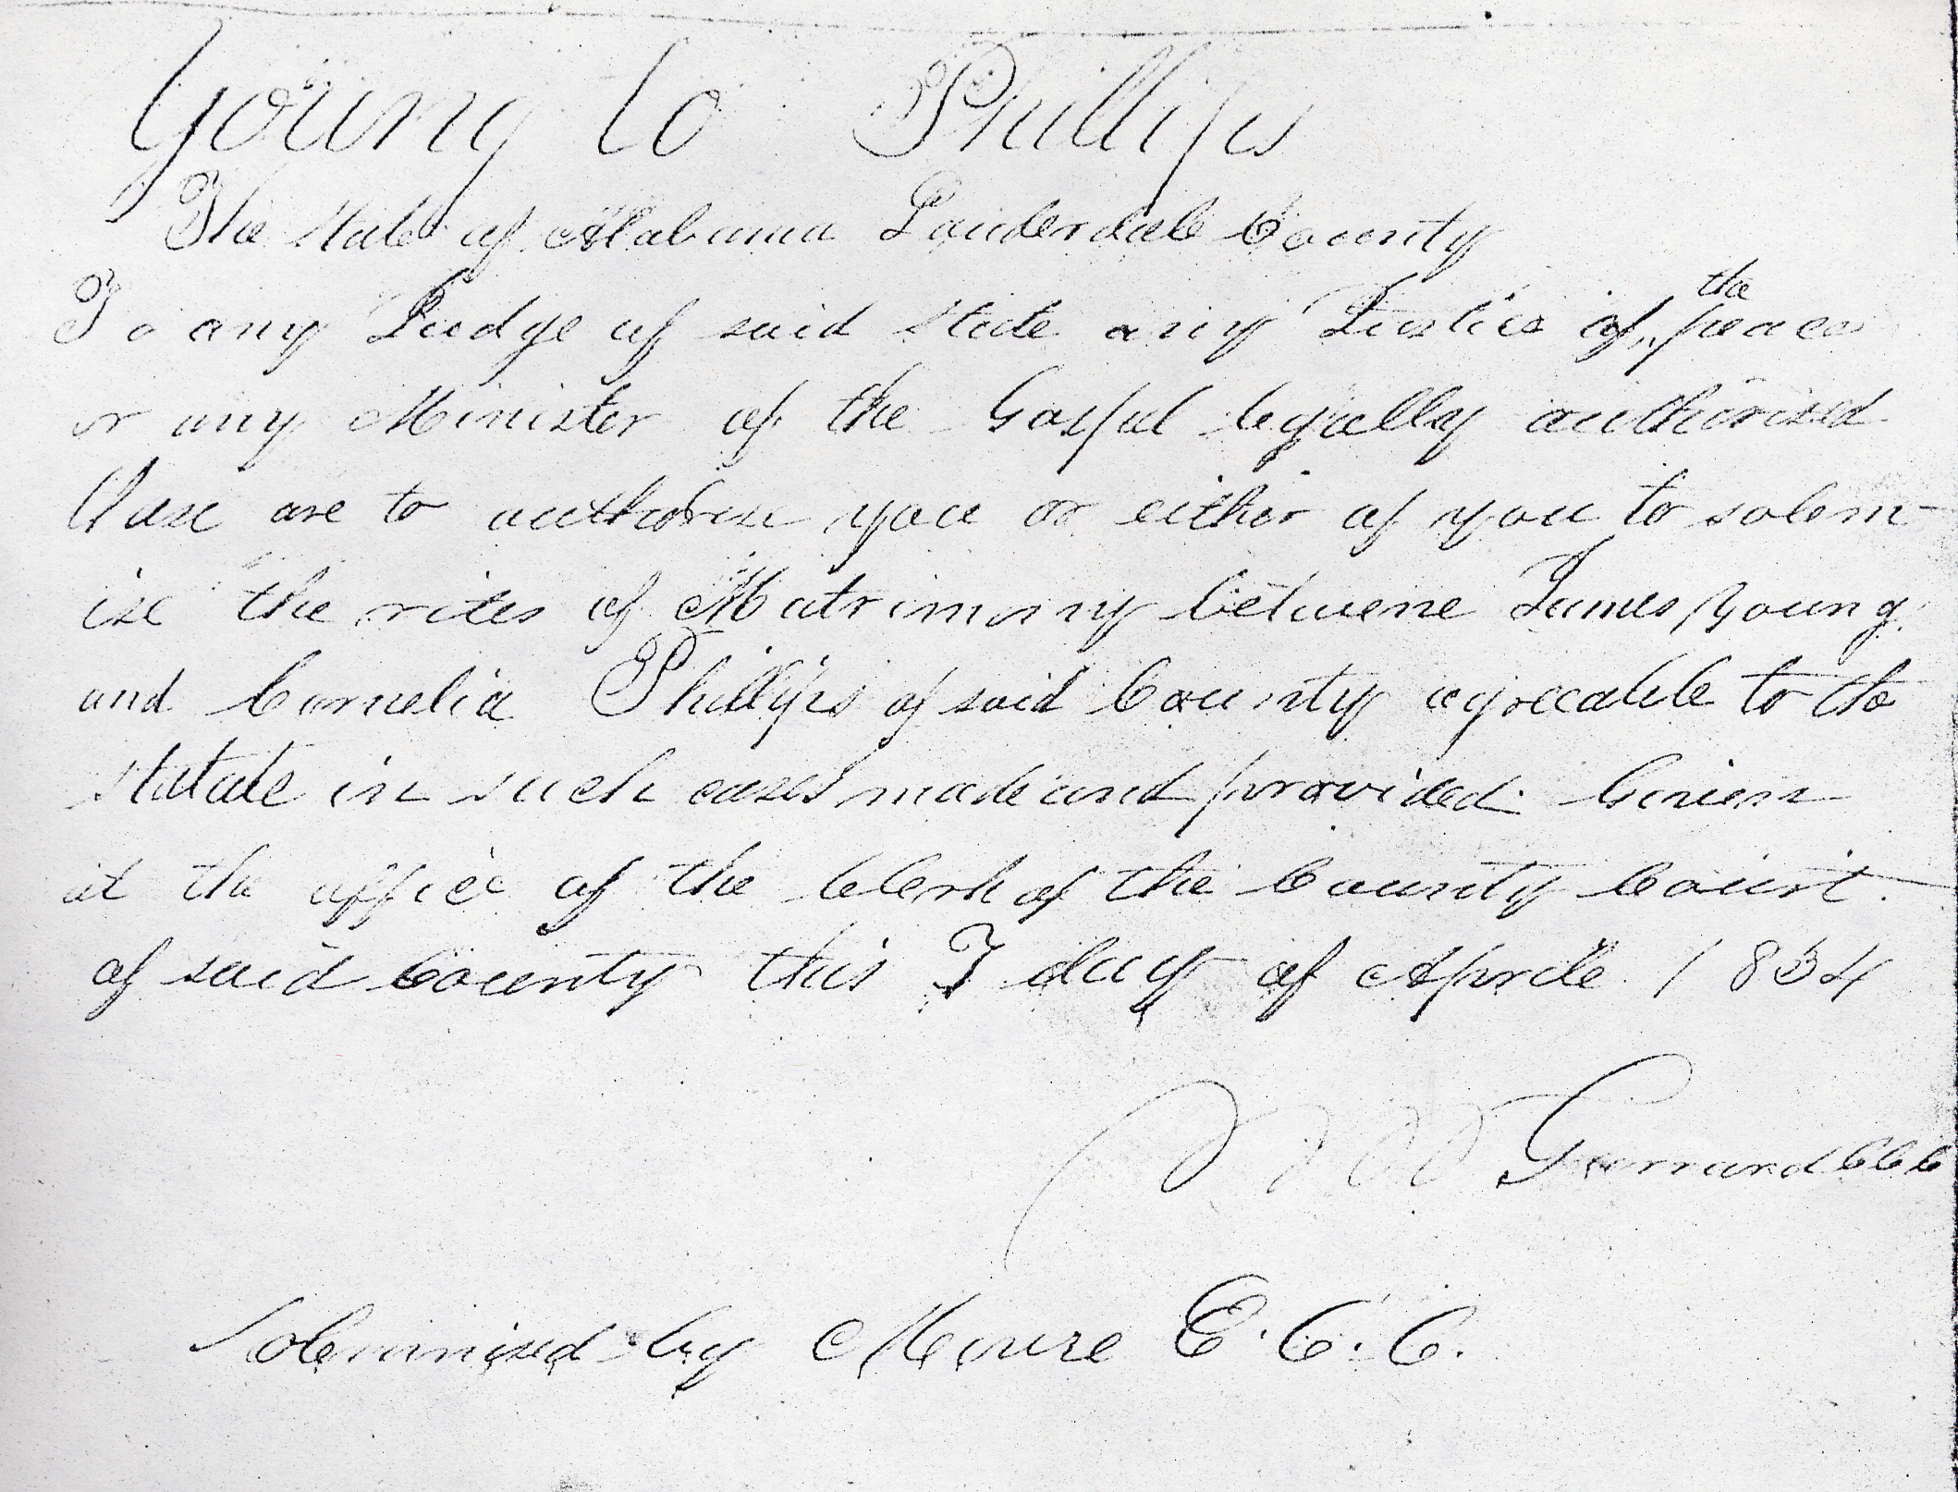
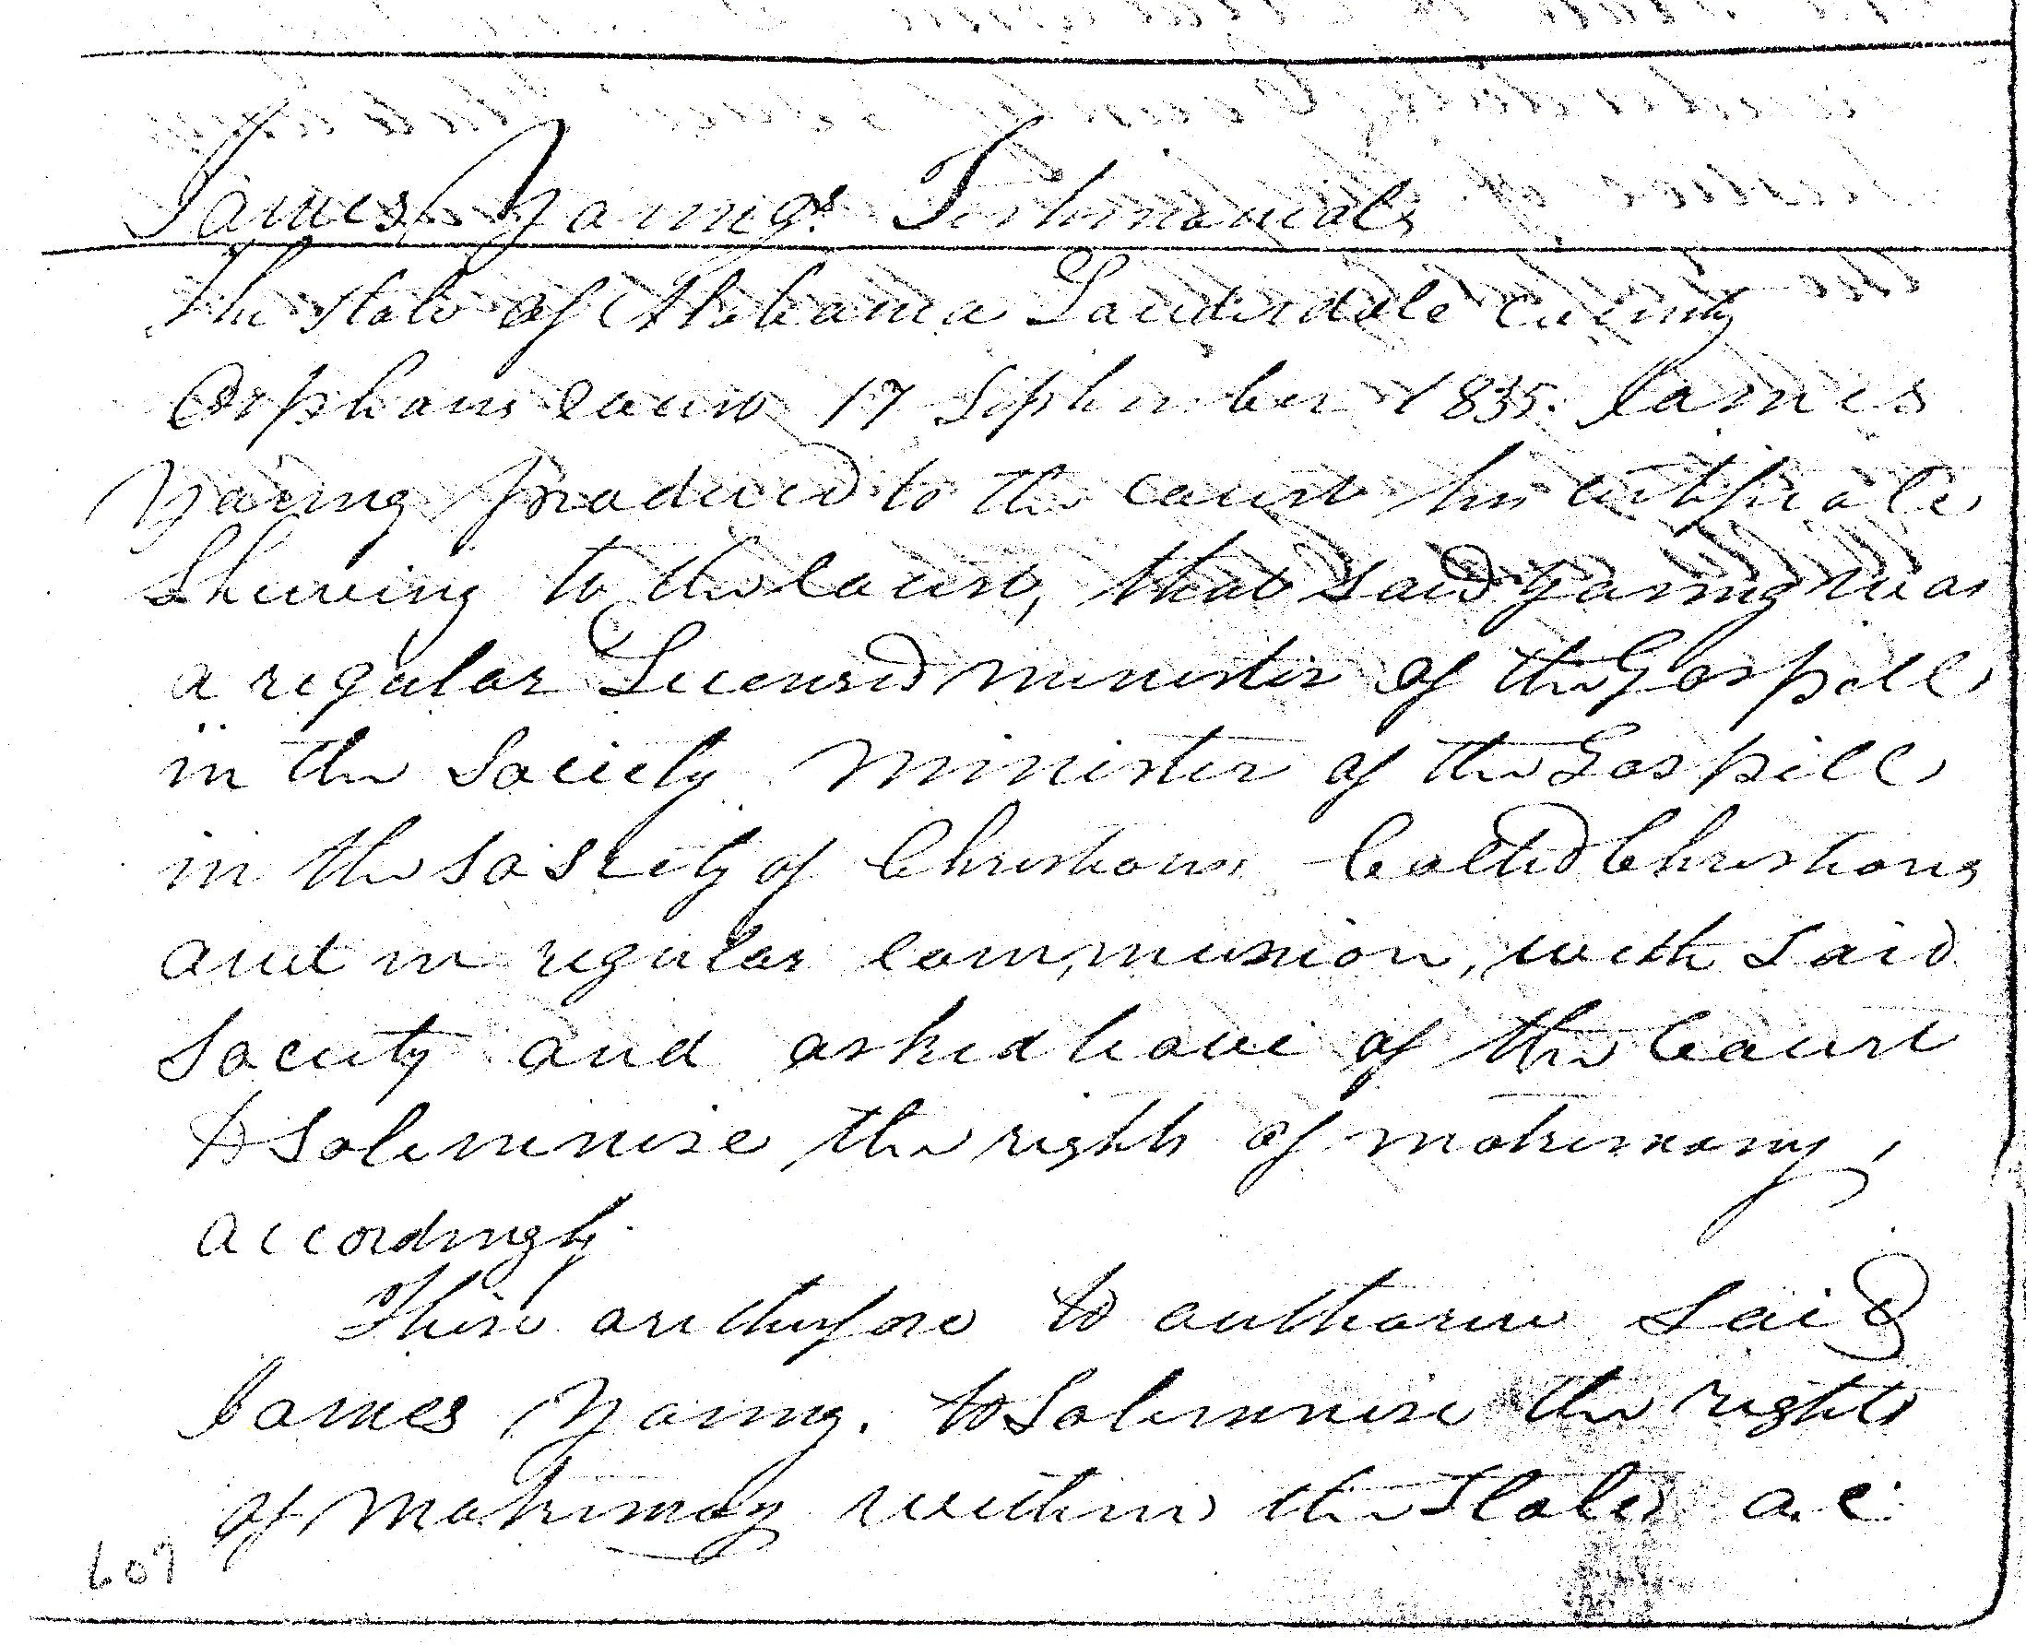
James Young

Slide 18
The following is a list of the names of most of the preachers in Tennessee and Alabama.
IN TENNESSEE—John Mulkey, Isaac Mulkey, Robert Randolph, ElihuRandolph, William D. Carns, Andrew Davis, Levi Nichols, Samuel Billingsley, William D. Jourdan, James Y. Green, Dr.—— Becton,—— Flinn, Levi Perkins, James Anderson, Corder Stone, John Hooton, William Hooton, —— Bills, John M. Barnit, Edward Sweat, Andrew Carnachan, Mansel W. Matthews, Jesse
Goodman, John Shultz, James Vinzant, Abner Hill, Henry Thompson,—Melvin, John M’Donald, William Nicks, and James Miller, (author of Trinitarianism Unmasked.) John Green.
IN ALABAMA—James A. Anderson, Thacker Griffin, Lorenzo Griffin, Reuben Mardis: Jonathan Parker, William Price, Elisha Price, Ephraim D. Moore,——Crocket,——M'Donald, John Northcross, Jesse Wilks, Tolbert Fanning, Jonathan Wallis, Elisha Randolph, James E. Matthews.
The camp-meetings in this county, are now in progress. At four which have been holden, 45 have been immersed. The Alabama Conference commences in this "county, on the last day of this month, and is regularly held, commencing on the Thursday, before the first Lord's day in October, every year. We should rejoice to see some of our Northern brethren in the ministry among us.
September 10, 1831

Slide 19
James E. Matthews ,Ephraim Moore ,and
Crocket McDonald are listed in Herald of
Gospel Liberty as being a part of the
Christian Connection.
Matthews’ letter to Simon Clough shows the
connection.

Slide 20
Extract of a letter from Elder James E. Matthews, to the Editor,
Dated Barton’s, Ala. September 10th, 1831.
BR. CLOUGH,—Yours of the 8th ult. came by last mail, at which time I was from home, attending a camp meeting. I now, in compliance with your request, hasten to reply, embracing the different subjects of enquiry contained in your Letter.
With respect to the condition and prospects of the Christian churches in Alabama and Tennessee, I will state, that according to the best information which I have, there are about 60 churches in Tennessee, with probably 4000 members; and in Alabama, about 20 churches, with about 1500 members. Some of these churches are very large, and many of them are in a flourishing condition. When I came to this country, something over five years ago, there was one small church of about 10 members; that church now contains upwards 200 members, and I have planted another church in my immediate vicinity, of about 60 members. Elder Moore and myself have had great opposition by the popular sectaries, but that opposition has comparatively ceased. Our prospects, in one respect, are a little discouraging at present, as brother Moore is about to leave this country, and I am left with a broken constitution, and fast declining

Slide 21
Further in this letter Matthews gives names of North Alabama Preachers.
Some of these men are converts of the first men to come to North Alabama,
yet they connected with Stone and his
Christian Messenger.
Carroll and Allen Kendrick are good examples of this.

Slide 22
The following is a list of the names of most of the preachers in Tennessee and Alabama. IN TENNESSEE—John Mulkey, Isaac Mulkey, Robert Randolph, Elihu Randolph, William D.Carns, Andrew Davis, Levi Nichols, Samuel Billingsley, William D. Jourdan, James Y. Green, Dr.—— Becton,—— Flinn, Levi Perkins, James Anderson, Corder Stone, John Hooton, William Hooton, ——Bills, John M. Barnit, Edward Sweat, Andrew Carnachan, Mansel W. Matthews, Jesse Goodman, John Shultz, James Vinzant, Abner Hill, Henry Thompson,—— Melvin, John M’Donald, William Nicks, and James Miller, (author of Trinitarianism Unmasked.) John Green.

Slide 23
The following is a list of the names of most of the preachers in Tennessee and Alabama. IN TENNESSEE—John Mulkey, Isaac Mulkey, Robert Randolph, Elihu Randolph, William D.Carns, Andrew Davis, Levi Nichols, Samuel Billingsley, William D. Jourdan, James Y. Green, Dr.—— Becton,—— Flinn, Levi Perkins, James Anderson, Corder Stone, John Hooton, William Hooton, ——Bills, John M. Barnit, Edward Sweat, Andrew Carnachan, Mansel W. Matthews, Jesse Goodman, John Shultz, James Vinzant, Abner Hill, Henry Thompson,—— Melvin, John M’Donald, William Nicks, and James Miller, (author of Trinitarianism Unmasked.) John Green.

Slide 24
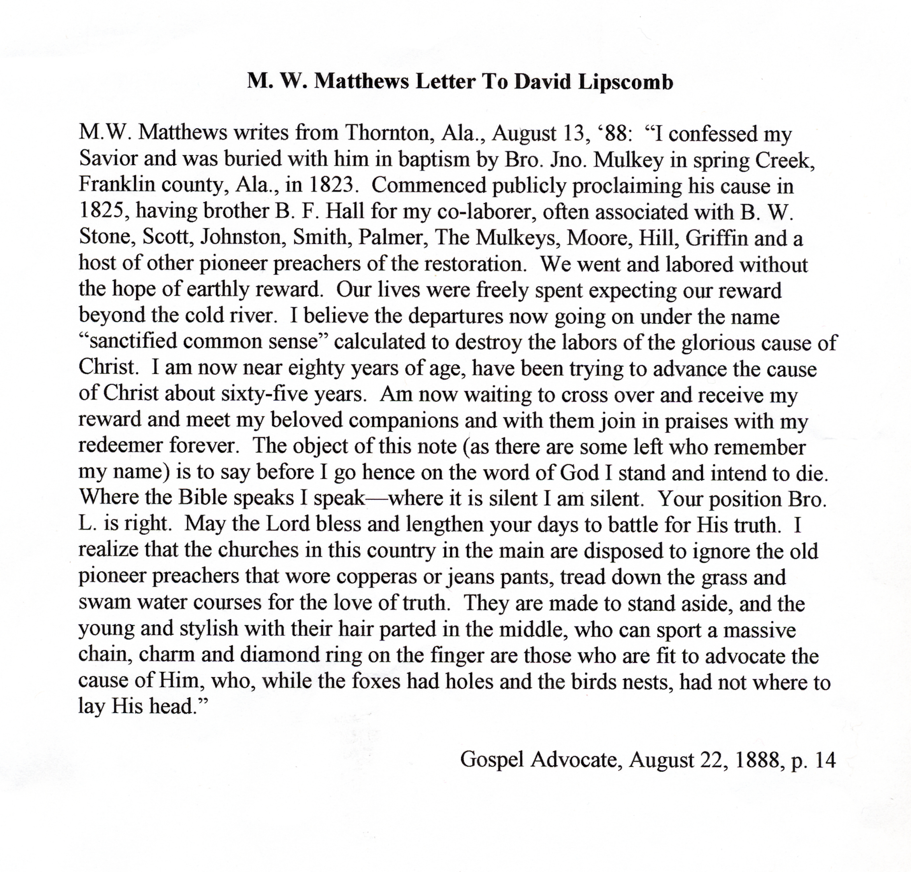
Mansell Matthews was baptized by a visiting preacher, who had by now, affiliated with Stone

Slide 25
1. Stone’s Christian Messenger, his acquaintances, and his onetime visit to Alabama made North Alabama one of the strongest areas for the Restoration Movement.
2. Stone’s influence did extend to Central and South Alabama, somewhat, however not with the same lasting results.
3. Alexander Campbell’s influence was stronger inSouth and Central Alabama.

