Slide 1
The History Of Bacon College

Slide 2
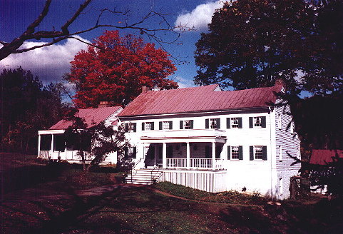
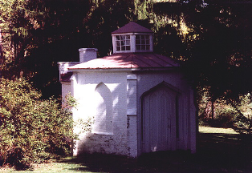
Early Schools Of The RM
Buffalo Seminary 1818-1823, Alexander Campbell In His Home, Bethany, Virginia
Second Edition Added For Seminary
Hours Each Day Spent In Study Only With Light From Above

Slide 3
Early Schools Of The RM
1817 Thomas Campbell Operated A School At Burlington, Kentucky For Two Or Three Years
Walter Scott Operated A School At Pittsburgh, Pennsylvania
Philip S. Fall Began Operating A Female College in 1831, Frankfort, Kentucky
Called Popular Hill Academy,
Also Called Female Eclectic Institute,
The Earliest Female Institute In Kentucky
Operated For 26 Years By P.S. Fall
Walter Scott’s Daughter Emily Educated There

Slide 4
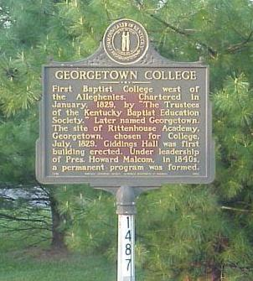
Rittenhouse Academy & Georgetown College
1788 Baptist Minister Elijah Craig Started A Classical School In Georgetown, Kentucky
1799 Rittenhouse Academy Absorbed The Classical School
1819 Barton W. Stone Began Serving As Principle Of The Institution
1829 Baptist Leadership Reorganized The College In Part To Prepare Baptists For The Influence Of The Disciples Movement.

Slide 5
Thornton Johnson
Attended West Point
Civil Engineering As A Vocation
1829 Moves To Georgetown, Kentucky To Become Professor Of Mathematics & Civil Engineering At Georgetown College
Roads And Bridges Were A Major Industry At That Time
Resulting In Students From All Over The Country Coming To Sit At His Feet
Befriended Barton W. Stone, Former Principle At Rittenhouse Academy, Became A Christian

Slide 6
Suffering Relationship At Georgetown
1831 Johnson Received Much Pressure From Baptist Leadership Concerning His Influences Among The Students – Conversions To Christian Movement – Resulted in Severed Ties With School
Note: January 1, 1832 – Merger Stone & Campbell Movement
1832 During School Break, He Went With B.W. Stone To Jacksonville, Illinois To Consider Opening Another School
Upon His Return He Learned That He Had Been Fired From Georgetown
Spent The Next 18 Months Out Of A Job
1834, April, Made Serious Plans To Move To Illinois To Begin The School He And B.W. Stone Had Earlier Considered
Georgetown College Was At The Point Of Closing Having Lost The Confidence Of The Community And The Baptists

Slide 7
Suffering Relationship At Georgetown
1834, May – T.F. Johnson Returns To Georgetown
Johnson Was Invited Back To Operate The School To His Own Liking
He Began With 9 Students, Seven Of Which Were Children Or Wards Of Reformers, By Weeks End There Were 11.
The First Year Ended With 25 Students
60 Students The Next Year, With Two Added Professors
During This Time This College Was Considered As An Independent College, Most Of The Students Were From The Reformers
1836, June, Two Months Into The Third Year With 104 Students, The Baptist Trustees Sought To Place A Baptist President Into Position, Mr. Farnsworth
October, Mr. Farnsworth Reported To Baptist Convention In Louisville That Georgetown Would Soon Produce A Death Blow To Campbellism In Georgetown, Kentucky

Slide 8
A College Is Planned
Though Assured By Georgetown Of A Job, He Began Making Plans To Start A Different School
Later Learned That The Promised Job Was To Be Short-Termed
Initial Contact With P.S. Fall To Move His Female College From Frankfort To Georgetown Fails
Communicates With Leadership In RM About A School Of Their Own Wanting B.W. Stone To Be President
Purchased Brick Building On Clinton Street, Georgetown For College, November 5, 1836

Slide 9
Bacon College Begins
The First Trustees Of Bacon Was An Impressive List
Walter Scott Lends His Support At The Encouragement Of Alexander Campbell, Agrees To Become Its First President
Delivered Inaugural Address
But Never Served Other Than Through Helping Raise Money
Stepped Down After A Year
John T. Johnson, Vice-President & Secretary
Samuel Hatch, Treasurer
Other Trustees Included: James Challen, P.S. Fall, and John Bowman, and Other Lesser Known Early Church Leaders

Slide 10
The Christian
1837 John T. Johnson & Walter Scott And John T. Johnson Publish Nine Issues Of A Journal From Georgetown, Kentucky
Walter Scott

Slide 11
Bacon College Begins
The Christian Reported A Highly Qualified Teaching Staff Was Selected
Thornton F. Johnson – Professor Of Mathematics & Civil Engineering
Dr. S. Knight – Professor Of Moral & Mental Sciences
S.G. Mullins – Professor Of Ancient Languages
C.R. Prezriminski – Professor Of Modern Languages & Topographical Drawing
Tolbert Fanning – Professor Of Natural History, Chemistry, Geology & Mineralogy
J. Crenshaw – Teacher In Preparatory Department

Slide 12
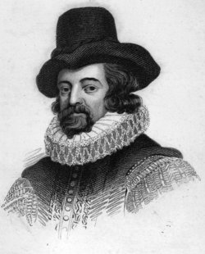
Bacon College Begins
November 11, 1836 Bacon College Opened Its Doors
To Not Appear To Be Stealing Students Johnson Waited Until Georgetown College Started Its Classes
When School Began Sixty Students Were In Attendance – Up to 130 Within 4 Mos.
Classes Begin on the 14th Because Teachers Had Not Yet Arrived
Called Bacon College After Famous English Philosopher Sir Francis Bacon

Slide 13
Johnson Builds A House On Hamilton Street To House Teaching Staff

Slide 14
The Road Was Difficult For Bacon
Charter Granted By Kentucky Legislature Feb. 23, 1837, By Vote of 19-13 In Senate And 61-30 In The House
The Reformers Were Supposed By The Baptists To Be 1/10th The Size Of The Baptist Church In Kentucky
Many Failed Attempts Were Made To Block A Charter For The College In The Legislature
“The chartering of Bacon College was a singular instance of legislative blindness as it was in direct opposition to the wishes of those most interested, the citizens of Scott County, in which Georgetown is situated.” – Mr. Sands, Editor Of Baptist Journal, The Religious Herald
In Vol. 1 No. 6, The Christian, J.T. Johnson Fired Back At Mr. Sands, The Religious Herald, And The Baptists In Ky For Their Attitudes
The College Ended Its First Year With The Total Of 203 Students, The Christian Vol. 1, No. 8, p.167

Slide 15
Bacon College The Second Year, 1837
D.S. Burnet Becomes Second President Of Bacon College, Serving Two Terms
Alexander Campbell Gives A Hardy Endorsement To The College
T.F. Johnson Leaves The School To Begin A Female School In Georgetown
Female Collegiate Institute
1837-1850 At Georgetown
Later Moved To Millersburg

Slide 16
Report In The Christian Vol. 1, No. 8, p.183 Concerning The Second Year, 1837

Slide 17
Financial Problems Force A Move For Bacon College
Because Of Financial Problems The College Is Forced To Relocate In Harrodsburg, KY
There Was No Endowment For The School As Of 1839, Only Student Fees, Not Enough
No Adequate Building To House The School In Georgetown
Trustees Offered To Move Anywhere If Someone Would Offer $50,000 In Scholarships, Or 100 $500 Scholarships
Major James Taylor, A Harrodsburg Lawyer, Raised The Necessary Fund Plus $10,000 For A Building

Slide 18
Bacon College Moves To Harrodsburg, Kentucky
1839, Sept. 2, First Session At Harrodsburg
With The Move
D.S. Burnet Resigns
Samuel Hatch Becomes Interim President
Henry H. White Becomes Head Of Department Of Civil Engineering And Mathematics

Slide 19
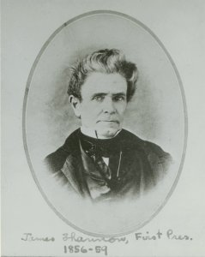
Bacon College Gets A New President
1840, James Shannon Becomes President Serving For Ten Years
Graduate Of Belfast Academical Institute, Ireland
Came To Georgia, USA, Teaching At Sunbury Academy, S. Of Savannah
Minister Of Augusta Baptist Church Four Years
1830-1836 Professor Of Languages At University Of Georgia
1836-1840 President Of Louisiana College At Jackson, Miss.
After Bacon, He Served As The Second President Of The University Of Missouri
Still Later Served As The First President Of Culver-Stockton College, Missouri
1799-1859

Slide 20
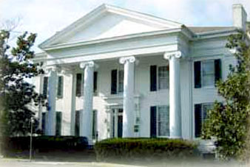
Bacon College Gets A New President
Built 9000 Square Ft. Mansion In Harrodsburg, “Aspen Hall”
In Inaugural Address Expressed That His Plan Was For A First Rate Educational Institute, Based On A Moral And Religious Foundation, Otherwise “Reasoning Brute”
1799-1859

Slide 21
Bacon College
1841 Degree Of Bachelor Of Arts Was First Conferred
1841-1850 27 B.A. Degrees Were Conferred
1843 Building Completed On A Ten-Acre Tract Of Land

Slide 22
More Financial Problems
1843 Financial Difficulties Continued As Average Of 100 Students In Student Body,
Less Than At Georgetown Perhaps Because Bethany Had Started In 1841
1845 Board Meeting At Harrodsburg, Accusations
If School Sought To Promote Moral & Religious Education Rather Than Liberal Arts There Would Have Been More Support From Brethren
Shannon Defends The College’s Performance
Shannon Resigns Due To Financial Troubles
Harrodsburg Church Offered Financial Backing
Shannon Stay Five More Years

Slide 23
Bacon College While At Harrodsburg, Kentucky
1847 Shannon Reports In The Millennial Harbinger That Bacon Had 113 Students The 1846 Year. MH Vol. IV No.1, January Page 30
1850, June 14, College Closes Due To Financial Trouble
Shannon Becomes 2nd President Of University Of Missouri

Slide 24
Bacon College While Gets A New Name
1850-1855 Dr. Samuel Hatch Operated A High School
1855, October 22 — A Meeting Was Held To Resurrect Bacon College
John B. Bowman: A Trustee & A Bacon College Student Its First Year, & Graduate Called A Meeting At The Harrodsburg Campus
Bowman Raises $150,000.00 In 50 Days
Application Is Made To The Kentucky Legislature For A New Name
1858, Feb. 2, Chartered As University Of Kentucky By Trustees

Slide 25
A New Start, But Trouble Still Lies Ahead
Robert Milligan Of Bethany College Was Made President
Faculty Included
John H. Neville, Christian Univ.
Robert H. Richardson, Bethany
Robert Graham, Arkansas College
1859, Sept. 19th, School Begins With 194 Students
1860 – The Civil War Begins
Student Body Dwindles Rapidly – 174 By 2nd Session, 113-3rd, 62-4th
October 8, Battle Of Perryville, Confederates Take Over School
Main Building Becomes A Hospital
1864, Feb. 16th Harrodsburg Main Building Destroyed By Fire

Slide 26
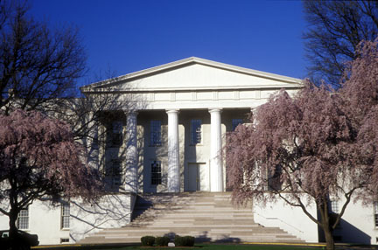
The University Of Kentucky Moves To Lexington
1864, A Meeting To Discuss The Future
If $100,000 Promised From A Community To Host A University Would Result In The Reception Of The College
John B. Bowman, Robert Milligan And Henry H. White Selected To Find A Suitable Place For Removal
1865, February 28, The State Legislature Approves Of A Merger With Then Defunct Transylvania University In Lexington
Transylvania Was The First College West Of The Alleghenies, 1780
Alumni Included - Jefferson Davis, John Hunt Morgan, Stephen F. Austin, Cassius M. Clay, Albert Sidney Johnston, Two U.S. Vice-Presidents-Richard M. Johnson and John C. Breckinridge-50 U.S. Senators, 101 Representatives, Three House Speakers, 36 Governors, and 34 Ambassadors.

Slide 27
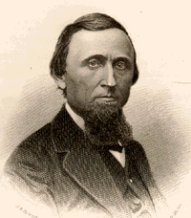
The University Of Kentucky In Lexington & College Of The Bible
Regent Of KU, John B. Bowman
Old Morrison Held Three Colleges Under Kentucky University Name
Arts College – From Harrodsburg
College Of Law
College Of The Bible
1865, October 2, College Of The Bible Begins
Robert Milligan Was 1st President Of The College Of The Bible
J.W. McGarvey Accepts A Chair

Slide 28
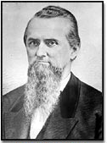
Bowman’s Vision For Kentucky University
As Regent, John B. Bowman Wanted To See Kentucky University Grow
Other Colleges Envisioned
A Normal College – Never Materialized
A College Of Medicine - 1873
An Agricultural And Mechanical College
A Commercial College – 1867
1869 Problems Began To Arise Between Bowman And McGarvey Over The Future Of The University
McGarvey’s Vision Was For More Of A Religious Influence
Bowman Leaves Main Street Church Where McGarvey Preached
1873, September 18th, For A Short Time McGarvey Was Forced Out Of The COB, Later Returning June 24, 1875
1877 The College Of The Bible Pulled Away From Kentucky Univ.
1878, January 28th, Bowman Was Removed As Regent
1878, March 13th, Agriculture & Mechanical College Removed & Office Of Regent Was Abolished

Slide 29
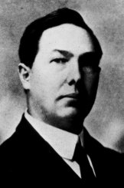
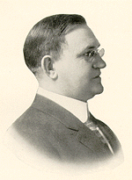
McGarvey’s Vision In H.L. Calhoun
After A Long Career J.W. McGarvey Had Groomed Hall Laurie Calhoun To Be President
Calhoun Had Been A Student At The College Of The Bible
He Attended And Graduated — B.D. @Yale And Ph.D. @ Harvard
Came Back To Teach, Becomes Dean Of College
1911, Oct. 6, McGarvey Died
Calhoun Becomes Interim President, Only For 3 Months
Richard H. Crossfield, Who Had Been KU President, Becomes President Of The College Of The Bible, Feb. 1. 1912
H.L. Calhoun
R.H. Crossfield

Slide 30
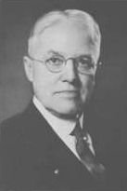
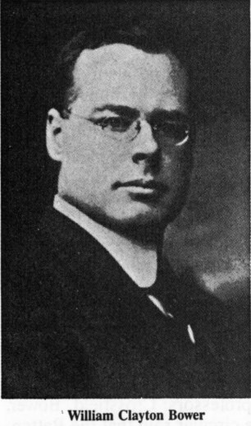
New Teachers With New Theology
1912, April 8, Alonzo W. Fortune Came To The College Of The Bible
Hiram College Graduate, Close To Ph.D. From University of Chicago
Church History And New Testament Theology
S.S. Lappin, Christian Standard Wrote Of His Concerns About Fortune Accusing Him Of Being A Member Of “The Campbell Institute”
Campbell Institute – Disciple Students At The University of Chicago, Theological Radical Group, Religious Snobs
1912, June, William C. Bower Hired To Chair Bible School Of Pedagogy
A.W. Fortune
W.C. Bower

Slide 31
The War Over False Teaching
1917, March 12, Ben J. Battenfield, Older Student Sent Out 300 Copies Of A 1200 Word Letter
Claiming Higher Criticism Being Taught By Four Teacher: Bower, Fortune, Crossfield & E.E. Snoddy
Signed By Nine Other Students
Christian Standard Enters The Fray
On Editorial Page An Open Letter Stating The For Over One Year He Knew Destructive Criticism Had Been Taught At COB.
1917 Hostilities Came To A Head At The College Of The Bible Over Destructive Criticism
Trial Took Place Resulting In Calhoun’s Dismissal
Turning Point In The Direction Of The COB
A.W. Fortune
W.C. Bower

Slide 32
Kentucky University Today
The Colleges On The Campus Of Transylvania College
Kept The Name Of Kentucky University Until 1908
Name Changed To Transylvania University
A Disciples of Christ Liberal Arts College Today
The Agricultural And Mechanical College Continued Under The Control Of The Commonwealth Of Kentucky.
In 1916 The Name Was Changed To The University Of Kentucky
Kentucky University Today Now Has No Relation To The Restoration Movement
1965, August 1st, College Of The Bible — A New Name Fitting A New Theology Took Place – Lexington Theological Seminary
Though Lexington Theological Seminary Is Located On The Campus Of Kentucky University It Has No Connection With It
Transylvania University And Lexington Theological Seminary Are Still Colleges Operated By The Disciples Of Christ

