Slide 1
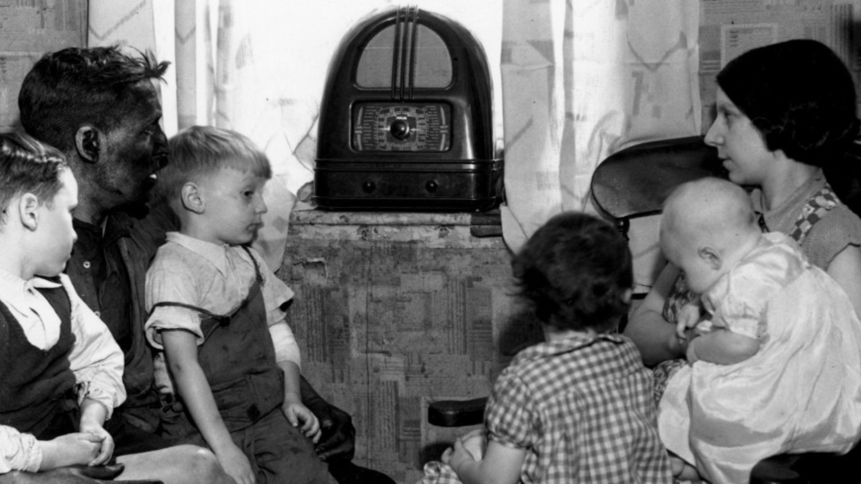
Radio Preaching By N.B. Hardeman H.L. Calhoun & Others

Slide 2
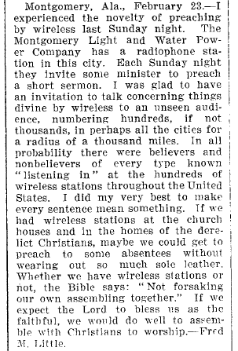
Fred M. Little (1881-1942) First Mention Of Radio Work In The GA Gospel Advocate, 03.02.1922, p.209

Slide 3
James A. Harding
1848-1922
N.B. Hardeman 1874-1965
Hall L. Calhoun 1863-1935

Slide 4
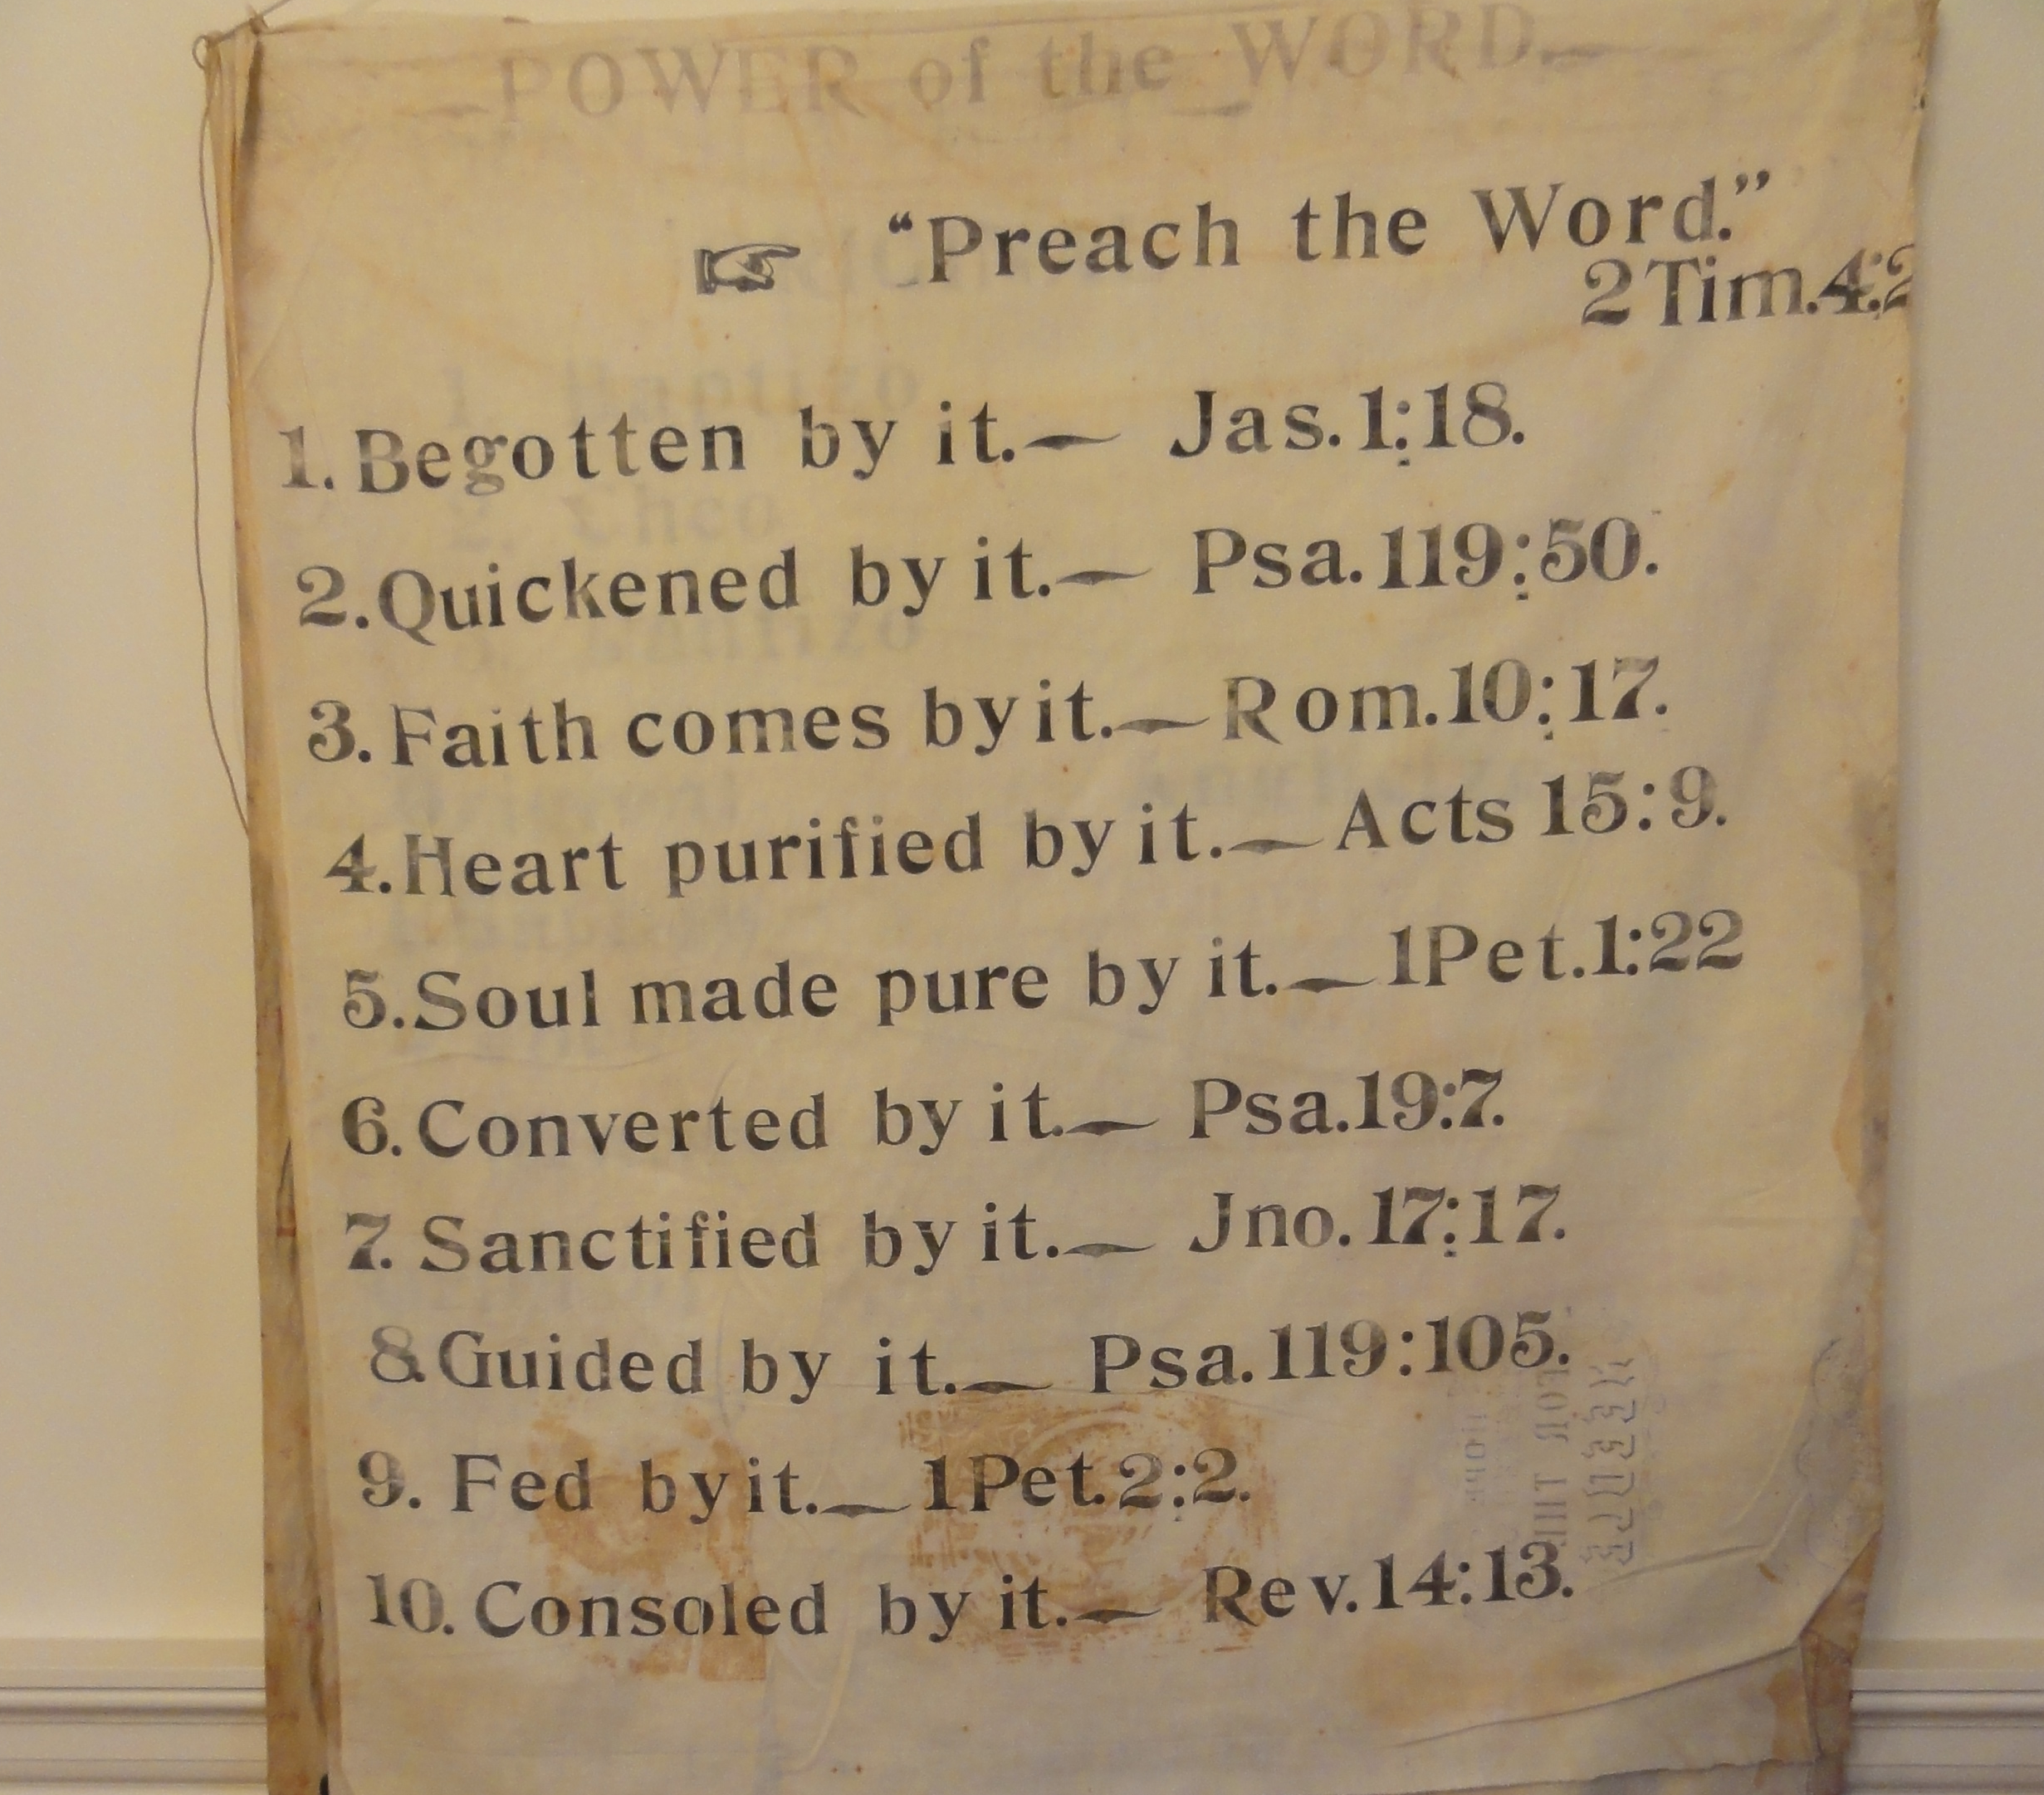
N.B. Hardeman (1874-1965)

Slide 5
Hall L. Calhoun 1863-1935
Adron Doran 1909-2001
J.E. Choate 1916-2013

Slide 6
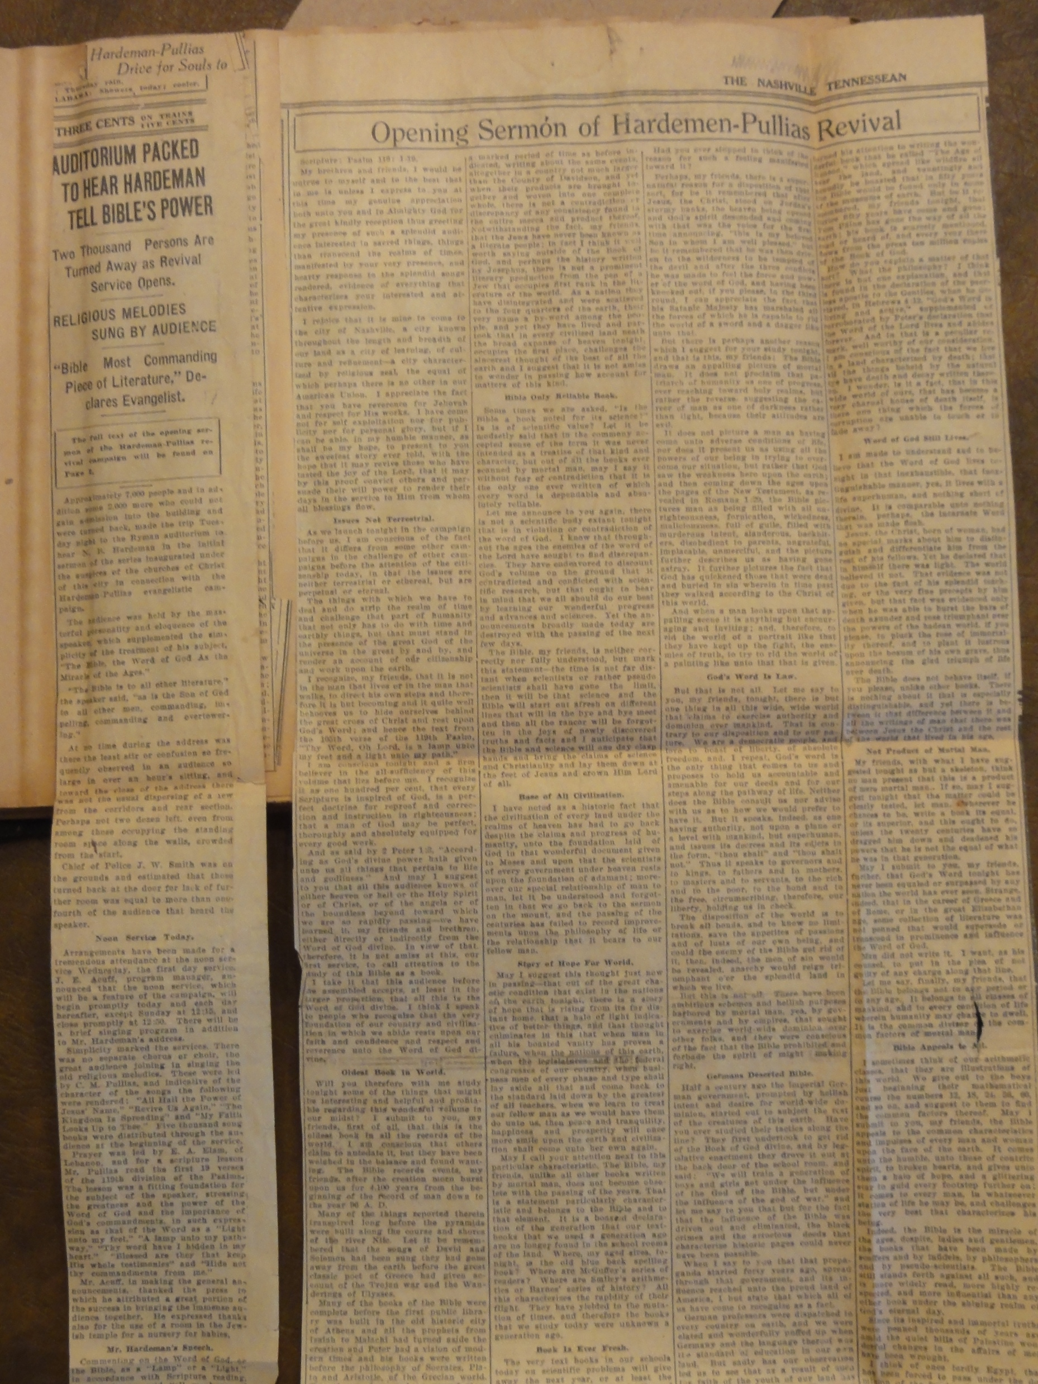
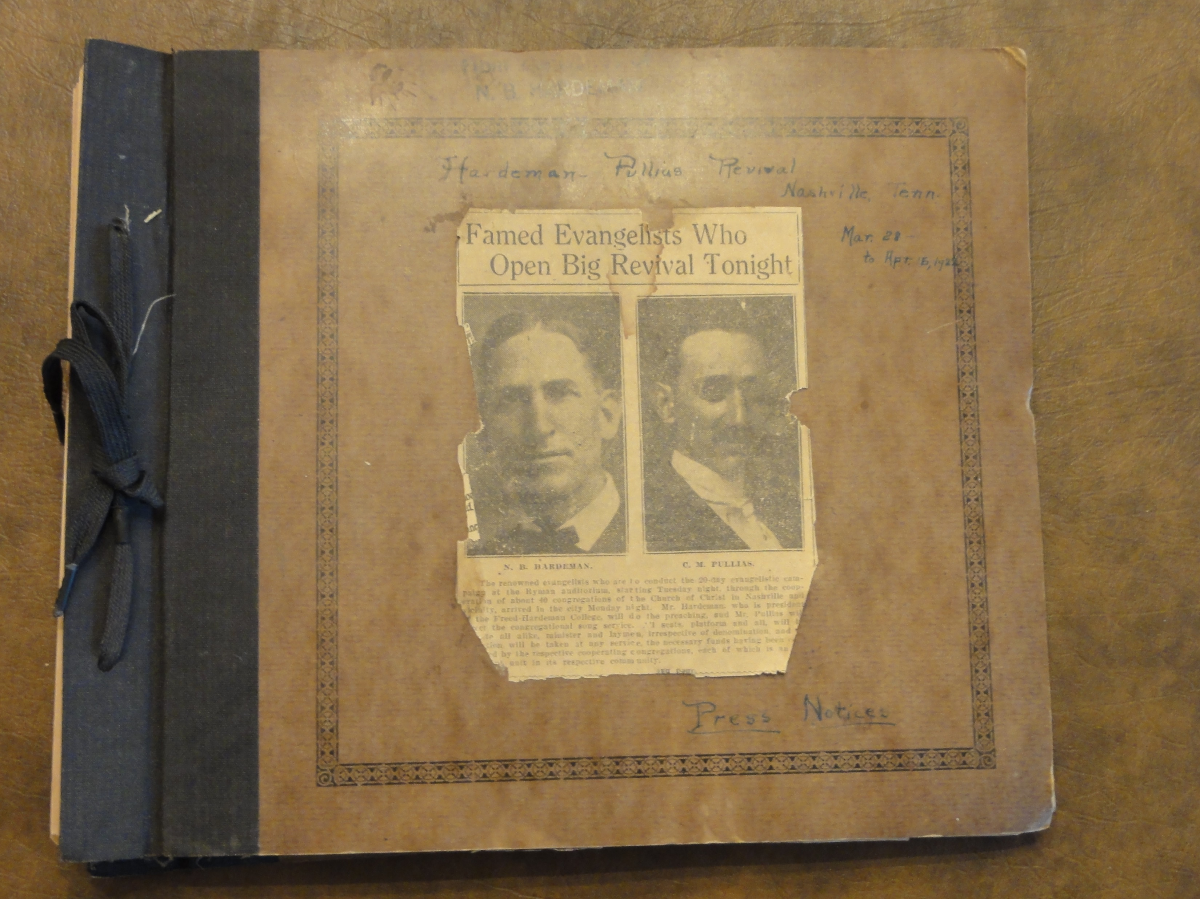
Hardeman Tabernacle Meeting Ryman Auditorium, March 28-April 16, 1922

Slide 7
Central Church Of Christ Nashville, Tennessee

Slide 8
A.M. Burton (1879-1966) Gospel Advocate, 10.18.1929, p985,988

Slide 9
Hall L. Calhoun 1928-1935 with Central

Slide 10
Hall L. Calhoun 1928-1935 with Central

Slide 11
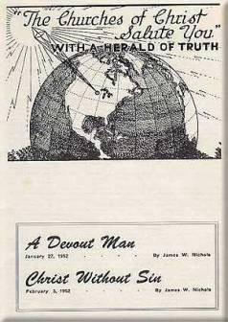
Herald Of Truth 1951

Slide 12
Herald Of Truth 1951
Olan Hicks
E. Claude Gardner
H.A. Dixon
Frank Van Dyke

