Slide 1
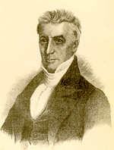
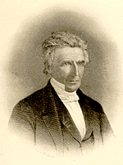
The Influence Of Alexander Campbell In Alabama
Evangelist In Alabama
1839
1857
1859
1839, Age 51
1853, Age 65

Slide 2
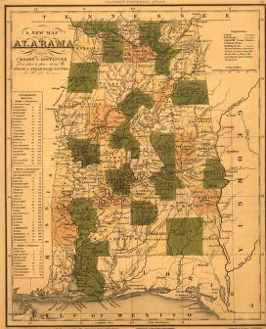
Early Preachers In South Alabama Influenced By Alexander Campbell
James A. Butler, Carlowsville, Wilcox Cty.
Dr. David Adams, Pine Apple, Wilcox Cty.
A.B. Walthall, Marion, Perry County
W.H. Goodloe, Mt. Hebron, Green Cty.
Alfred Berry, Selma, Alabama
Jabez Curry, Oak Grove
Arnold Jolly, Mt. Hebron, Green Cty.
William Payne, Sandy Ridge, Lowndes Cty.
P.F. Strother, Clinton, Green Cty.
W. H. Hooker,
P.B. Lawson, Marion, Alabama
W.C. Kirkpatrick, Fair Prospect, Montgomery Cty.
J.M. Barnes, Montgomery, Highland Home, Strata, Montgomery Cty.

Slide 3
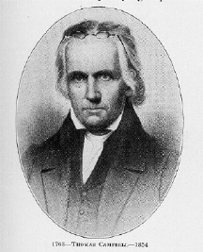
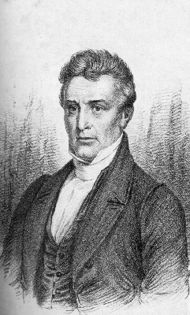
Early Life Of Alexander Campbell
Alexander Campbell Born In Ballymena, County Antrim, Ireland, September 12, 1788
His father, Thomas Campbell (1763-1854) arrived in the U.S. two years prior to his son, May, 1807
During the two years both father and son came to the point of recognition that Presbyterianism was foreign to the Ancient Order of Things

Slide 4
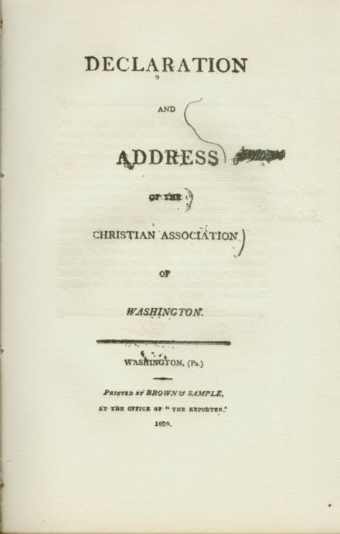
Early Life Of Alexander Campbell
Summer, 1809, Thomas Campbell pens the words of the Declaration & Address
October, 1809 Alexander Reaches Washington, Pennsylvania
1810, July 15, A.C. preaches his first sermon on Matt. 7:24-27

Slide 5
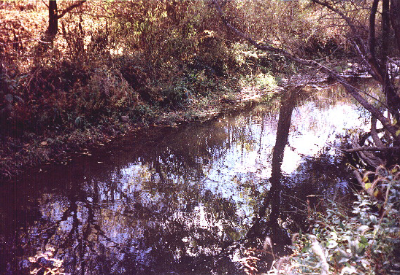
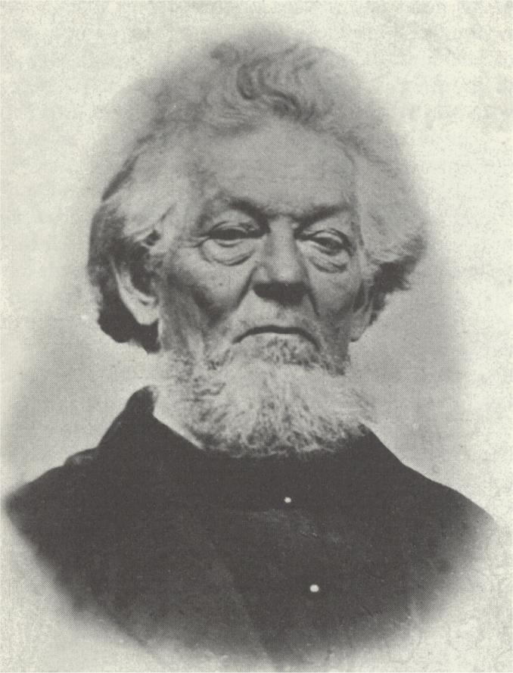
Early Life Of Alexander Campbell
June 12, 1812 Immersed By Elder Matthias Luce, Of The Baptist Church, On The Confession Of Faith In Christ As The Son Of God, in Buffalo Creek
By Mid-1812, Thomas Campbell, Concedes To Alexander The Leadership Of The Movement At Age 24
Admitted To Redstone Baptist Association
Matthias Luce

Slide 6
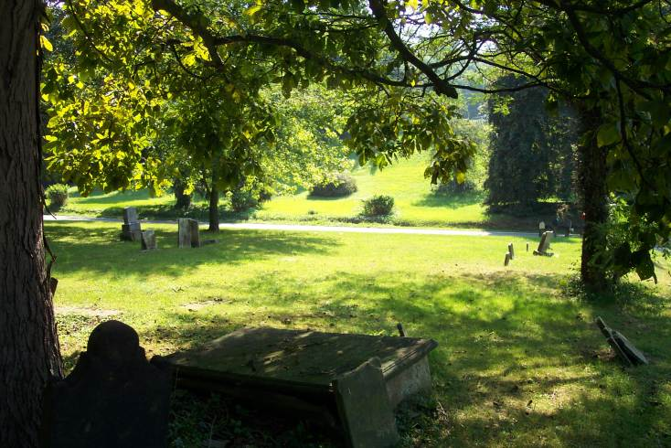
Sermon On The Law
1816 – Brush Run Church Was A Part Of The Redstone Association
August 30, 1816 – Meeting of the annual gathering of the Redstone Association @ Cross Creek Baptist, north of Wellsburg, W.Va.
Showed Difference Between The Old Law Of Moses & The New Law

Slide 7
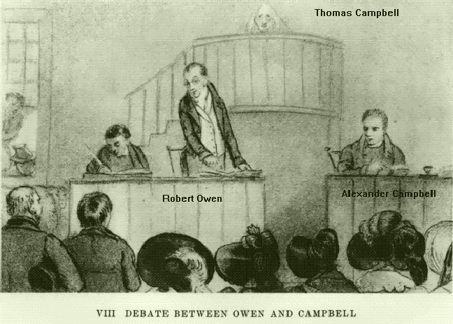
The Influence Of His Debates
1823 Campbell/McCalla Debate, Washington, Kentucky, on Baptism
1829 Campbell/Owen Debate, Cincinnati, Ohio, on the Existence Of God
1843 Campbell-Rice Debate, In Lexington, Ky, On Baptism, 16 Day Debate

Slide 8
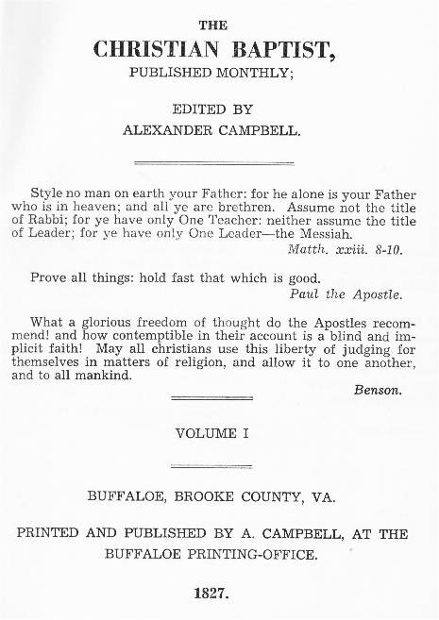
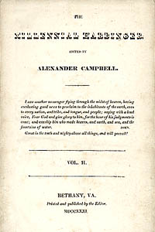
The Influence Of His Journals
1823-1830 – The Christian Baptist
1830-1870 – The Millennial Harbinger

Slide 9
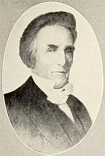
Early Contact
With Alabama
Periodical - Christian Baptist – CB Vol. 5, #8, March 3, 1828 – p. 200, New Agent for Alabama, Elder John Favor, Limestone Cty.; Vol. 12 #6, July 6, 1829, purchases of back issues of CB by Bishop John Favor
1829, CB Vol. 7 #2, Sept. 7, 1829, p. 52 – Under “New Agents,” Jonathan Wingate, Bellville, Alabama
1830, Age 42

Slide 10
January 4th, 1830 Begins The Millennial Harbinger
It is not until 1830 that A.C. parts with the Baptists and closes the Christian Baptist with the Vol 7, #12, July 5, 1830 Issue

Slide 11
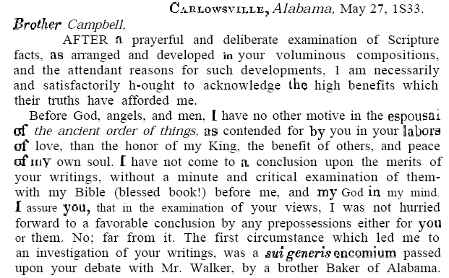
Early Contact With Alabama
James A. Butler
  Baptist who learned the way of truth through teaching in the Millennial Harbinger

Slide 15
Other Reports Sent In By J.A.Butler
1834 – MH p. 519, from Williamson, Lowndes County, Aug. 14th, Concerning further confrontations among the Baptists
1834, July 31st, MH p. 521, from Carlowsville, AL, discussing “regeneration.” Also, Sept 27th reporting the conversion of two men. Another letter on Sept. 28th, again reporting on baptisms and sharing his understandings on worship issues; Another Bible questions is answered on page 547 of the Nov. 1834 issue.
1835, p14, Under the title, “Progress of Reform” Butler reported the Baptism of a Methodist Minister

Slide 16
1835, p. 18, Under the title, “Reformation Periodicals” it was announced that a new publication in Alabama was being produced by James A. Butler, and a Brother A. Graham, under the title of “The Disciple.”

Slide 17
1836, MH, p. 161 – Update on “The Disciple.”

Slide 18
In the January issue of the MH, 1839, A.C. began a series under the title, “Incidents On A Tour To The South” Explaining His Purpose
Notes:
It is not until the January issue of the MH that A.C. announces his intentions of beginning a school. Jan., 1840, P.31, giving the idea that his tour to the south was not intended to raise money for the college.
He was still in support of Bacon College, Georgetown, KY which began in Nov. 1836.

Slide 19
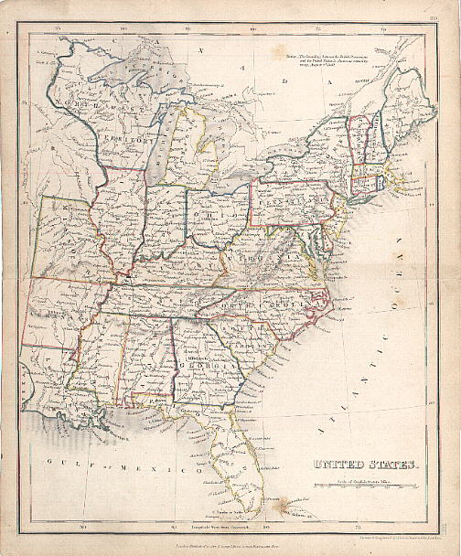
1st Tour Through The South, November, 1838- March, 1839
Six month tour including Virginia, the Carolinas, Georgia, Alabama, Louisiana, Mississippi & Kentucky – MH, 1839 p.312
Arrived in Bethany, March 28, 1840
Preached almost every day he was traveling either through public meetings or fireside discussions
6 Months, 5000 miles

Slide 20
1st Tour Through The South, November, 1838 - March, 1839
1.Baltimore, MD (E)
2.Washington, D.C.
3.Fredericksburg, VA
4.Richmond, VA
5.Charlottesville, VA
6.Petersburg, VA
7.Wilmington, NC
8.Charleston, SC
9.Blackville, SC
10.Augusta, GA (S)
11.Erwinton, SC
12.Savannah, GA
13.Augusta, GA
14.Erwinton, SC
15.Abbeville,SC
16.Greenville, SC
17.Anderson, SC
18.Evergreen, SC
19.Ruckersville, GA
20.Elberton, GA
21.Augusta, GA
22.Warrenton, GA
23.Montgomery, AL
24.Hayneville, AL
25.Mount Willis, AL
26.Mt. Pleasant, near Portland, AL
27.Carlowsville, AL
28.Mobile,AL
29.New Orleans, LA 30.St. Francisville, LA
31.Jackson, LA (MS)
32.Clinton,LA
33.Woodville,MS
34.Natchez, MS
35.Grand Gulf, MS
36.Port Gibson,MS
37.Vicksburg,MS
38.Louisville,KY
39.Shelbyville,KY
40.Frankfort,KY
41.Lexington,KY
42.Versailles,KY
43.Georgetown,KY
44.Mays Lick,KY
45.Maysville,KY
46.Wellsburg,VA
47.Bethany,VA

Slide 21
1st Tour Of Alabama, January, 1839 – Reported MH, May Issue, p.193

Slide 22
Summarizing Alabama
—Millennial Harbinger, 1839, page 195

Slide 23
Summarizing Alabama
Speaking of the lack for potential to grow spiritually in Alabama.
—Millennial Harbinger, 1839, page 196,197

Slide 24
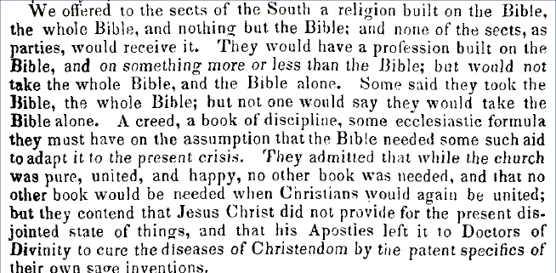
Struggles To Plant The Church In The South
—Millennial Harbinger, 1839, page 185

Slide 25
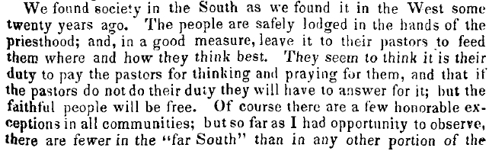
Closed Minded Religious Southerners
—Millennial Harbinger, 1839, page 185

Slide 26
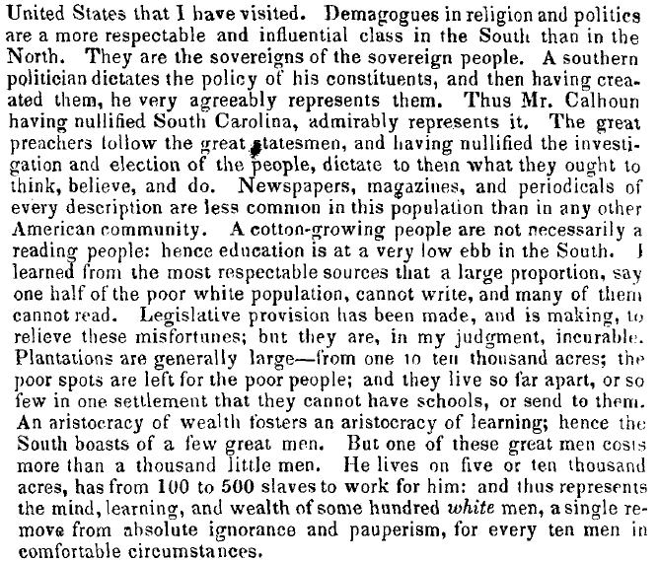
Economically Poor & Ignorant
—Millennial Harbinger, 1839, page 186

Slide 27
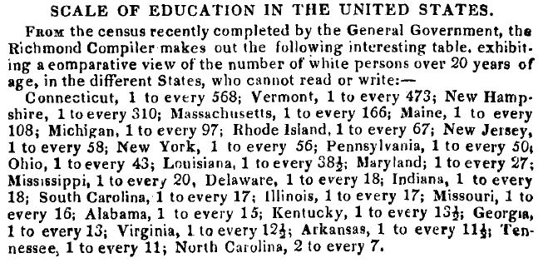
Report On Literacy In The US
—Millennial Harbinger, 1843, page 95

Slide 28
On The Control Of Political Leaders & Religious Leaders
—Millennial Harbinger, 1839, page 186

Slide 29
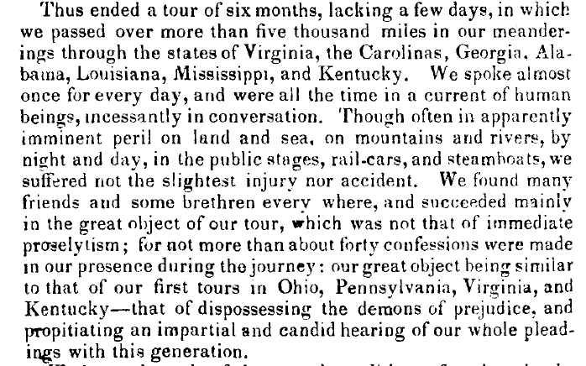
End Of The Tour Report In MH
—Millennial Harbinger, 1839, page 312

Slide 30
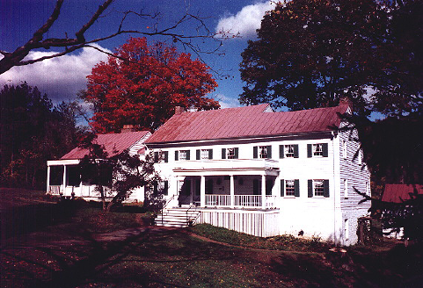
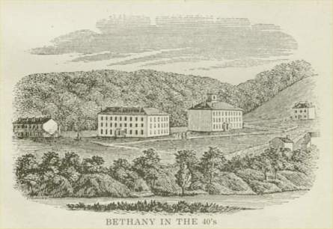
Bethany College
1818-1823 Buffalo Seminary Was Operated Out Of His Home
It was A.C.’s Dream To Open Another School
Bethany College Began In 1840
Before The Civil War: Six Graduates From Alabama
Only Two After The War in The 19th Century
43 Total Graduates From Alabama in the 166 years of its history
Second Edition Added For Seminary
Notes:
This Institution, in the number, respectability, and general moral standing of its students, is steadily advancing from year to year. The last session registers in the various departments some one hundred and twenty students. These are convened from Virginia, Kentucky, Tennessee, Alabama, Mississippi, Louisiana, Arkansas, South Carolina, Maryland, Missouri, Pennsylvania, Ohio, Indiana, and Illinois. —Millennial Harbinger, 1845, page 376
In a report July 4, 1846, under the title, Bethany College Report, signature included was that of T.L. Ricks, Alabama, —M.H. 1846, p.415
In 1847, MH, report on Examinations at Bethany College, in the Class of Logic, R.D. Boykin, Alabama, MH. P467
In 1854, MH, p. 655, reported that Bethany College had its largest graduating class from fifteen states, including Alabama.
In 1857, P.B. Lawson, Marion, Alabama, was appointed general agent for Bethany College in Alabama & Mississippi, MH, p.467
Contributions To The School
1850 MH, p. 107 – Under, “Liberal Donations To Bethany College” W.D. King of Alabama contributed $3000.00 for the rebuilding of the college, and an addition $1000.00 to the Bible Union. It was a cash donation.

Slide 31
Invitation For Second Trip - 1856
—Millennial Harbinger, 1856, Oct., p. 598,99

Slide 32
Second Tour 1857
February 26th – May 3rd covering 6000 miles
Purpose, MH, 1857 p.309 – two-fold: to plead the cause of original Christianity & the appeal for Bethany College
Traveled with son, Alexander
Notes:
Apr. 1 = Sailed To Mobile from New Orleans
Apr. 4 = Arrived At Selma, Alabama
Apr. 7 = Went To Marion, Alabama
While there visited with Jacob Creath, Jr., whose daughter was a member there.
Received $5000.00 from Robert T. Goree, of Marion, Alabama to Bethany College for $5000.00. On the trip A.C. raised at total of $10,000.00, MH, 1857 page 470
Apr. 12 = Greensburgh (Greensboro)
Apr. 14 = Mt. Hebron, Green County
Then To Clinton, AL & On To Columbus, Mississippi
Apr. 21 = Back To Marion
Apr. 22 = Montgomery
Train to Atlanta, then Augusta, then Richmond
May 3, 1857 – Arrived Home

Slide 33
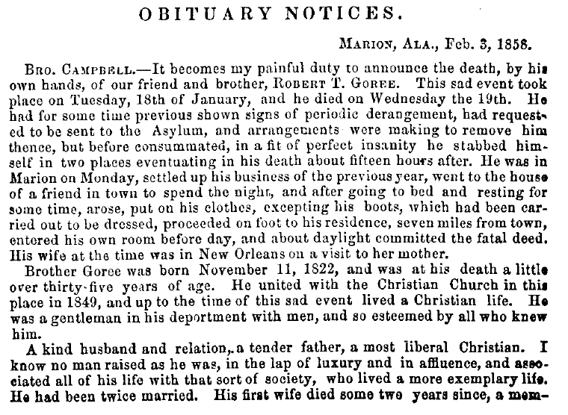
Sad Death Of Robert T. Goree
1858, MH, p.239,240

Slide 34
3rd Tour 1859
“Nothing but absolute necessity which seems to be laid upon me by the burning of our College Building, Libraries, Apparatus, &c., could at this season and at my time of life with the many pressing demands calling for my presence at home, to take the arduous labor which are thus placed before me. If I did not feel that it is the Lord’s work, and that he will be my helper, I would shrink from the task.” MH, 1858, p.47
Tour For Bethany College
March 14th-June 7th,1859

Slide 35
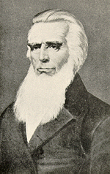
The Sage Of Bethany Goes Home
March 4, 1866
At 11:45 P.M
Campbell Finishes His Course
His Wife Comforted Him With "The Blessed Savior Will Go With You Through The Valley Of The Shadow Of Death." He replied: "That He Will! That He Will!" These Were His Last Words.

Slide 36
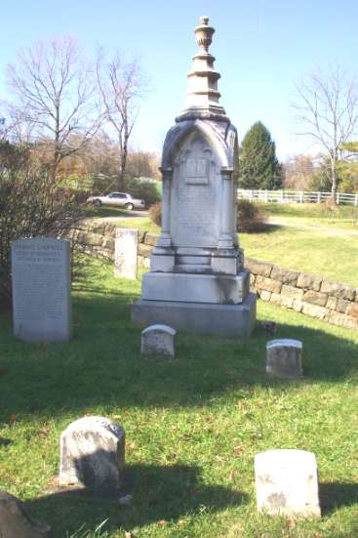
Buried Among His Parents,
Wives & Children
In Memoriam
Alexander Campbell
Defender Of The Faith
Once Delivered To The Saints
Founder Of
Bethany College
Who Being Dead Yet Speaketh By His Numerous
Writing And Holy Example
Born In County Of
Antrim, Ireland
Sept. 12, 1788
Died At Bethany, Va
March 4, 1866

Slide 37
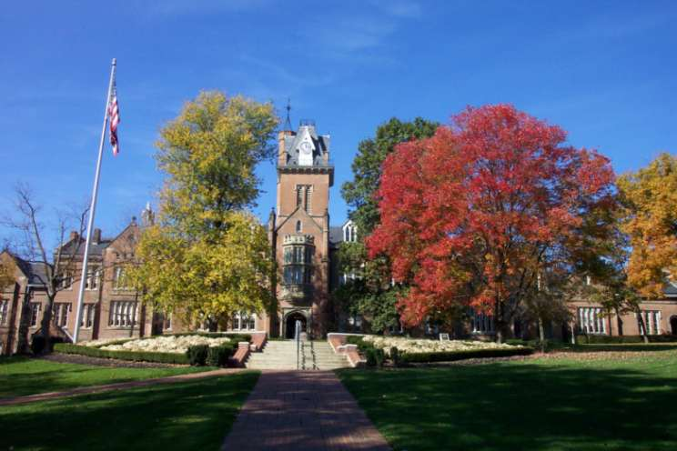
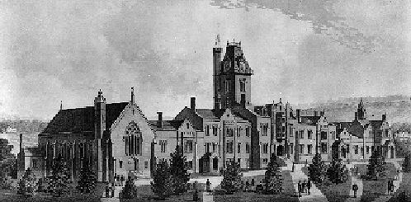
Bethany College

