Slide 1
God’s Family Through The Centuries
Daniel 2:44

Slide 2
Daniel 2:44,45
44“And in the days of these kings the God of heaven will set up a kingdom which shall never be destroyed; and the kingdom shall not be left to other people; it shall break in pieces and consume all these kingdoms, and it shall stand forever. 45“Inasmuch as you saw that the stone was cut out of the mountain without hands, and that it broke in pieces the iron, the bronze, the clay, the silver, and the gold—the great God has made known to the king what will come to pass after this. The dream is certain, and its interpretation is sure.” - Daniel 2:44,45 NKJV

Slide 3
Jesus Taught:
Mark 9:1 – Some Standing Here Will Not Taste Death Before The Kingdom Comes
Matthew 16:13-19 – “Upon This Rock I Will Build My Church . . . And I Will Give Unto You The Keys Of The Kingdom Of Heaven”

Slide 4
On That Day Of Pentecost
Prophecy Fulfilled
vv.16-21 – Joel 2 – God’s Great And Notable Day
vv. 25-28 – Psalm 16:8-11 – David’s Prophecy
Church Starts – v.38-40
Kingdom Rule Begins Thru Apostles’ Binding Authority, cf. v.42-47 with Matthew 16:18,19

Slide 5
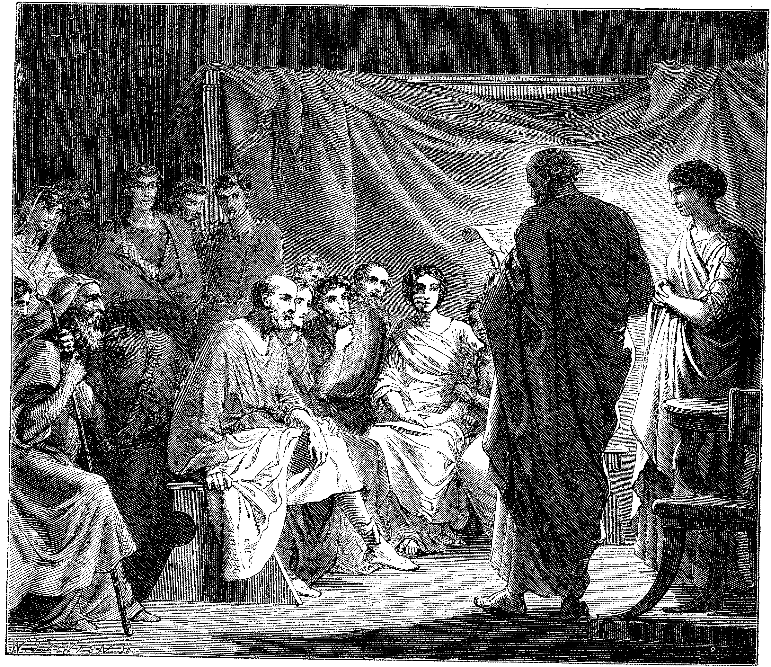
Problems In The Church Required Letters
1 & 2 Corinthians
Disunity Through Partyism
Taking Brothers To Law
Incest
Denial Of The Resurrection, etc.
Colossee – Mysticism, Gnosticism
Revelation – 7 Churches – All With Problems
Acts 20:28ff – Paul’s Warnings

Slide 6
The Johannes Gutenberg Printing Press - 1454
Arguably History’s Greatest Invention
Produced In Mainz, Germany
First Produced Book: The Bible

Slide 7
The Age Of Enlightenment & The Reformation
John Wycliffe – English Reformer (1329-1384)
Jan Hus – 1373-1415 — Prague, Czechoslovakia
Martin Luther – 1483-1546 - Germany
Girolamo Savonarola —1452-1498, Florence, Italy
William Tyndale — 1494-1536 English Reformer
Ulrich Zwingli – (1484-1531) — Geneva, Switzerland
John Calvin – 1509-1564 — Another Swiss Reformer

Slide 8
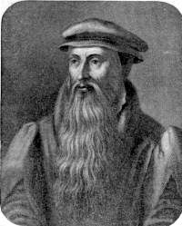
John Knox 1505-1572
George Wishart 1513-1546

Slide 9
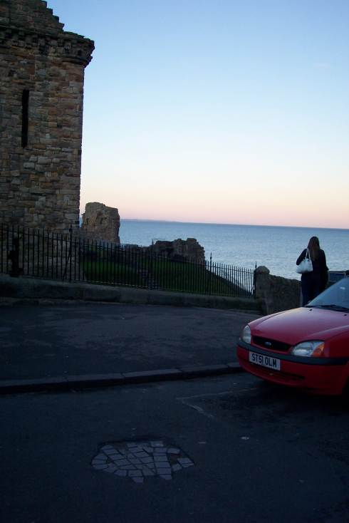
Death of George Wishart
Burned At This Place By Cardinal Beaton March 1, 1546

Slide 10
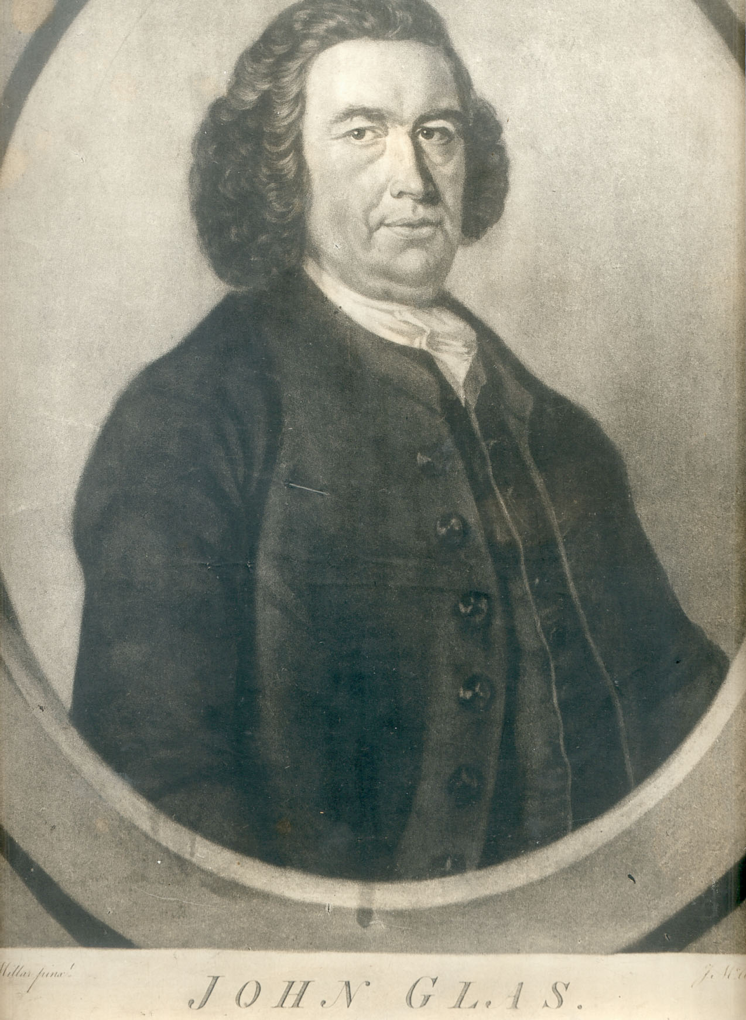
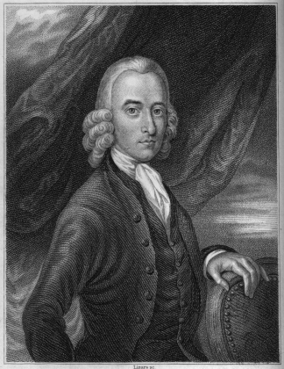
John Glas 1695-1773
Fathers Of Congregationalism
Robert Sandeman 1718-1771

Slide 11
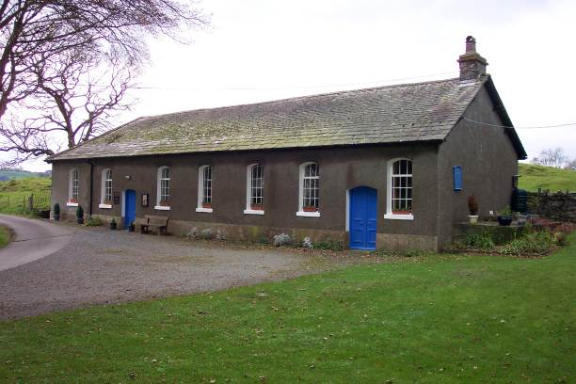
Tottlebank Church
A Church of Christ
-Early As 1669

Slide 12
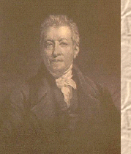
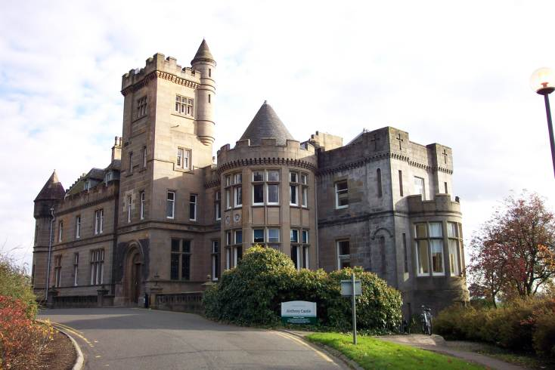
Robert & James Haldane
Baptist Ministers Who Brought About Reform In The British Isles
James Haldane 1768-1851

Slide 13
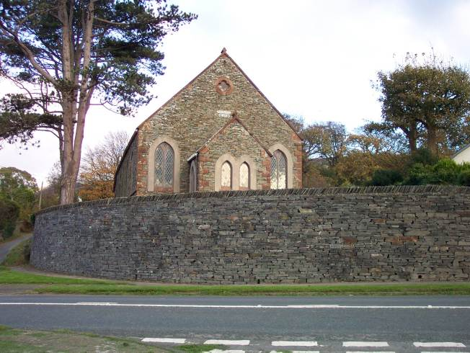
Kirkby Church of Christ
By 1824 a church after the ancient order was serving the Lord at Kirkby.
It was 30 years before any hear of Barton W. Stone or Alexander Campbell

Slide 14
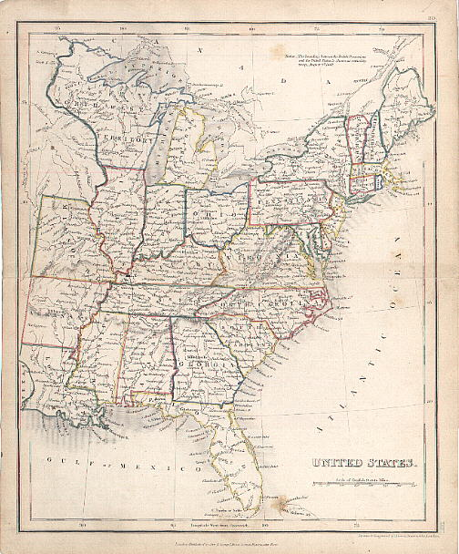
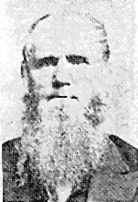
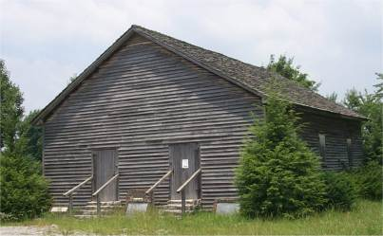
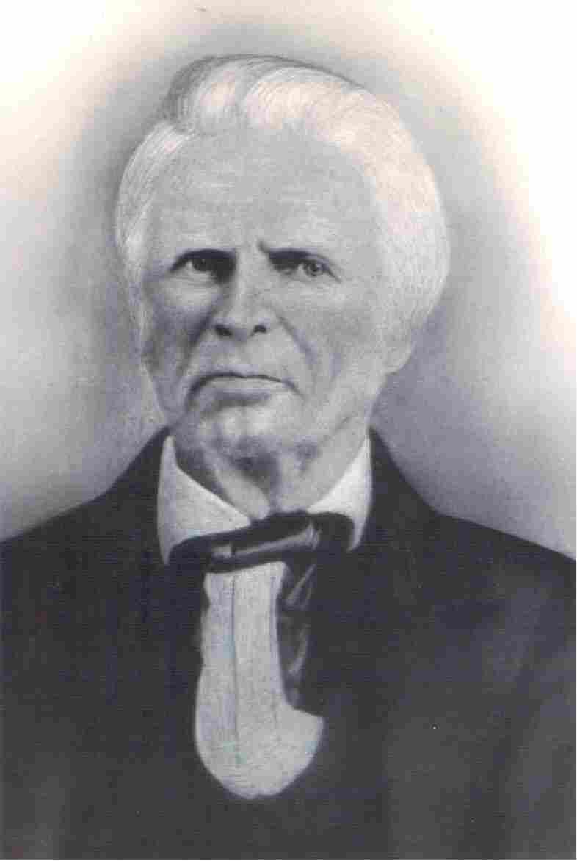
Movements Independent Of Stone & Campbell Part II
Old Philadelphia
Warren Cty. TN
Dr. Chester Bullard
1809-1893
1805
John Taylor
Christian H. Dasher
1807-1895
1789-1866

Slide 15
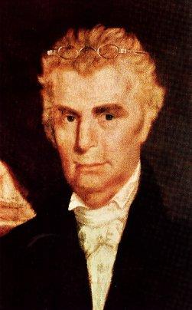
The Work And Influence Of Barton W. Stone

Slide 16
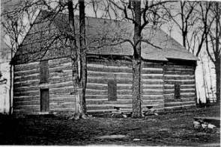
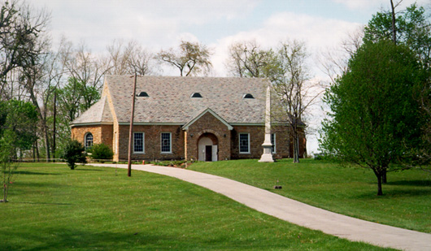
Cane Ridge Revival August 14-19, 1801
Area Settled In The Mid 1700s By Daniel Boone And Group From North Carolina
1791 – Built Largest One–Room Log Cabin In America
Between 15 & 25,000 People Gathered From All Denominations
Many Got Religion, Repented Of Sin And Confessed The Lord
Different Preachers Would Get Up On The Back Of Wagons And Speak To Groups In Their Area
People Left When Food Ran Out At The End Of Six Days

Slide 17
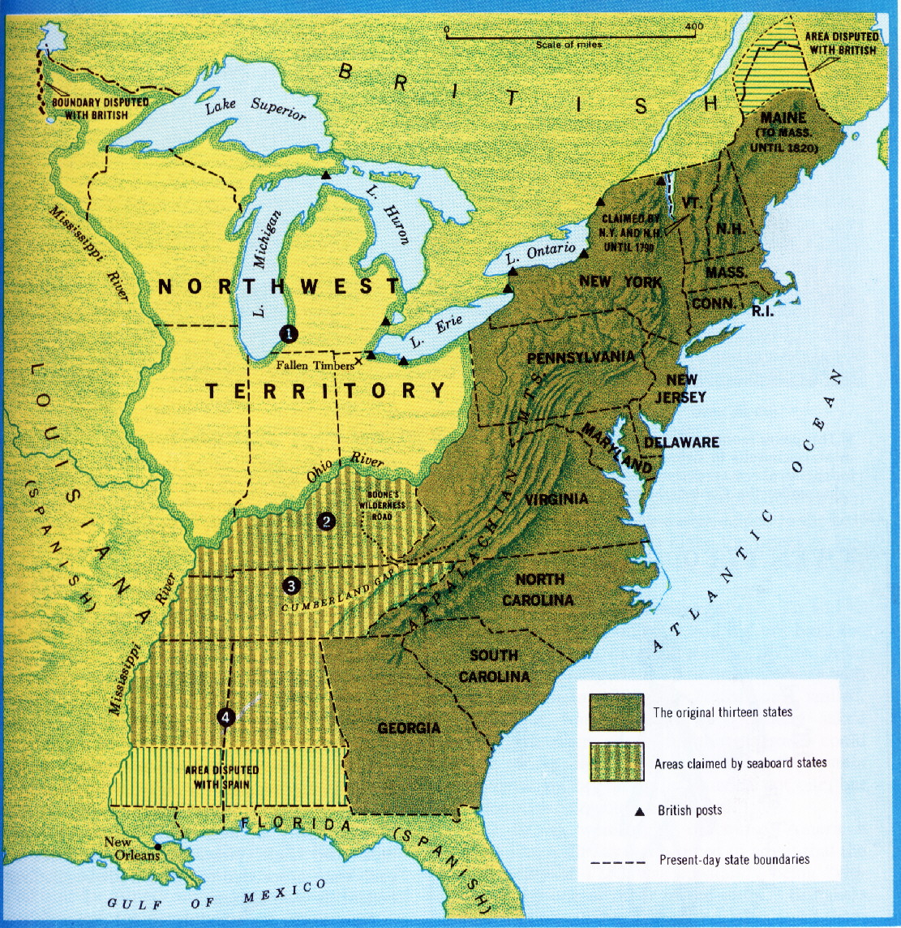
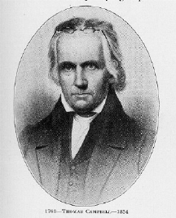
The Influence Of Thomas & Alexander Campbell
1809, Thomas & Alexander Campbell, Bethany, Virginia
Thomas Campbell 1763 - 1854

Slide 18
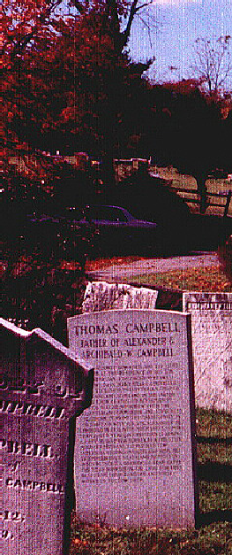
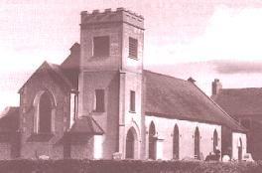
Thomas Campbell 1763 - 1854
The Presbyterian Church in Ahorey, Northern Ireland where Thomas Campbell preached before moving to the United States. The bell tower is not original.
Thomas Campbell born February 1, 1763 in Newry, County Down, Ireland. Arrived here May 13, 1807. A Presbyterian preacher who through study of the Bible saw the need to preach it and live wholly under its authority. Now buried at God’s Acre, Bethany, West Virginia next to his son, Alexander.

Slide 19
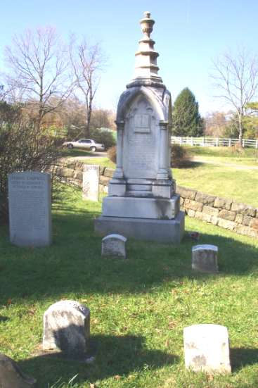
Alexander Campbell 1788-1866

Slide 20
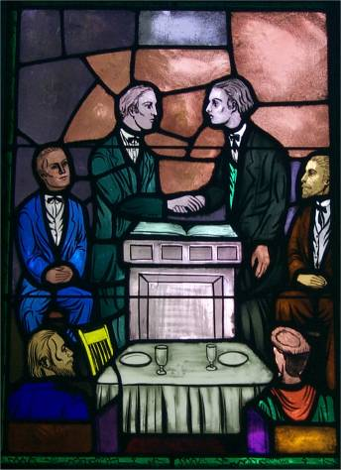
1831 Union Of The Reformers (Disciples of Christ) and Christians Under The Leadership of Barton W. Stone in Kentucky. This United Body Had 10,000 Members In The State.
Hill Street Church Lexington, KY

Slide 21
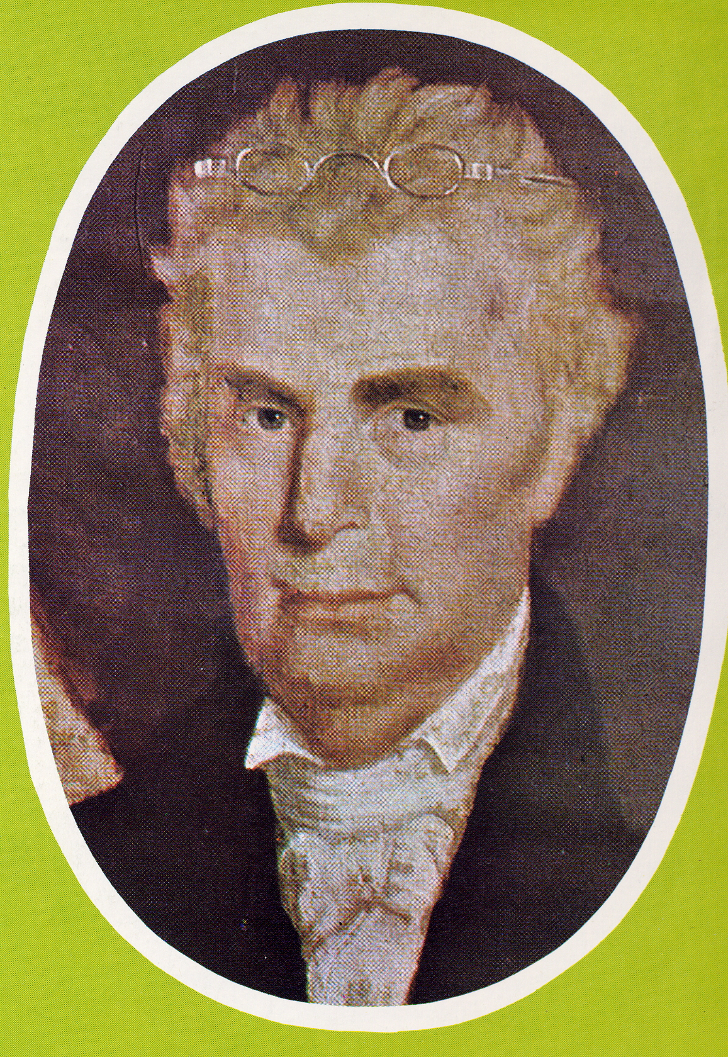
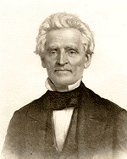
Coming Together Of A Movement
Meeting Of Stone’s Christians & Campbell’s Disciples At Hill Street Church In Lexington, Last Week In 1831
January 1, 1832 Joined Forces With A. Campbell’s Disciples Movement
“Let us, then my brethren, be no longer Campbellites or Stoneites, New Lights or Old Lights, or any other kind of lights, but let us come to the Bible, and to the Bible alone, as the only book in the world that can give us all the light we need.” — John Smith
Hill Street Church, Lexington, Kentucky
“Raccoon” John Smith

Slide 22
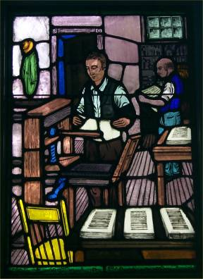
The Printing Press Contributed To Union
B.W. Stone’s 1826 Christian Messenger A. Campbell’s 1830 Millennial Harbinger Distributed The Message Of Union Among Christians, Later Others Like 1884 Firm Foundation & 1855 Gospel Advocate Continued The Unity Call

Slide 23
Christian Education
1834 – Bacon College, Georgetown, Kentucky
1840 – Bethany College, Virginia
1843 – Franklin College, Tennessee
1869 Henderson, Tennessee, Henderson Male & Female Institute Begins, Root School Out Of Which Would Later Come Freed-Hardeman University
1891 – Nashville Bible School Begins, Later Lipscomb University

Slide 24
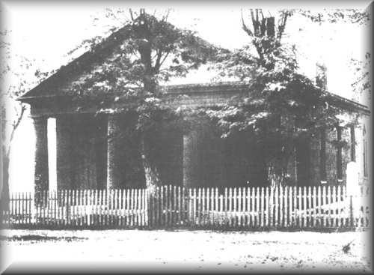
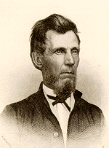
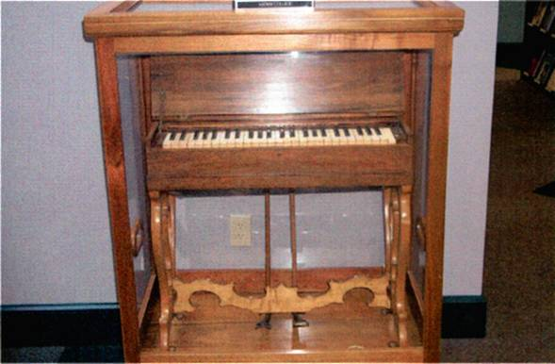
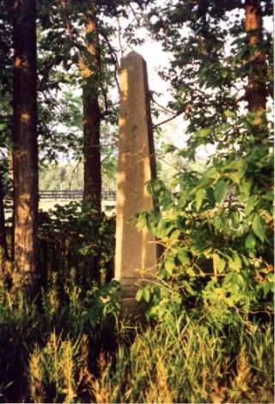
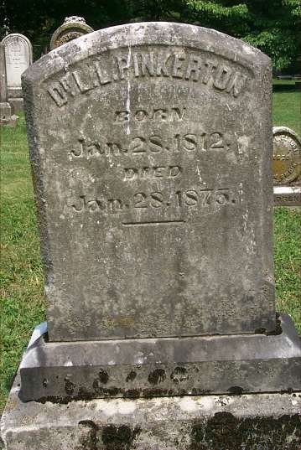
1860 — The Incident At Midway, Kentucky
Adam Hibler Grave
L.L. Pinkerton Grave

Slide 25
Other Things Contributing To Division
American Christian Missionary Society – 1849
The Civil War – 1861-1865
1866 Christian Standard Begins With Isaac Errett As Editor – Devoted To A More Progressive Approach To Christianity

Slide 26
Splintering Continues In The 20th Century
March, 1917 Major Controversy In The College Of The Bible Exists Over The Subject Of Higher Criticism, Leading To A Major Split Among Christians, Enter: The Disciples Of Christ
1920s Controversies With R.H. Boll Over Premillennialism
1930s & 40s Relative Quietness Due To Economic Depression & War
1950s To 1970s Battles Over Support Of Institutions/Sunday School/Located Preachers/Christian Colleges/etc.
1980 To Today – The Change Movement – New Hermeneutics/Worship Styles etc.

