Slide 1
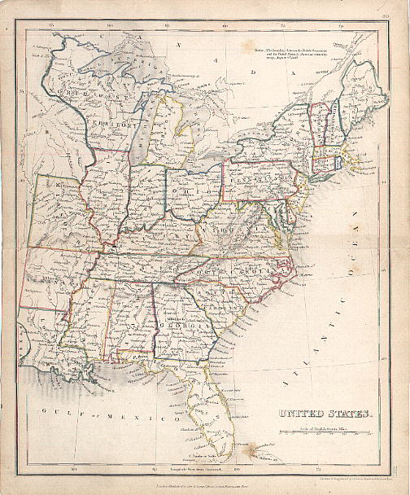
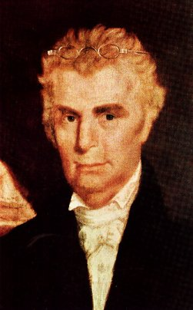
The Work And Influence Of Barton W. Stone In Kentucky

Slide 2
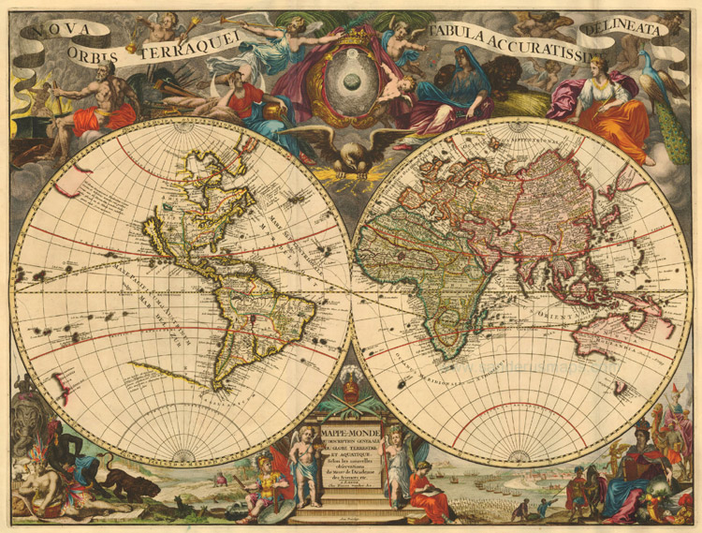
Going To The Americas

Slide 3
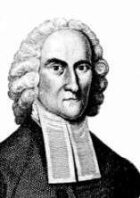
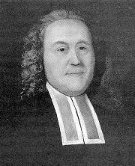
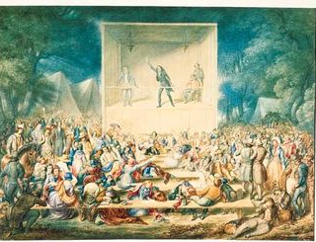
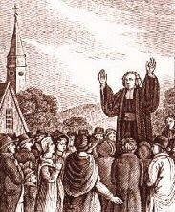
1st Religious Awakening In America - 1740s
Jonathan Edwards
Gilbert Tennent
George Whitefield

Slide 4
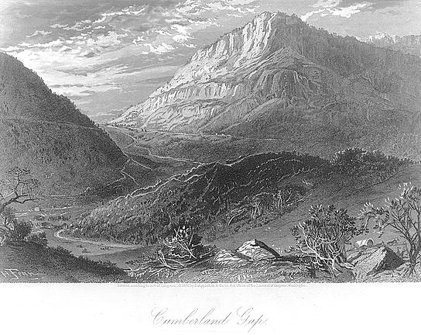
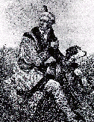
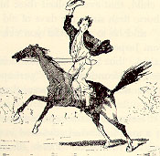
Early 19th Century America

Slide 5
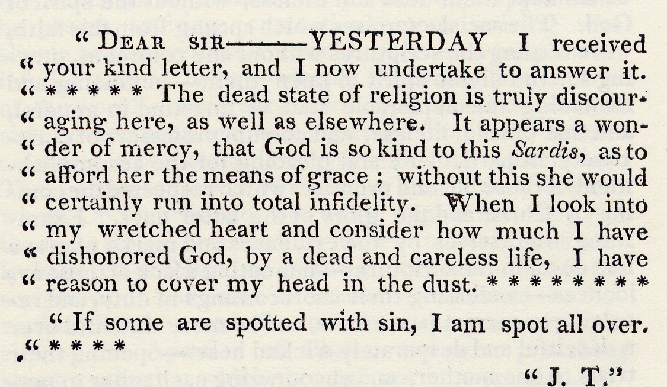
Background To The Kentucky Revival
“The Kentucky Revival” Richard McNemar, Chapter 1

Slide 6
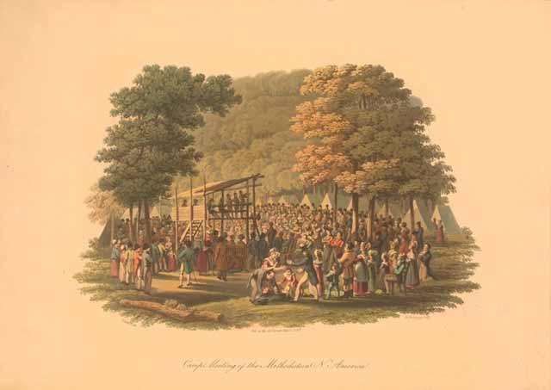
Getting Religion: Calvinism’s Influence On Late 18th & Early 19th Century Religion

Slide 7
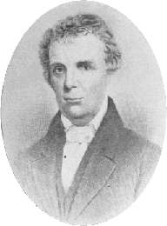
Barton
Warren
Stone
Born In 1772 – Port Tobacco, Maryland
    Father Died When He Was Young
    Moved South During His Youth
    During Revolutionary War, He Lived In Alamance County, North Carolina When Cornwallis Met General Green At The Battle Of Guilford Courthouse, Though 30 Miles Away Could Hear The Sounds Of Artillery Causing Great Fear
    At The Age Of 15 or 16 He Decided He Wanted To Be Educated To Become An Attorney
Feb 1, 1790, Age 18, Attends Doctor David Caldwell’s Guilford Academy

Slide 8
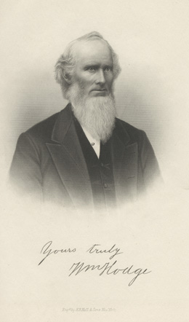
Barton
Warren
Stone
The Young Student Gets Religion Under The Preaching Of William Hodge
William Hodge

Slide 9
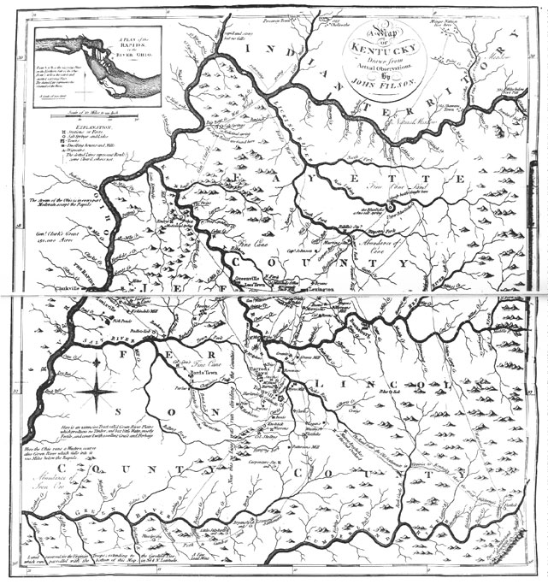
Barton
Warren
Stone
Stone Goes West To Kentucky

Slide 10
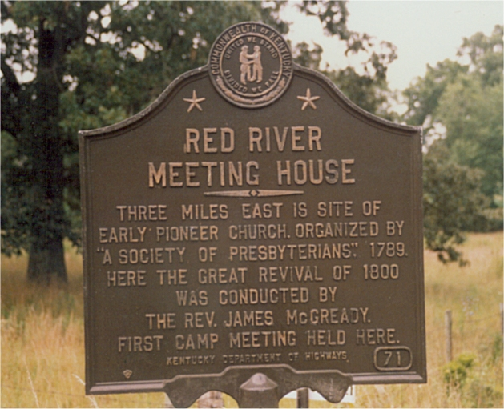
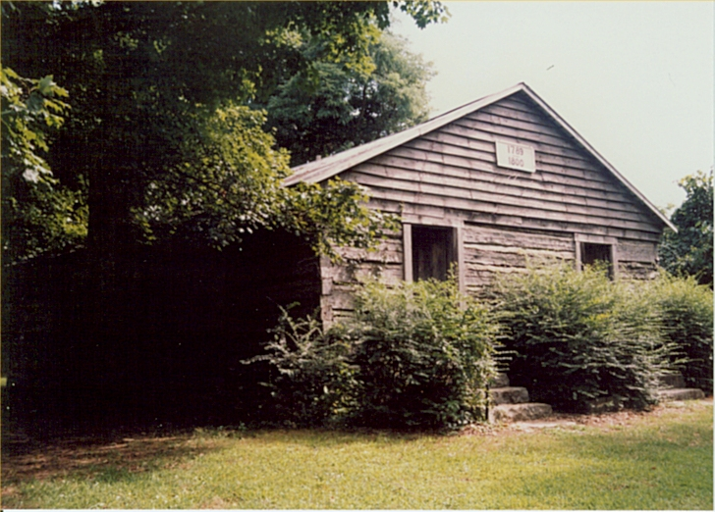
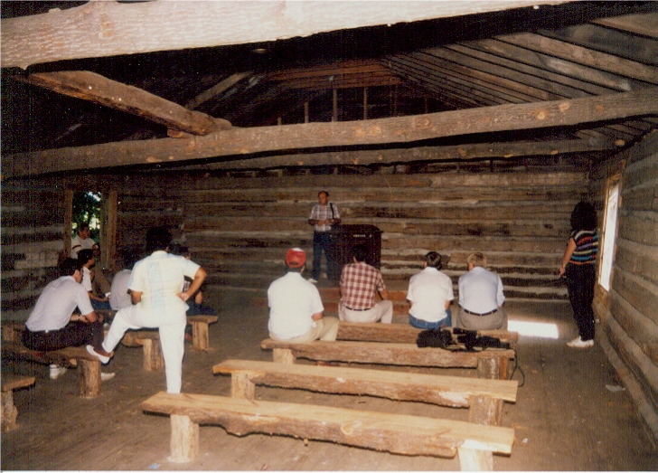
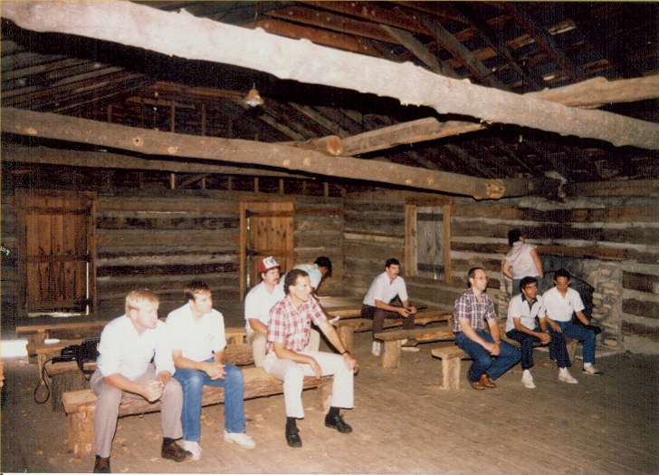
Red River Meetinghouse
Logan County, Kentucky
Birthplace Of The Kentucky Revival

Slide 11
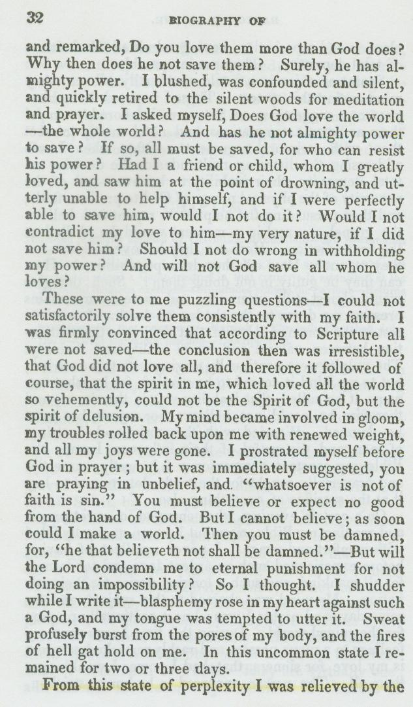
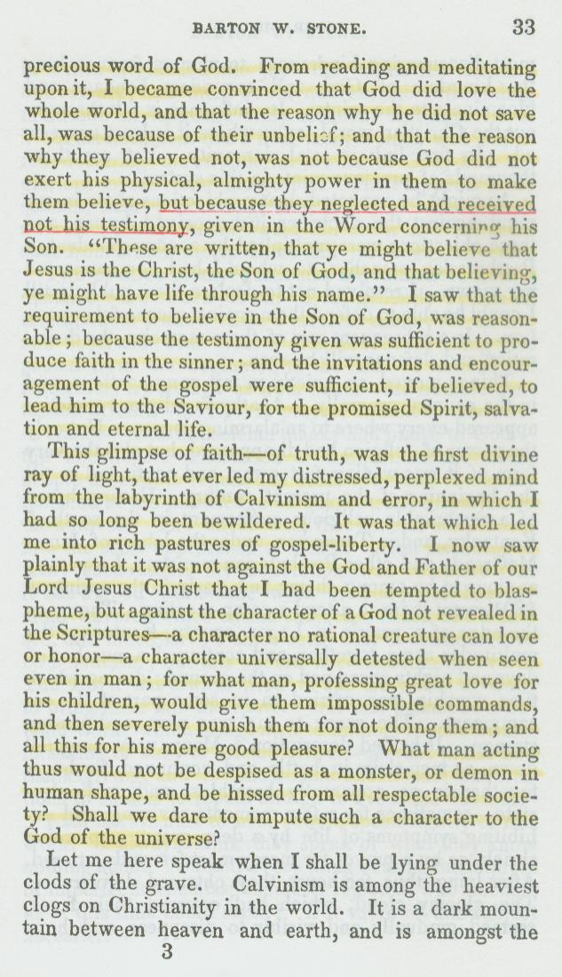
B.W. Stone Battle With Calvinism
Continued On Next Slide

Slide 12

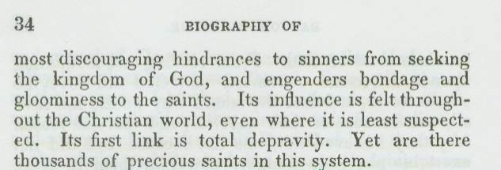
B.W. Stone Battle With Calvinism

Slide 13
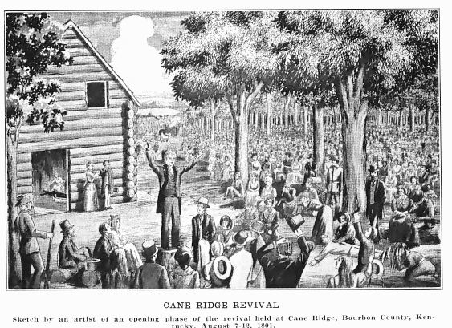
The Cane Ridge Revival
k

Slide 14
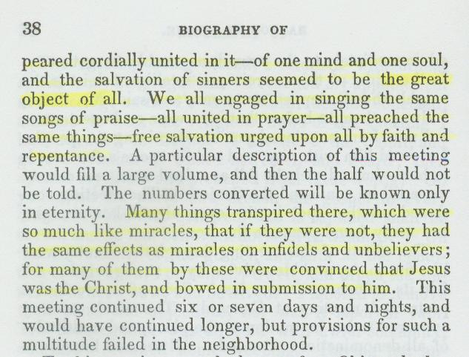
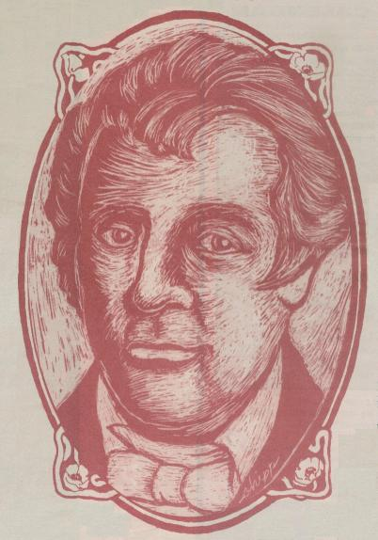
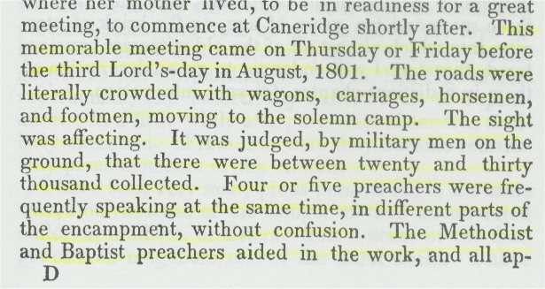
The Focus Of The Revival
Some Falsely Claim That The Focus Of The Cane Ridge Revival Was To Achieve A Religious Experience. See Stone’s Purpose In The Revival From His Autobiography

Slide 15
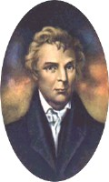
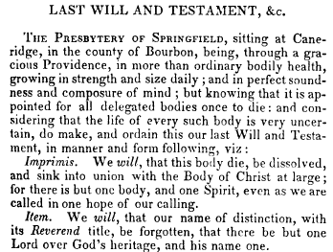
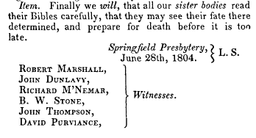
The Last Will & Testament Of The Springfield Presbytery

Slide 16
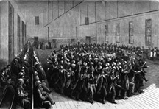
Growth Of A Movement
1805 Trouble With The Shakers Movement, McNemar & Dunlavy Defect
Thompson & Marshall Return To Presbyterianism
His 1st wife, Eliza Passes Away
Even With Setback, The Movement Grows Rapidly
The Shakers In Kentucky

Slide 17
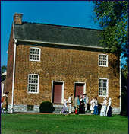
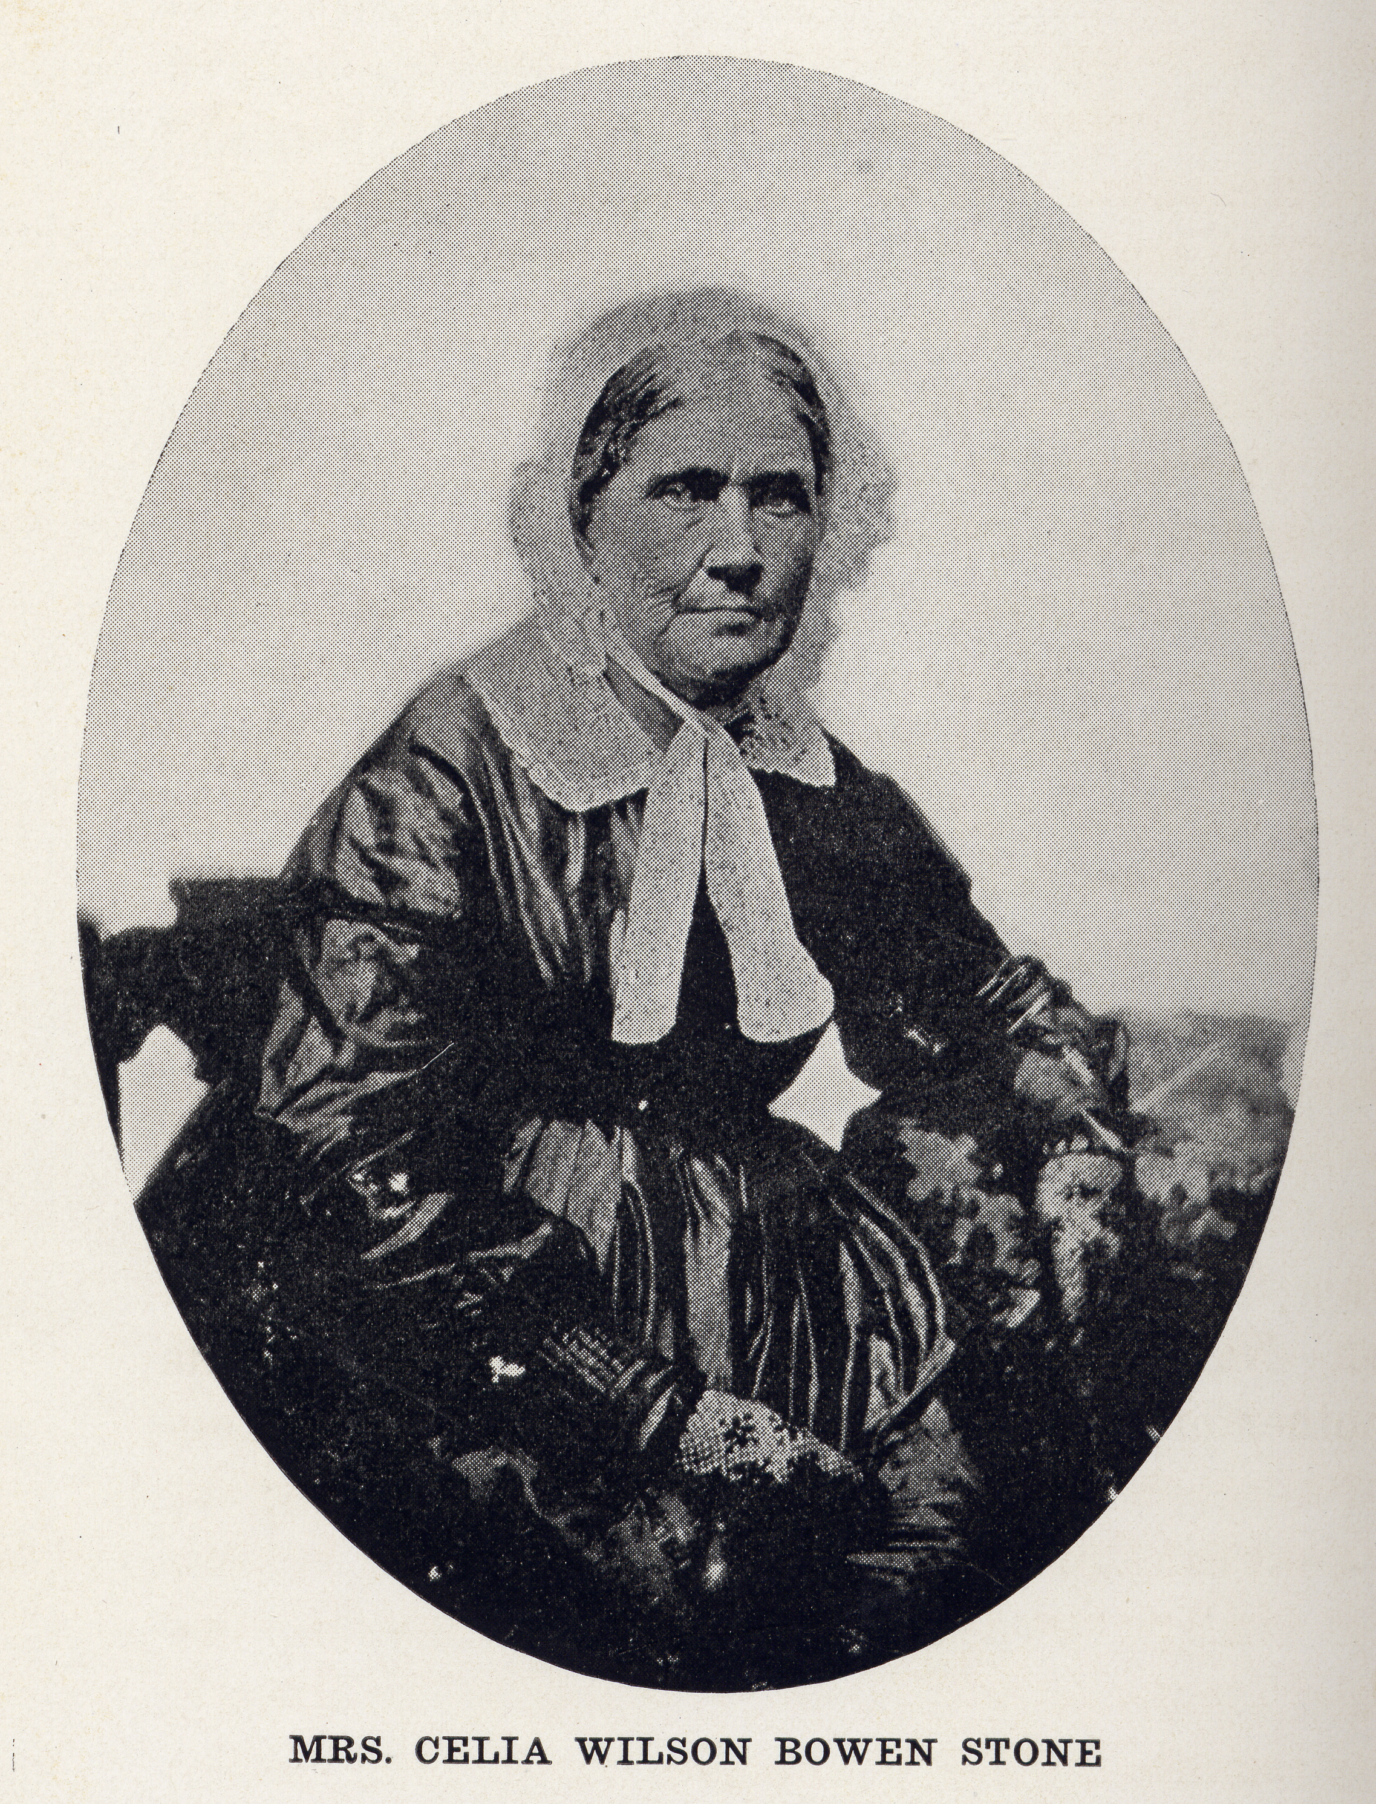
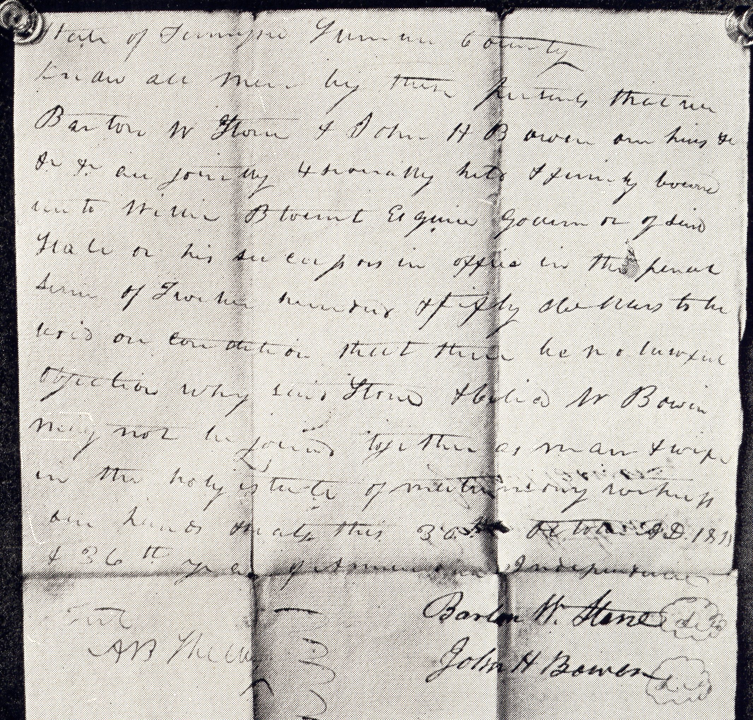
While At Gallatin, Tennessee
Married Celia Bowen October 31, 1811
Bowen Home
Mansker’s Station, Tennessee
Copy Of Marriage Bond, Gallatin, Tennessee

Slide 18
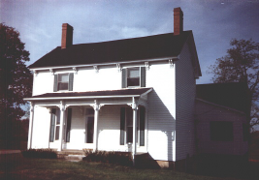
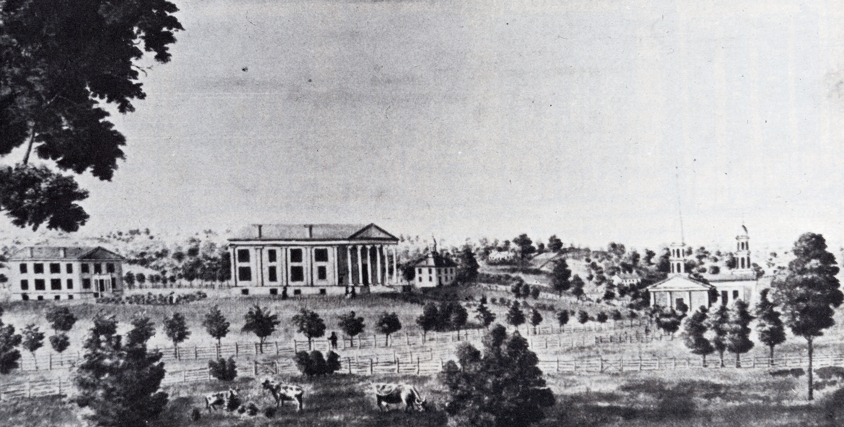
Stone At Rittenhouse Academy
1816 Stone Was Invited To Come And Be Headmaster
He continued until 1819
Note: In 1829 It Became Absorbed Into The Georgetown College (Baptist) – Continues To This Day
Stone Home In Georgetown

Slide 19
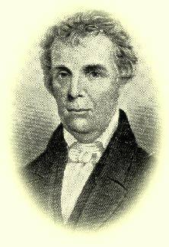
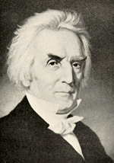
1824 — First Meeting Of Stone & Alexander Campbell

Slide 20
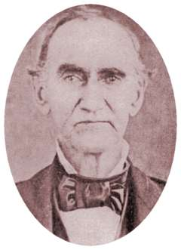
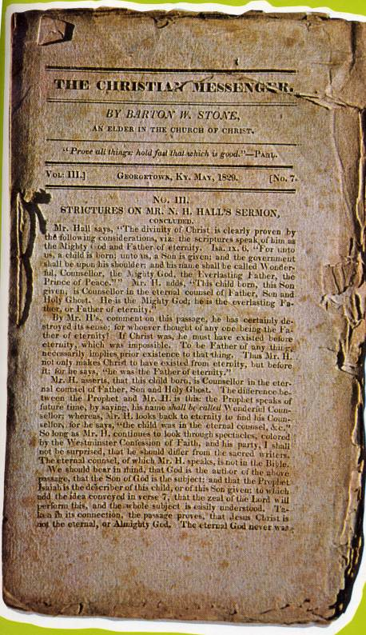
The Christian Messenger
The Christian Messenger Ran From 1826-1844
John T. Johnson Helped Produce It
Kept The Brotherhood Connected
John T. Johnson

Slide 21
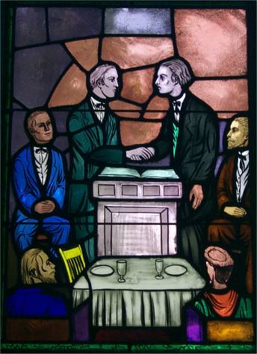
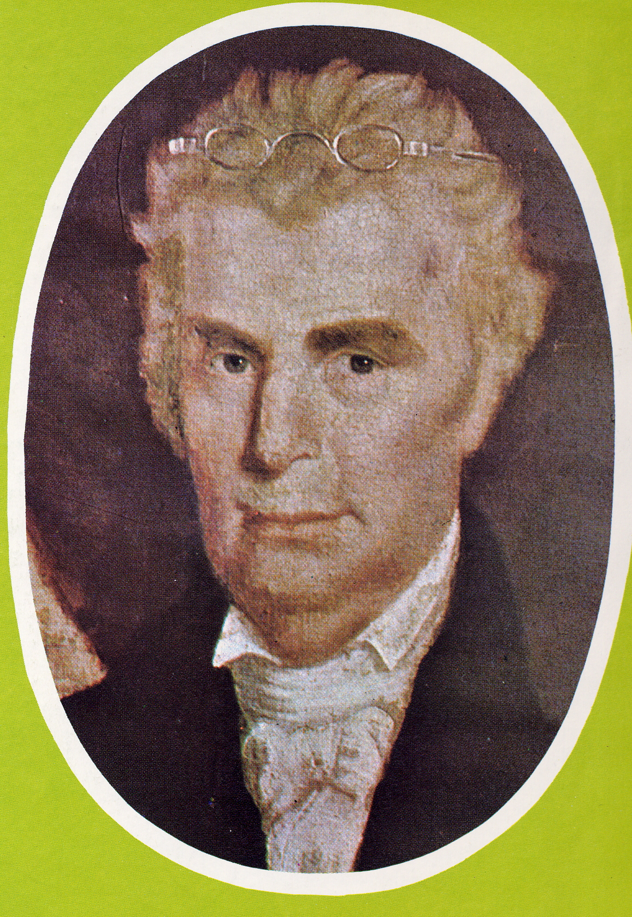
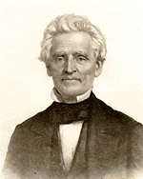
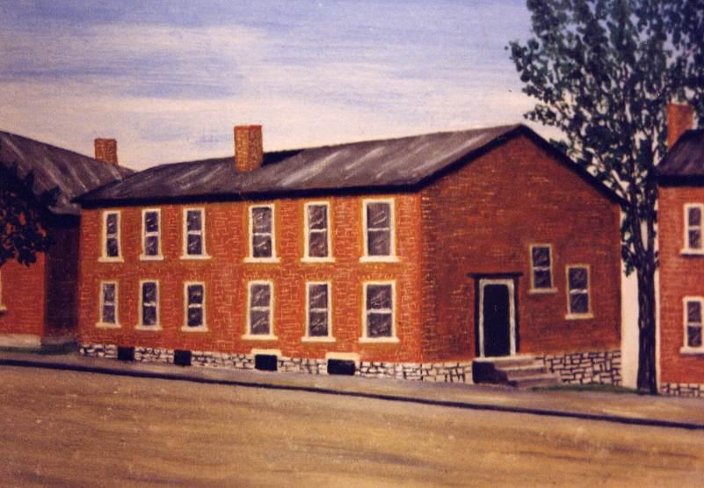
Coming Together Of A Movement
Meeting Of Stone’s Christians & Campbell’s Disciples At Hill Street Church In Lexington, Last Week In 1831
January 1, 1832 Joined Forces With A. Campbell’s Disciples Movement
“Let us, then my brethren, be no longer Campbellites or Stoneites, New Lights or Old Lights, or any other kind of lights, but let us come to the Bible, and to the Bible alone, as the only book in the world that can give us all the light we need.” — John Smith
Hill Street Church, Lexington, Kentucky
“Raccoon”
John Smith

Slide 22
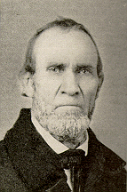
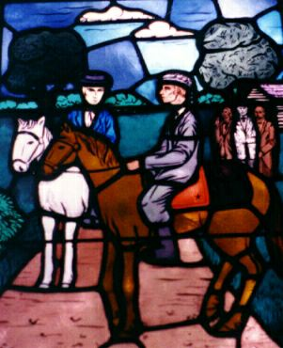
The Good New Spreads
John T. Johnson

Slide 23
Last Years Of The Life
Of B.W. Stone
Campbell Influence Overshadows Stone
1834 Stone Moves To Jacksonville, Illinois
1835 Hymn Book Is Produced
1841 Stone Suffers A Stroke But Improves
1843 Write His Autobiography

Slide 24
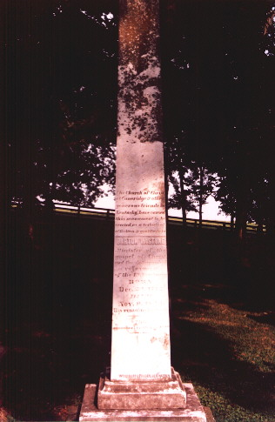
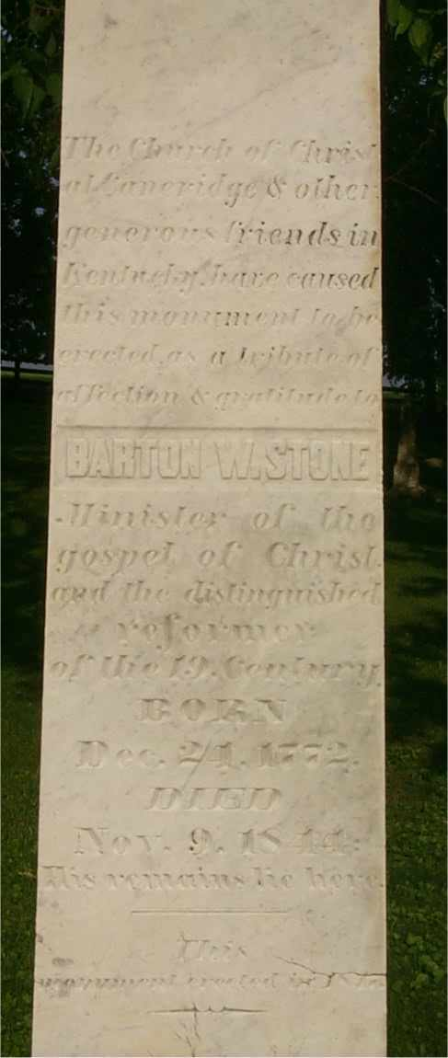
Cane Ridge Cemetery
The Church of Christ
at Caneridge & other
generous friends in Kentucky
have caused this monument
to be erected as a tribute of
affection & gratitude to
BARTON W. STONE
Minister of the gospel of
Christ and the distinguished
reformer of the 19 Century.
BORN Dec. 21, 1772
DIED Nov. 9, 1844
His remains lie here.
This monument was erected in 1847

Slide 25
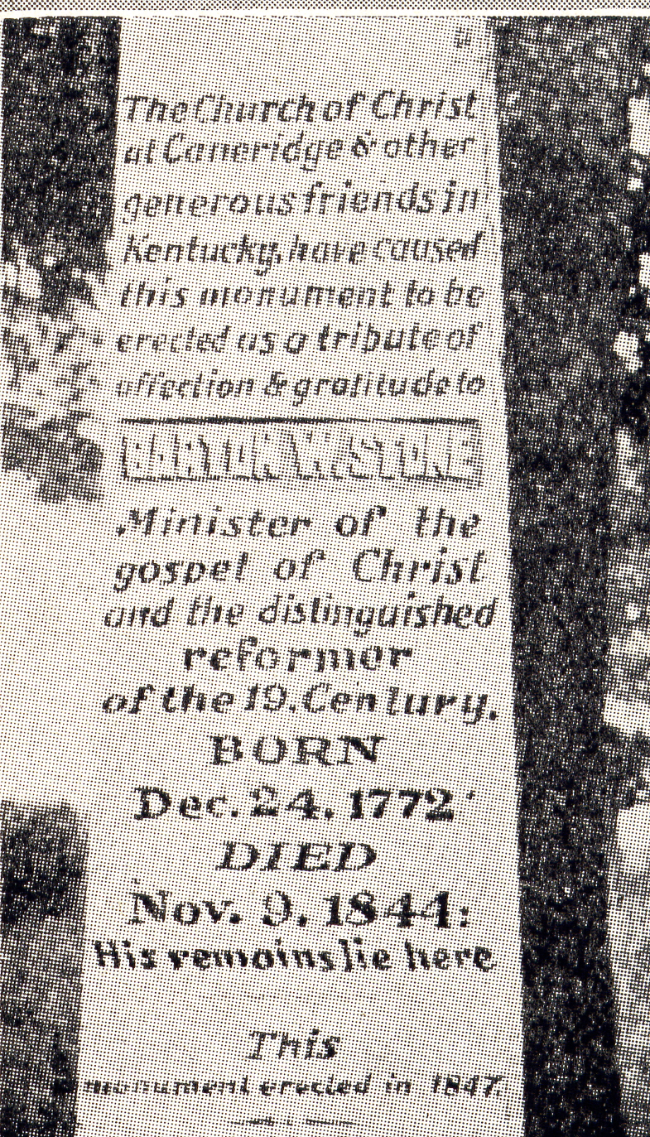
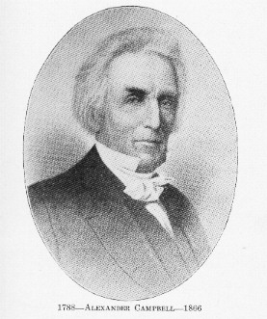
Campbell’s Visit
Campbell’s Reaction Upon His Visit To The Grave Of Barton W. Stone

Slide 26
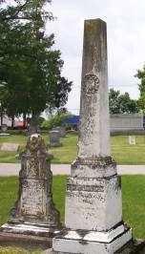



Bacon College 1836
Walter Scott
T.F. Johnson

Slide 27



Around Cane Ridge

Slide 28




Around Cane Ridge

Slide 29

Grave Of William Rogers
William Rogers
BORN IN
Campbell Co. VA
July 7, 1784. Removed With His Father To Caine Ridge Bourbon Co.
Apr, 1798
United With The
Church Of Christ
At Cane Ridge
In 1807
DIED Feb. 15, 1862.
In The 78 Year Of His Age.
He was the friend of God

