Slide 1
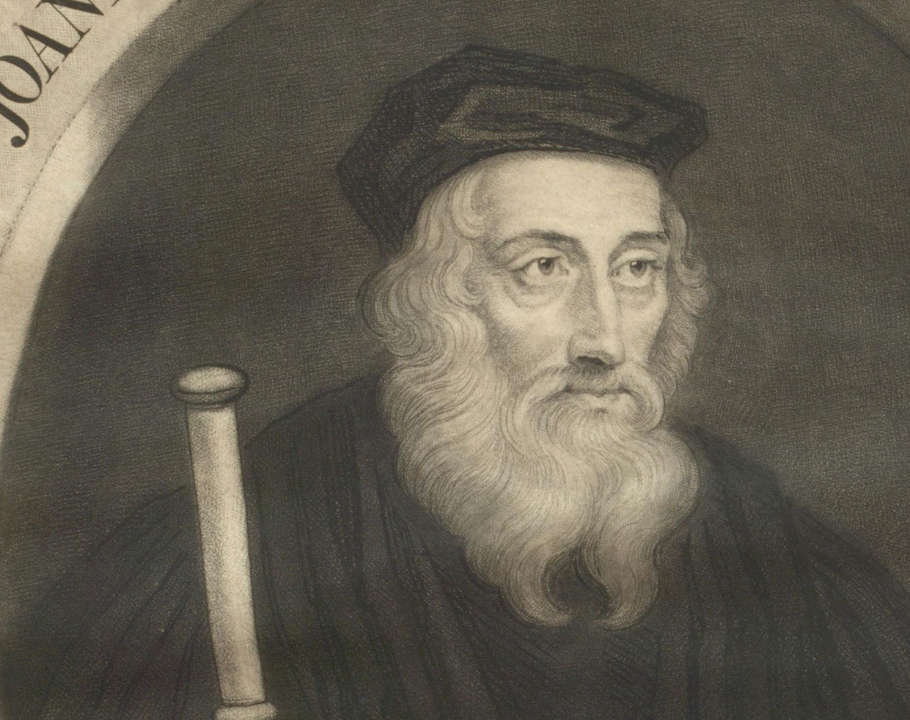
John Wycliffe
1328-1384
Morning Star Of The Reformation
Source: vision.org
Notes:
1320 – John Wycliffe was born village of Spreswell, modern Hipswell, a “good mile” south of Richmond in Yorkshire, England. (John Leland, historian who traveled during the time of Henry VIII, said he was born here in one place – in another he said that Wycliffe derived his origin from the village of Wycliffe, on the river Tees, about ten miles north of Richmond. 1324 is often given as the date of birth. Some say 1330 is his date of birth. Much is missing after the 1428 burning of most of his papers
1351 – Goes to Oxford to study (some say 1345)
1353 – His father dies, and John W. becomes Lord of the Manor
1360, 61 – Became a fellow in Merton College, and was listed as Master of Balliol College of Oxford University –
1361 – Wycliffe was appointed vicar/rector of the parish church of Fillingham, Lincolnshire, and later rector of Lutterworth. Receives his Masters of Arts degree / ordained for the See (Diocese) of Lincoln (area around Oxford)
1365 – Warden of New Canterbury Hall
1363 – Prebend of Aust (Prebend was paid preacher) (Aust village in Gloucestershire, England)
1367 – Deposed at Canterbury Hall by new Archbishop of Canterbury (Langham); appeal to Pope Urban V fails.
1367 – Rector of Ludgershall, Wiltshire, England
1369 – Receives Bachelor Of Divinity
1370 – 1st presentation of his doctrine on Eucharist.
1372 – Receives Doctor of Theology. Gets more involved in public life, enters service of the crown.

Slide 2
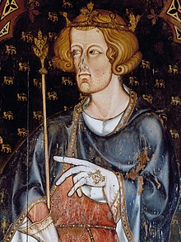
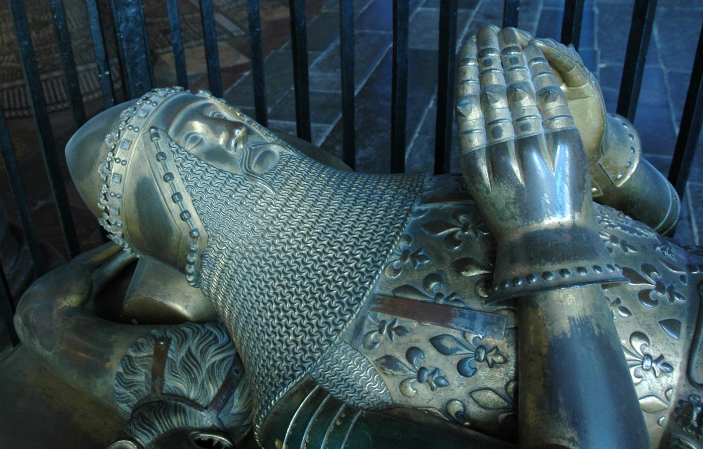
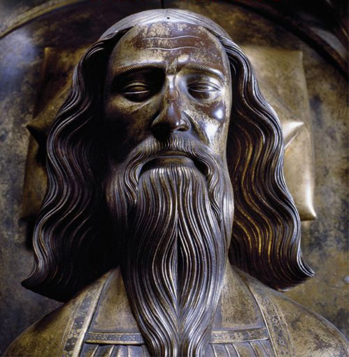
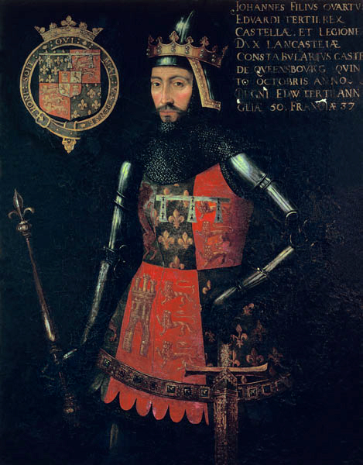
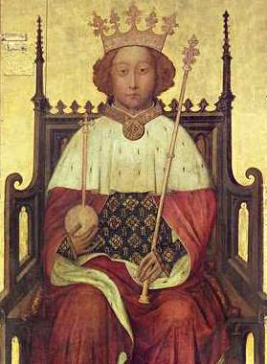
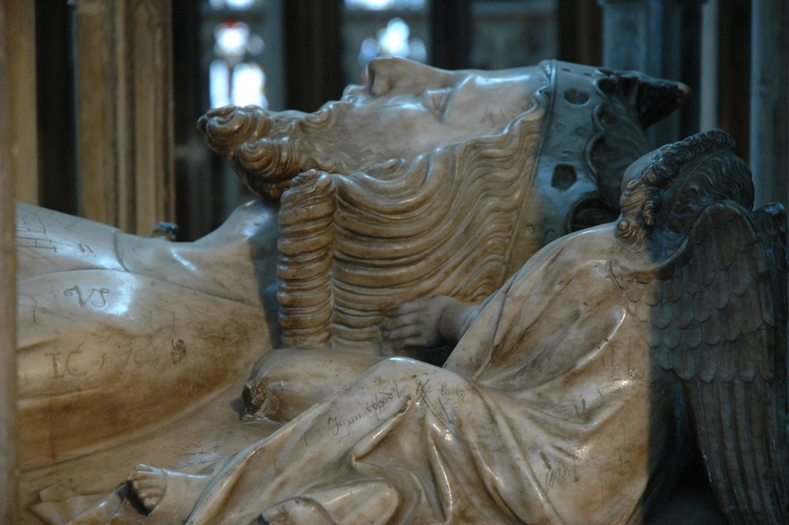
The Time of the House of Plantagenet
1216-1399
Sons of Edward III
Edward I Longshanks 1239-1307
Edward, The Black Prince
1330-1376
Edward III 1312-1377
John of Gaunt
1340-1399
Duke of Lancaster
Edward II 1284-1327
Richard II
1367-1400
Photos Source: Wikipedia.com
Notes:
To put into perspective, time wise. This is the time of the House of Plantagenet – which lasted from 1216-1399. They were a family divided into two main houses, the house of Lancaster, and the House of York which brought about the Wars of the Roses between 1455 and 1487. Historically, a French family that had come to rule over England.
Edward I – Longshanks reigned from 1272-1307. He was referred to as the Hammer of the Scots. Of William Wallace/Robert the Bruce fame. Mel Gibson’s Braveheart. The battles at Stirling Bridge (1297), Falkirk (07,1298) and the like.
Longshank’s son is Edward II, with little note.
The period of Wycliffe is primarily in the late term of Edward III’s reign (1327-1377).
Edward, The Black Prince was next in line to Edward III. He was his eldest son, but he died the year that John Wycliffe published his work Of Civil Dominion in 1376.
Unfortunately, his father Edward III is getting close to his own deathbed, causing the need of his third of five son, John of Gaunt to handle the state of affairs of government. At the time of Wycliffe, John was the potentially the most powerful man in England.
When Edward died in 1377, the throne goes to his grandson, Richard II, son of Black Prince – He is 10 years old. The queen mother is regent, but John’s place in England was strong. Shakespeare is supposed to have produced his play on Richard II

Slide 3
Parliament During Wycliffe’s Day
Photos Source: Wikipedia.com
Palace of Westminster dates back to 1016, to the reign of William II, son of the Conqueror
House of Lords: Made up of large landowners
House of Commons: Smaller landowners
Pre-1834 Fire
Notes:
When we think of Parliament in England we see this majestic building on the right. It has only looked that way since reconstruction after the big fire in 1834. But, Parliament has been in this location on the Thames River since the reign of William the Conquer’s son, William II, in 1016. Encased in this building is the original structure.
Today the House of Commons are made up of MP’s elected by the people. But the House of Lords is made up primarily of entrepreneurs and wealthy businessmen, appointed to their positions by the queen.
In the days of Wycliffe, it was different. Larger landowners were in the House of Lords & Smaller landowners made up the House of Commons

Slide 4
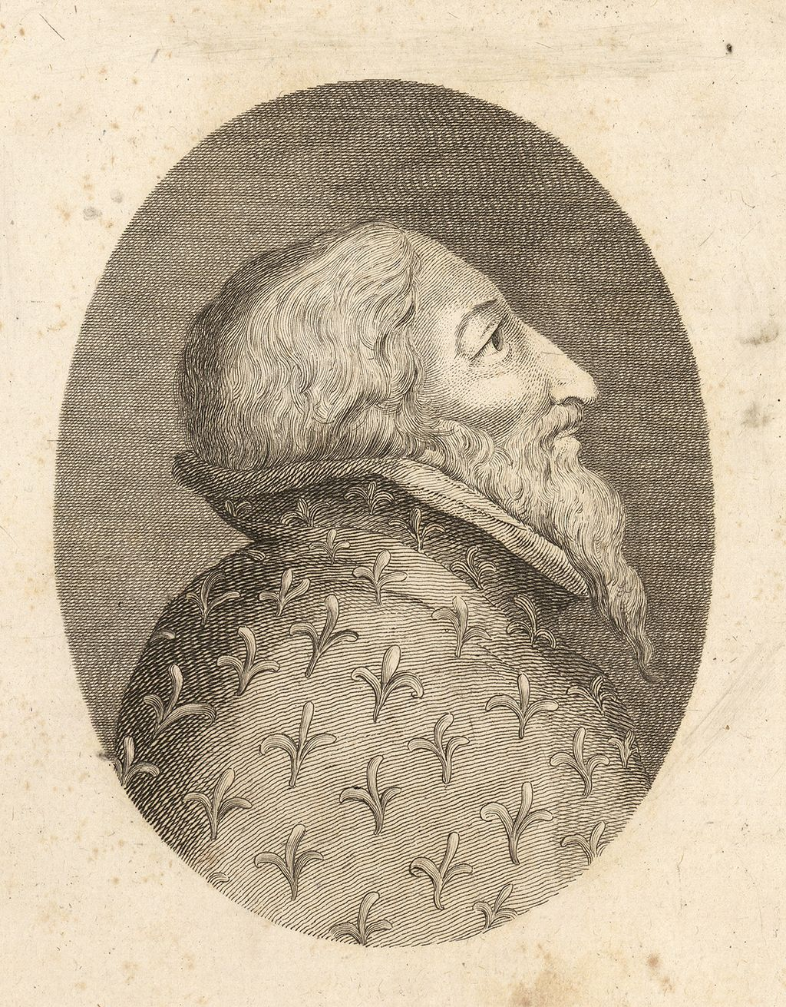
Parliament During Wycliffe’s Day
Lord Henry Percy, 1st Earl of Northumberland, 4th Baron Percy, titular King of Mann
Lord Marshall, leader in House of Lords
Friend and protector of John Wycliffe
Henry Percy
1341-1408
Pre-1834 Fire
Photos Source: Wikipedia.com
Notes:
During The Days Of Wycliffe Parliament did not have the power that Parliament has today. This does not change until the days of Oliver Cromwell in 1651. Until then, the king is in charge, and the houses of Lords and Commons were subject to the king. But, they were powerful, none-the-less.
During the days of the rise of John Wycliffe, there was no man more powerful than that of Lord Henry Percy, 1st Earl of Northumberland. He was a wealthy land owner. Was more or less ”king” or “protector” of the northern part of England. He was of the House of Lancaster through his mother.
He supported King Richard II, and when he died, supported the crowning of Richard II.
And, the biggest thing for us is that he was a good friend of John Wycliffe.

Slide 5
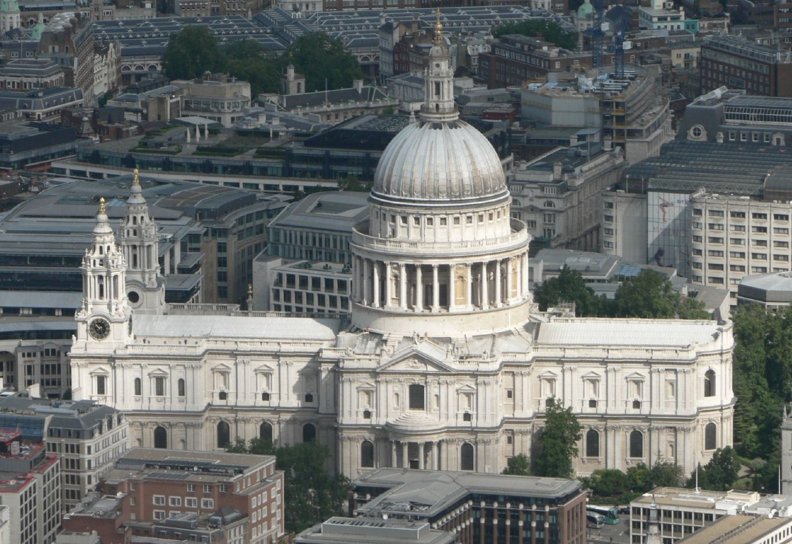
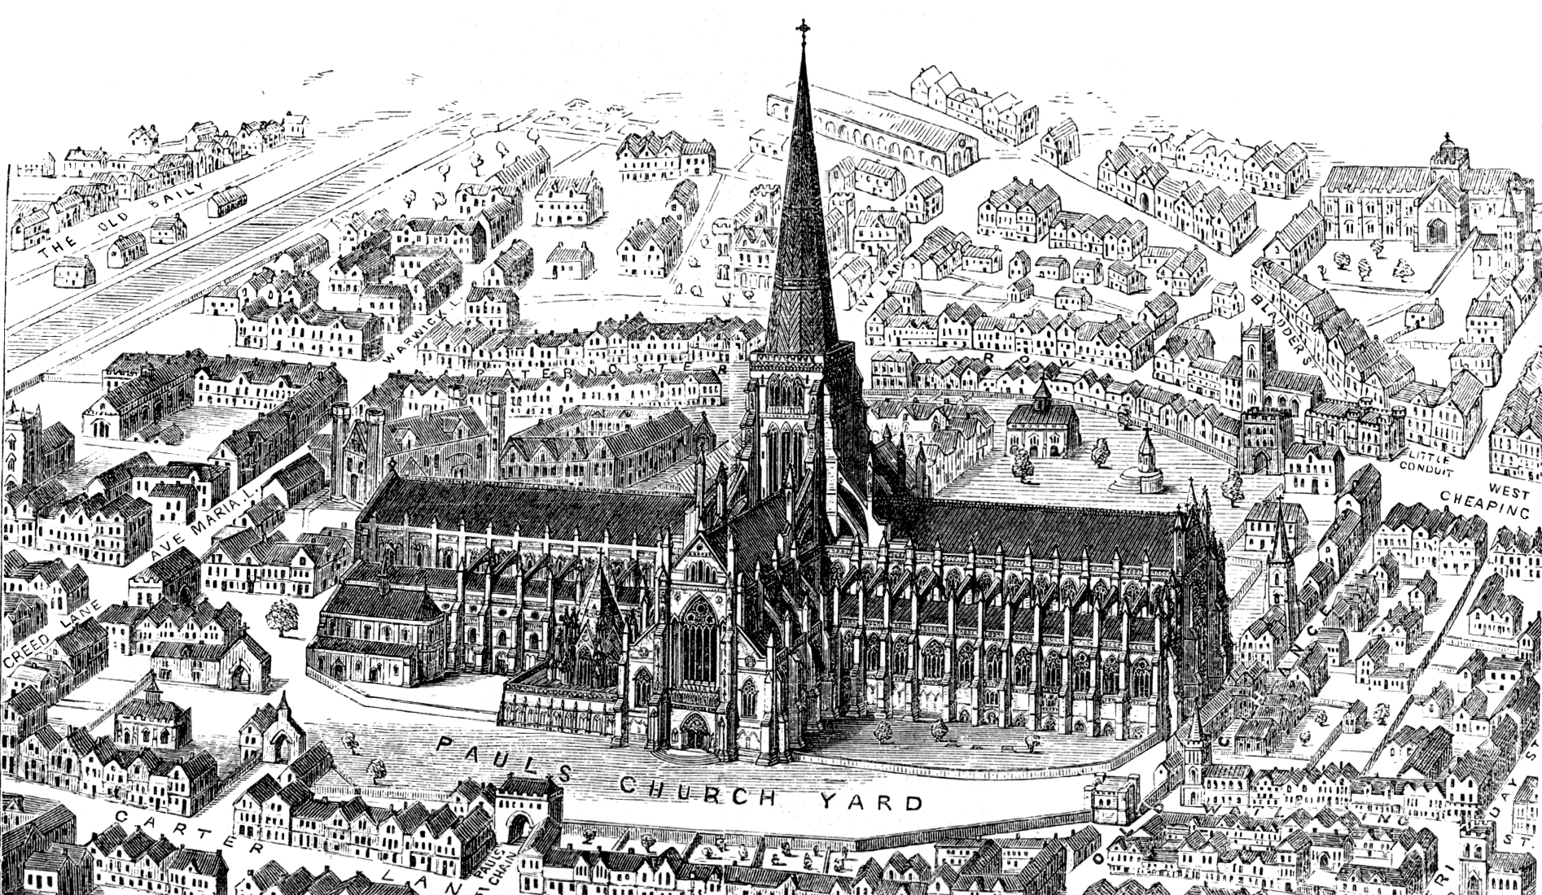
The State of the Church in Wycliffe’s Time
In 1377 a Catholic Church – still 157 years away from being Church of England
Photos Source: Wikipedia.com
St. Paul’s Cathedral Today
St. Paul’s Pre-1561 lightning strike of the spire
Notes:
The State of the Church in Wycliffe’s Time
In 1377 it is still very much a Catholic Church – still 157 years away from being Church of England
1377 – Came the end of what has been called the Babylonian Captivity of the Roman church as it’s home, and the home of the Pope was In Avignon, France 1309-1377 or 70 yrs.
In 1377 - The pope is Gregory XI, and he is the pope that moves the home of the church back to Rome. Mostly because of reform
Many of the priests were also members of the House of Commons & House of Lords.
The church was a financial machine. Sales of office was a way of life – Simony. The sales of indulgences were commonplace. The church was rich and was sucking the economic blood out of society.

Slide 6
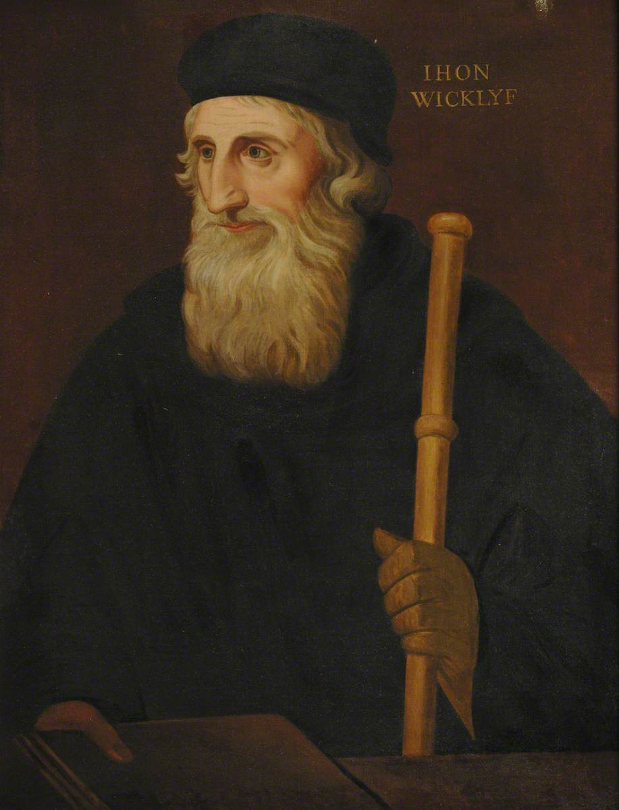
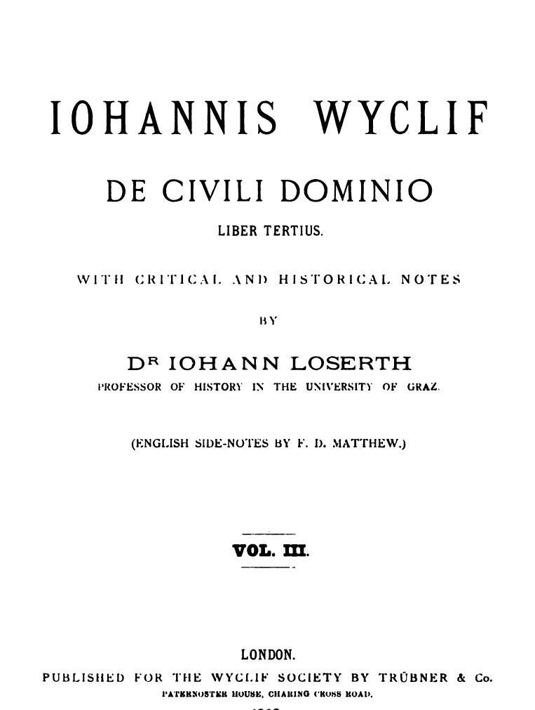
1376 – De Civili Dominio
Dominion – a central doctrine of the church
Purgatory, Sales of Indulgences, Endowment, etc. were imbedded in Church Dominium
Wycliffe argued that the nature of the Kingdom of Christ was spiritual, John 18:36, and that God left the affairs of this earth to man.
Source: Wikipedia.com
Notes:
The subject of Dominion was a cornerstone doctrine of the church. God created/hence owned the earth at creation.
Sin entered, and dominion was lost to man. Jesus instituted His Kingdom to reclaim the dominion of the earth.
Doctrines developed over the centuries like
In 1376 Wycliffe released Of Civil Dominion, arguing that the nature of the Kingdom of Christ was spiritual, John 18:36 and that God left the affairs of this earth to man. Think of the ramifications of this. If the church should not own the lands of the earth, this was music to the ears of Landowners and Kings! He argued that Kings have the right to Dis-Endow properties previously endowed by ancestral land owners who had left their land to the church in order to achieve a better reward in heaven.
Dominion – a central doctrine of the church
Purgatory, Sales of Indulgences, Endowment, etc. were imbedded in Church Dominium
Wycliffe argued that the nature of the Kingdom of Christ was spiritual, John 18:36, and that God left the affairs of this earth to man.

Slide 7
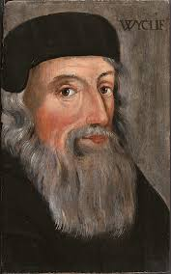
Heresy Trial – February 1377
Photos Source: Wikipedia.com
Wycliffe was called before the Bishops at St. Paul’s to stand trial.

Slide 8
Heresy Trial – February 1377
Photos Source: Wikipedia.com
Henry Percy
John of Gaunt
Leading the way are his patrons: Lord Henry Percy & John of Gaunt
Notes:
“Wycliffe arrived at the door of the great Cathedral and moved slowly up the crowded aisle which boasted to be the longest in Christendom. Four friars from Oxford, each representing one of their four orders, came with him to defend his doctrines. But the prisoner was not supported by logic and learning alone. By his side walked the great Duke; in front strode the King's Marshal, the Northern lord who proposed to administer border-law in the streets of London.
“With all the pride of a Percy, he pushed the merchants and prentices to right and left, to make room for his patron and his strange friend. Considering the circumstances of the case, and the violence which the Londoners so often displayed, it is more wonderful that the noblemen returned to Westminster alive, than that the mob forgot for the time their favour to Wycliffe and his doctrine. Courtenay, Bishop of London, who appears to have been in the aisle as the procession moved up it, angrily rebuked Lord Percy for mishandling his flock, declaring that he would never have admitted them into the church if he had known that they were going to behave in this manner. The Duke answered that they would do as they pleased, whether the Bishop liked it or not.
“They had now reached the Lady Chapel where the conclave was sitting. The Duke and Lord took chairs for themselves, and Percy bade Wycliffe be seated: 'Since you have much to reply, you will need all the softer seat.' Courtenay, whose hot blood had been already stirred by the insolence the men had shown at their entry, cried out that the suggestion was impertinent, and that the accused should stand to give his answers. The two nobles swore that he should sit; Courtenay, taking the proceedings out of the hands of Archbishop Sudbury, who was glad enough to sit quiet, insisted that the prisoner should stand. The Duke, finding he could not carry the point, broke out into abuse and threats.
“He would bring down the pride of all the Bishops of England; Courtenay need not trust in his parents the Earl and Countess of Devon, for they would have enough to do to take care of themselves. The Bishop made the obvious answer that he trusted in God and not in his high connections. The Duke, it was afterwards asserted, muttered to his attendants some threat of dragging him out by the hair of his head. The next moment the Londoners had broken in on the proceedings with wild cries of vengeance, and a general melee ensued between the citizens and the Duke's guard. The assembly broke up in confusion, and the prisoner was carried off by his supporters, whether in triumph or in retreat it was hard to tell. Of Wycliffe's share in the proceedings it can only be asserted that he made no noticeable interference, and that he, lost no popularity in London on account of the events of that day. What he thought of it all we can never even guess.
“Whether he had wished the Duke to accompany him must remain a mystery. He does not mention the scene in any of his works, though he speaks much of his later persecutions. In the roaring crowd of infuriated lords, bishops and citizens, he stood silent, and stands silent still.
Source: England In The Age of Wycliffe, by George MaCauley Trevelyan, London: Longman’s, Green, And Co., c.1899, Pages 44,45.

Slide 9
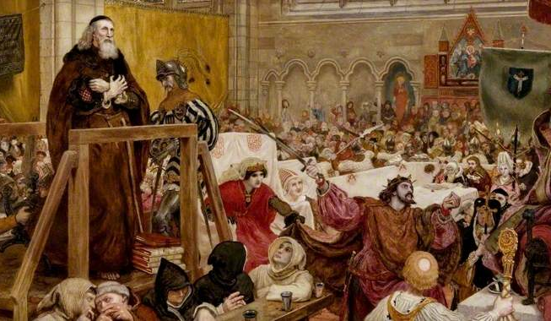
Pope Gregory XI Issued Five Bulls Of Excommunication – May 22, 1377
The heretic was standing for England against Rome, for state against Church.”
The heretic declared against the power of the Pope to bind and loose and had maintained that excommunication when unjust had no real effect.
Wycliffe had pronounced it the duty of the State to secularize the property of the Church when she grew too rich, in order to purify her.
Wycliffe had said that any ordained priest had power to administer any of the Sacraments, several of which the Church had reserved for Bishops alone.
Wycliffe had declared that the “Saints are in actual possession of all things.”
Source: https://4bddb437wtgj3d01ry183nz9-wpengine.netdna-ssl.com/wp-content/uploads/2019/10/Screen-Shot-2019-10-28-at-10.55.34-AM.png
Notes:
Pope Gregory XI Issued Five Bulls Of Excommunication – May 22, 1377
1. The heretic was standing for England against Rome, for state against Church.”
2. The heretic declared against the power of the Pope to bind and loose and had maintained that excommunication when unjust had no real effect.
3. Wycliffe had pronounced it the duty of the State to secularize the property of the Church when she grew too rich, in order to purify her.
4. Wycliffe had said that any ordained priest had power to administer any of the Sacraments, several of which the Church had reserved for Bishops alone.
5. Wycliffe had declared that the “Saints are in actual possession of all things.”
BY December, John Wycliffe is censured for the first time by the Archbishop of Canterbury for public speaking against Catholicism. Wycliffe is under house arrest at Oxford.

Slide 10
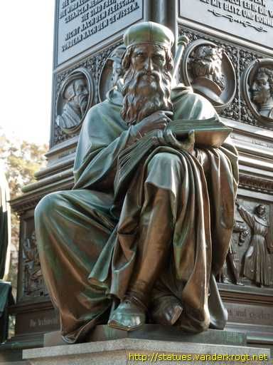
1378 – Wycliffe released On the Truth of Holy Scripture
Wycliffe wrote that the Bible is without error and constitutes the ultimate authority in matters of doctrine.
https://i.pinimg.com/564x/75/93/57/75935772f37da51c2c8348122e1398c4.jpg

Slide 11
1378 – Wycliffe released De Ecclesia
Attacks Papal authority
Called before the Bishops at Lambeth.
Queen Mother Intervenes at Wycliffe’s trial
https://i.pinimg.com/564x/75/93/57/75935772f37da51c2c8348122e1398c4.jpg

Slide 12
1378 – Wycliffe released On The Eucharist
“The nature of the bread is not destroyed by what is done by the priest, it is only elevated so as to become a substance more honored. The bread while becoming by virtue of Christ’s words the body of Christ does not cease to be bread. When it has become sacramentally the body of Christ, it remains bread substantially.”
“Nobody on earth is able to see Christ in the consecrated Host with the bodily eye, but by faith.”
“The consecrated Host we priests make and bless is not the body of the Lord but an effectual sign of it. It is not to be understood that the body of Christ comes down from heaven to the Host consecrated in every church.”
The bread is figuratively the body, and fruit of the vine is figuratively the blood of Christ.
It is impossible for man of any kind to say words and turn bread into deity
Notes:
Attacked the church’s teaching on Transubstantiation – that at the blessing of the priest that the bread and fruit of the vine became the literal body and blood of Jesus.
1. “The nature of the bread is not destroyed by what is done by the priest, it is only elevated so as to become a substance more honored. The bread while becoming by virtue of Christ’s words the body of Christ does not cease to be bread. When it has become sacramentally the body of Christ, it remains bread substantially.”
2. “Nobody on earth is able to see Christ in the consecrated Host with the bodily eye, but by faith.”
3. “The consecrated Host we priests make and bless is not the body of the Lord but an effectual sign of it. It is not to be understood that the body of Christ comes down from heaven to the Host consecrated in every church.”
4. The bread is figuratively the body, and fruit of the vine is figuratively the blood of Christ.
5. It is impossible for man of any kind to say words and turn bread into deity
Wycliffe struggled with the idea that a priest by pronouncing a blessing had within his power to produce deity.
6. “In the Mass creed, it is said, ‘I believe in one God only, Jesus Christ, by whom all things be made’ … And you then, who are an earthly man, by what reason may you say that you make your Maker? You say every day that you make of bread the body of the Lord, flesh and blood of Jesus Christ, God and man; … If you make the body of the Lord in these words, ‘Hoc est corpus meum,’ you yourself must be the person of Christ or else there is a false God … If you cannot make the work that God made in Genesis, how shall you make Him that made the works? And you have no words of authority.”
This tract led to sharp criticism even from his protectors.

Slide 13
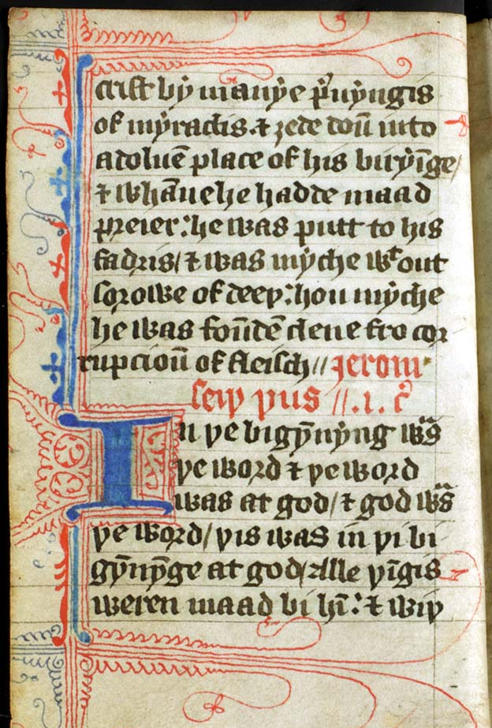
The Wycliffe Bible
1379-1380
Photo Source: Wikipedia.com
Notes:
1379-1380 – Fanning the flames of change could only be done if the book was in the hands of the people who could read it.
At the time of Wycliffe’s preaching, the Scriptures were at best hard to come by. And, if you had a copy of the Bible you would pay up to a year’s wage for a copy, and you would have to wait a year for it to be hand written. Remember Guttenburg would not invent his press for another 75 years. (1454) So it took a year to copy a Bible, and when you got it, it would be in Latin. If you could read Latin, you were in good shape.
The common language of England was English. The ruling families, House of Plantagenet, was French. Some years earlier, the French had produced a volume in French. Why not one for the English people?
Wycliffe and his students began working on an English version. Parts of the NT was released in 1379, and finally the Old Testament in 1380. Believed that the greater part of the Old Testament was the work of Nicholas of Hereford. A few years later, It is said that John Purvey perfected the version. It is from Jerome’s Latin Vulgate.

Slide 14
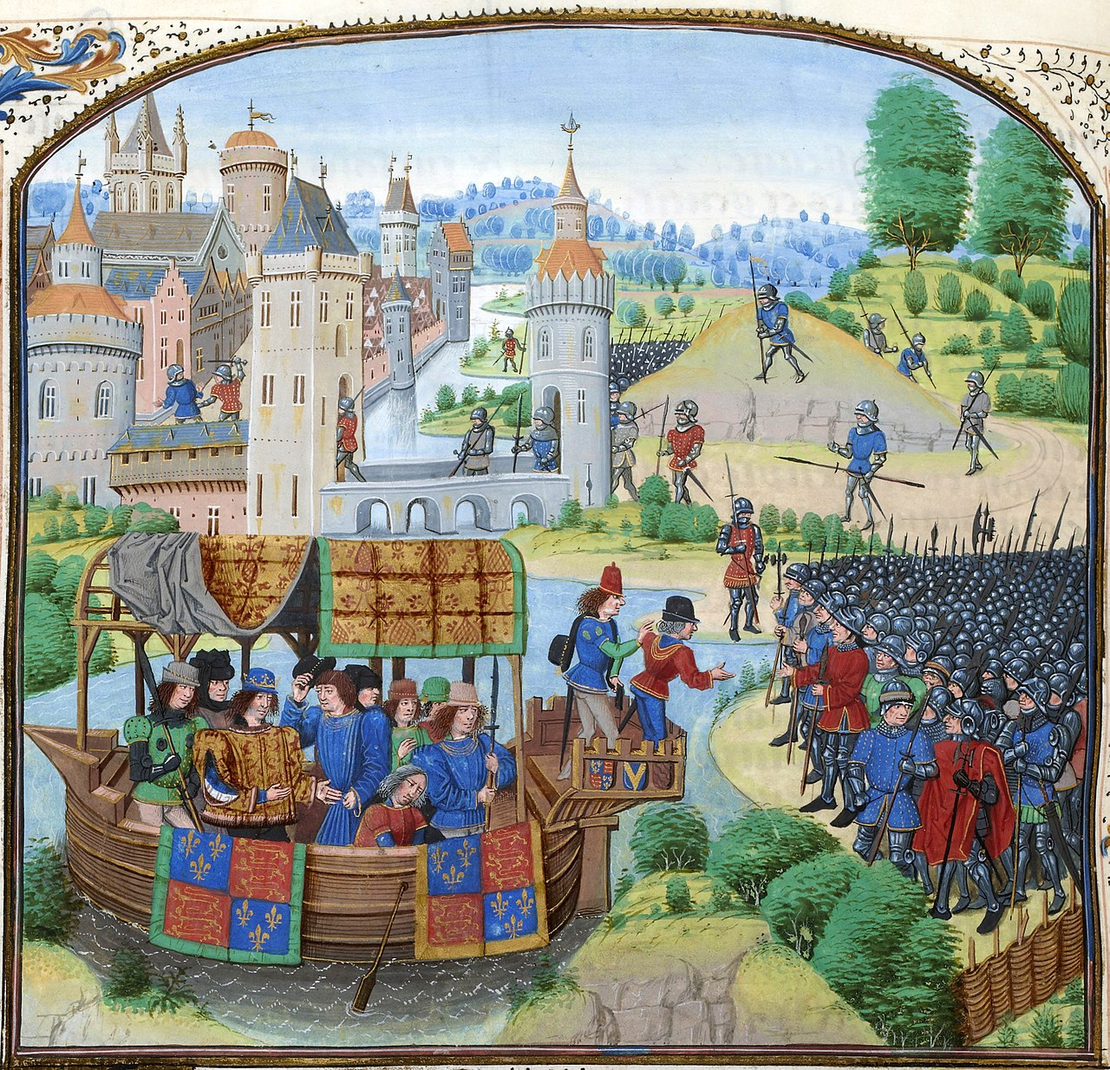
The Peasants Revolt 30 May 1381 – November 1381
Black Plague had come in 1340 killing thousands
A heavy poll tax from the new king Richard II
Wycliffe was blamed. Fired from Oxford and banished to church at Lutterworth.
Source:https://upload.wikimedia.org/wikipedia/commons/thumb/3/33/Jean_Froissart%2C_Chroniques%2C_154v%2C_12148_btv1b8438605hf336%2C_crop.jpg/600px-Jean_Froissart%2C_Chroniques%2C_154v%2C_12148_btv1b8438605hf336%2C_crop.jpg
Notes:
Several things contributed to the Peasant Revolt.
For years the country had not been at ease:
Black Plague came in 1340 killing thousands
Richard III had died in ’77
Wycliffe’s teachings had helped enrich Lords and Landowners
A heavy poll tax from the new king Richard. Wat Tyler’s Rebellion / or the Great Rising!
Wycliffe was blamed. Relieved from his position at Oxford and banished to church at Lutterworth.

Slide 15
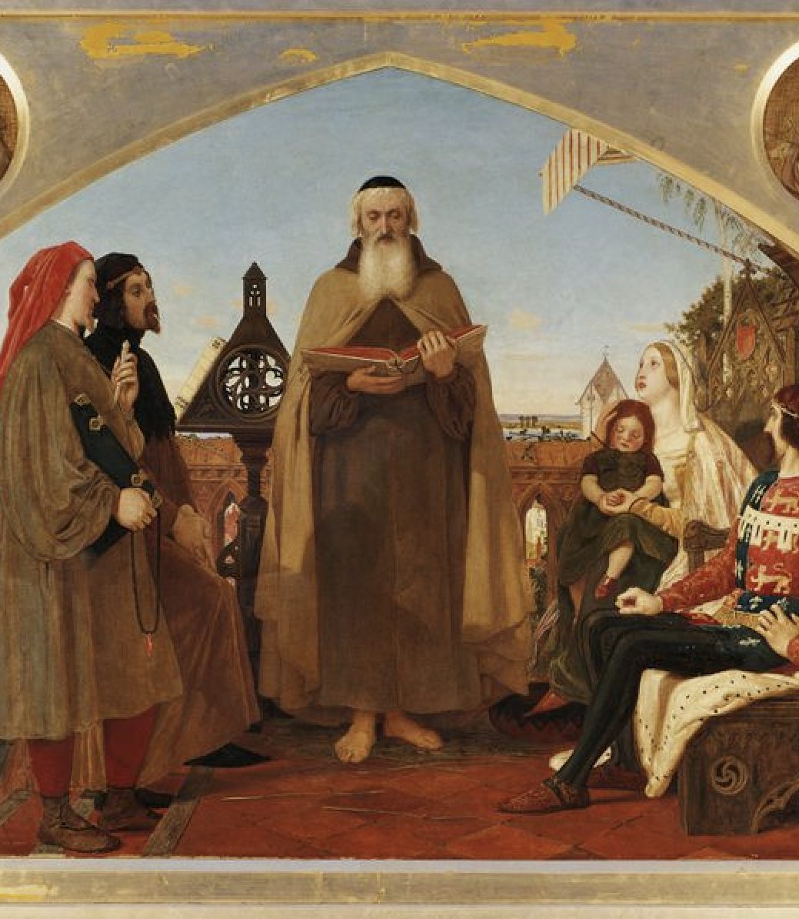
Wycliffe On Preaching
“Some men who preach tell the tales that they find in the saints’ lives without teaching Holy Writ. And such things often please more the people. But we believe there is a better way—to avoid such that please and, instead, to trust in God and to tell surely His law and specially His Gospel. And, since these words are God’s words, they should be taken as believed, and God’s words will given men new life more than the other words that are for pleasure.”
Source: https://www.learnreligions.com/thmb/Z0ZVKnCW1VL6MJbhUWpgtGEcaWo=/768x0/filters:no_upscale():max_bytes(150000):strip_icc()/john-wycliffe--1324--1384--reading-his-translation-of-the-bible-to-john-of-gaunt--by-ford-madox-brown--1821---1893---119-5x153-5-cm--153050004-5c51d783c9e77c0001859b8a.jpg

Slide 16
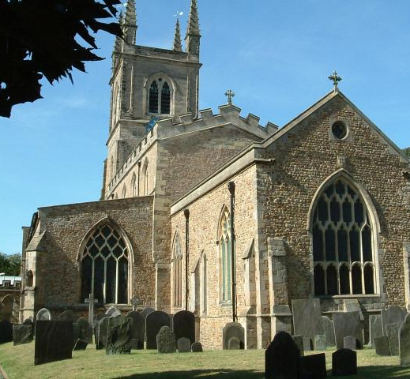
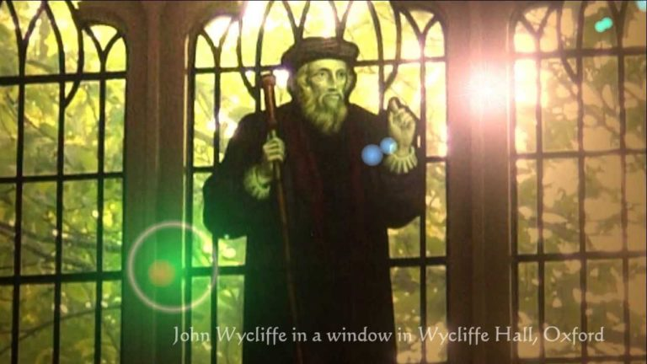
The Death of John Wycliffe December 31, 1384
SiurceL https://vancechristie.com
Suffered a paralytic stroke at Lutterworth Dec. 28th, resulting in his death 3 days later.
Burial in the church graveyard at Lutterworth.
1428 – His writings are condemned, bones dug up and burned, ashes thrown in the river Swift

Slide 17
The Influence of John Wycliffe
Lollards
Photos Source: Wikipedia.com
Notes:
Lay preachers who had been students invaded Europe with Wycliffe’s teachings.
Lollards go into Scotland and Ireland promoting the reading of Scriptures.

Slide 18
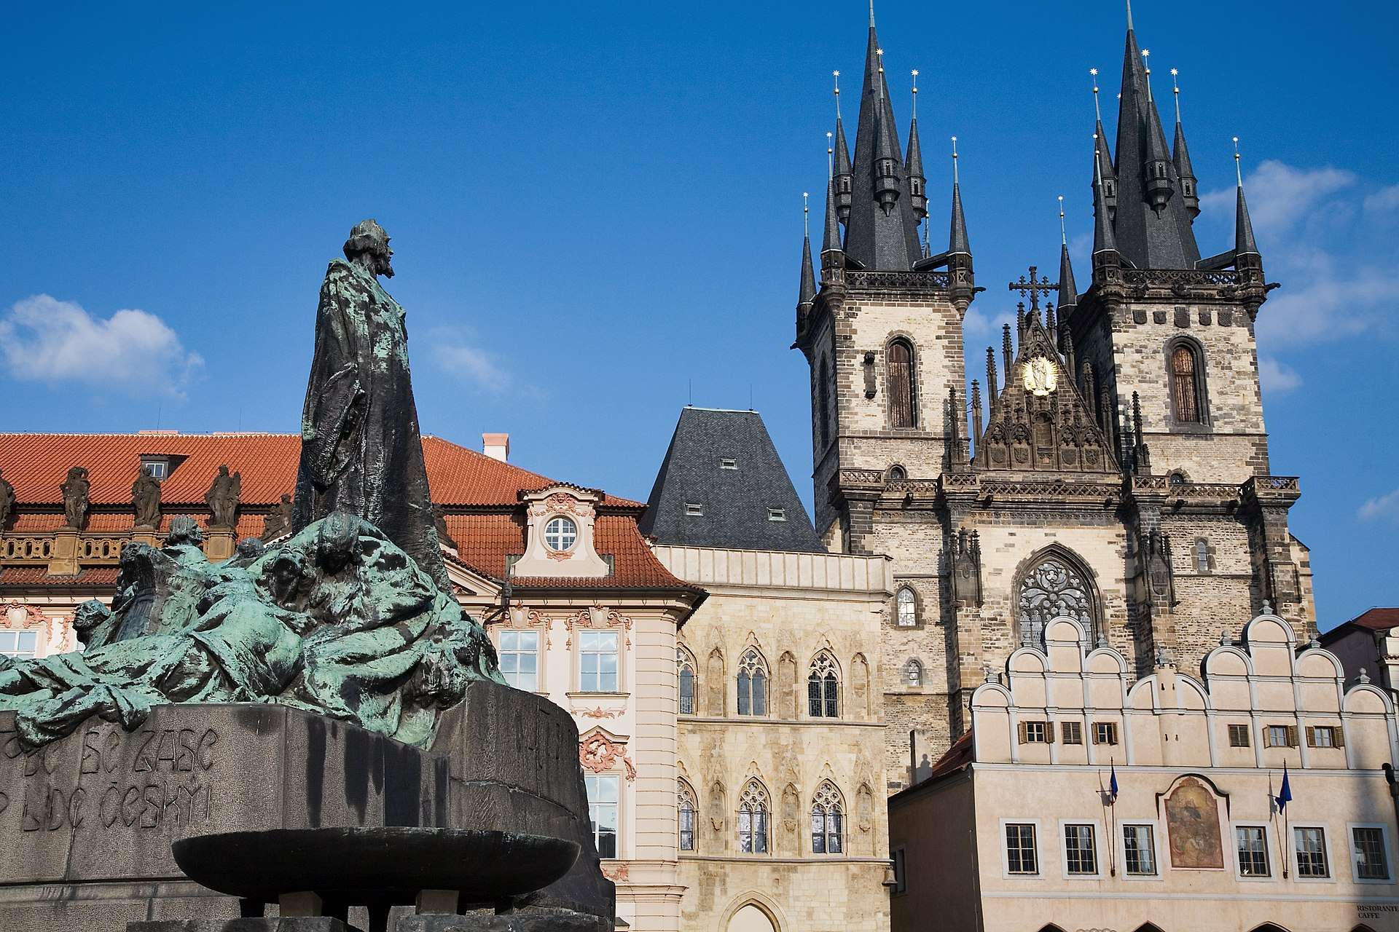
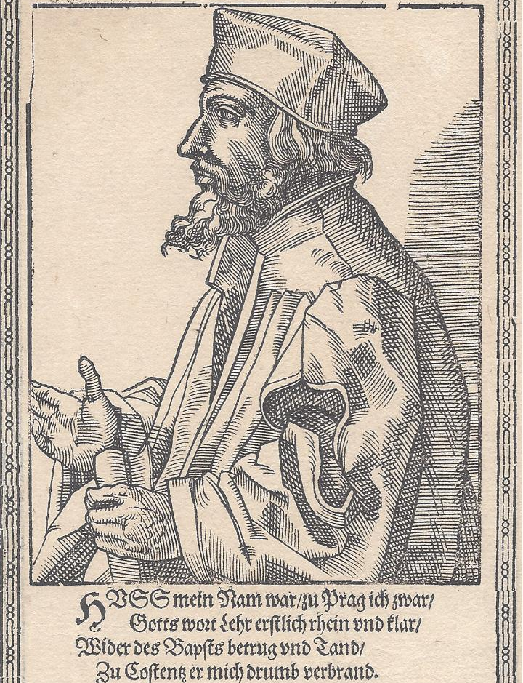
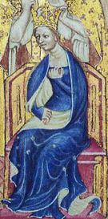
Jan Hus
Photos Source: Wikipedia.com
1372-1415
Anne of Bohemia
1366-1394
Notes:
Jan Hus – 1372-1415
In January 1382, when Richard II was 15 years old and Princess Anne of Bohemia (1366-1394) was 16 years old, they were married in St. Stephens Chapel, at Westminster. Reportedly, Anne had been persuaded to accept the proposal because of positive reports that she had received of the Reformation work of Professor John Wycliffe of Oxford University.
Ann’s most prized possession was a copy of the gospels. She had arrived in England with copies of the Bible in Latin, Czech, & German. The English papacy was horrified to hear that the Queen owned copies of the Gospels, which she avidly studied.
Professor John Wycliffe was delighted to learn of Anne’s love for the Scriptures, and he publicly compared her to the Biblical Mary who sat at Jesus feet listening to what the Master had to say.
For her part, Queen Anne protected Wycliffe from his many enemies and intervened on numerous occasions to protect him from prosecution and to save his life.
At the encouragement of Queen Anne, Bohemian students came to Oxford to study under John Wycliffe. Many of these students carried back the Reformation writings and teachings of Wycliffe to Prague, Bohemia and throughout central Europe.
One such Catholic priest to hear of the teachings of Wycliffe was Jan Hus (1272-1415). His study of Wycliffe work caused him to lead a reformatory effort in Bohemia. He was burned at the stake for his teachings.
John Foxe wrote, “When the fagots were piled up to his very neck, the Duke of Bavaria was so officious as to desire him to abjure. "No, (said Huss;) I never preached any doctrine of an evil tendency; and what I taught with my lips I now seal with my blood." He then said to the executioner, "You are now going to burn a goose, (Huss signifying goose in the Bohemian language;) but in a century you will have a swan whom you can neither roast nor boil." If he were prophetic, he must have meant Martin Luther, who shone about a hundred years after, and who had a swan for his arms. The flames were now applied to the fagots, when our martyr sung a hymn with so loud and cheerful a voice, that he was heard throughout the cracklings of the combustibles, and the noise of the multitude. At length his voice was interrupted by the severity of the flames, which soon closed his existence.”
-Fox’s Book of Martyrs, or History of the Acts and Monuments of the Church, page 170.

